Slide 1
Spring Updates: TELPAS and TELPAS Alternate
January 25, 2024
Event #1136

Slide 2
Agenda
TELPAS Updates
TELPAS Alternate Updates
Questions

Slide 3
TELPAS

Slide 4
TELPAS Overview
TELPAS annually assesses the progress that emergent bilingual (EB) students make in learning the English language.
All K–12 students classified as emergent bilingual EB/EL in the Public Education Information Management System (PEIMS) are required to participate in TELPAS, including those who have parents who have declined bilingual/English as a Second Language (ESL) program services.
The TELPAS testing window is February 19th to March 29th.

Slide 5
Exceptions to an EB Student Being Assessed in One or More Language Domain
An EB student receiving special education services
Decision must be made by ARD committee in conjunction with the LPAC.
Participation must be considered on a domain-by-domain basis.
Reason for not assessing a student must be well-supported and documented.
An EB student from another Texas school district, state, or country who enrolls on or after the first day of the TELPAS testing window
Will not be assessed by receiving district in the holistically-rated domains.
Is required to take the TELPAS listening and speaking test and the reading and writing test.
Refer to the Student Mobility page in the DCCR for more information.
Notes:
DONE

Slide 6
TELPAS Components
Grades K–1
Grades 2–12
Holistically-rated Assessments
Online Tests
Listening
Speaking
Listening and Speaking
(2-3, 4-5, 6-8, 9-12)
Reading
Writing
Reading and Writing
(2, 3, 4-5, 6-7, 8-9, 10-12)

Slide 7
TELPAS Key Dates for 2023-2024
Due Date for Adding All Students in TIDE | By 11/30/23
Due Date for Districts to Indicate Special Administration (paper and holistic) in TIDE | By 11/30/23
Districts Receive Test Administrator Manuals | 1/22/24—1/26/24
Districts submit Additional Order of Paper Test Materials | 2/12/24—3/25/24 Test Materials By 4/8/24 Return Labels
Assessment Window | 2/19/24—3/29/24
Submit Score Codes and Upload Holistic Ratings in TIDE and Submit Student Responses (paper admin) in DEI; (this means entered/submitted and processed by that date and time) | 3/29/24 11:59 p.m. (CT)
Districts Return Paper Test Materials | By 4/12/24
The Calendar of Events is found on the Calendars page in the DCCR.

Slide 8
TELPAS Additional Order Window
When is the TELPAS AO window? | The TELPAS additional order window is 2/12-3/25 for test materials and by 4/8 for return labels.
What should I know about the TELPAS AO window? | TELPAS reading paper tests (regular print, large print, braille contracted, and braille uncontracted) must be ordered during the additional order window (even if the TELPAS paper test format was indicated in TIDE by 11/30).
What should I take into consideration when placing an AO? | When placing an AO, a district must consider the time it will take to ship materials, administer the assessment, and enter the responses in DEI by 3/29/24.

Slide 9
Special Administration of a TELPAS Online Test
In rare circumstances that prevent a student from testing online, the student must meet eligibility criteria for a special administration of a TELPAS online test (listening and speaking or reading and writing) for grades 2–12.
 | Accommodations cannot be applied Technology access is precluded* Unable to participate in one domain
 | A student may receive a special administration (paper test or holistic assessment) of an online test ONLY if this it is noted in the student’s individualized education program (IEP) or Section 504 plan.
*This applies in rare situations where computers or technology are absolutely not available such as homebound students without internet access, JJAEPs, jails, or detention centers. For these types of scenarios, contact Texas Testing Support at (833) 601-882 or TexasTestingSupport@cambiumassessment.com for assistance in ordering paper materials.

Slide 10
Special Administrations for Online TELPAS Tests
Special Administration for TELPAS
Both online TELPAS tests have two language domains combined. If a student is eligible for a special administration in one of the test’s domains, the student will need to have a special administration in both domains (if applicable).
TELPAS Listening and Speaking | Holistic for listening and speaking | Holistic administrations conducted by raters that have completed training and calibration successfully
TELPAS Reading and Writing | Paper for reading | Regular print, large print, and braille (contracted and uncontracted)
 | Holistic for writing | Holistic administration conducted by raters that have completed training and calibration successfully. Will require writing samples that meet the writing collection criteria.
More information about special administration of an online TELPAS assessment can be found in the DCCR and in the TELPAS Paper and Holistic Administration Information document which is posted on the Test Administrator Manuals page in the DCCR.

Slide 11
Test Mode and Paper Test Format in TIDE
The due date for districts to indicate TELPAS special paper or holistic administration of an online assessment in TIDE was 11/30.
The Test Mode defaults to online mode. If a district/campus has additional grades 2-12 students eligible for a special administration, the information needs to be noted in TIDE and if applicable, paper test materials will need to be ordered.
NOTE: There is no action required for K-1 students if the student’s grade level is noted in TIDE as kindergarten or grade 1 (even if the test mode is in the online mode).

Slide 12
Blank Graphic Organizers for Online TELPAS Tests
NEW
A student may use a blank graphic organizer (paper only) for online TELPAS tests (listening and speaking and/or reading and writing) so TELPAS has been added to the Supplemental Aids policy document.
Supplemental aides such as mnemonic devices and organizers with graphics or text will not be allowed. ​
Refer to the policy document for additional information on student eligibility and which committee can make the decision. LPAC does not have sole authority for this designated support.
Blank graphic organizers will need to be noted in TIDE as part of the non-embedded supports for TELPAS.

Slide 13
Designated Supports for TELPAS Online Tests
Designated Support | Listening and Speaking | Reading and Writing | Non-embedded Support in TIDE | TEA Approval
Basic Transcribing | X | X | X
Individualized Structured Reminders | X | X | X
Manipulating Test Materials | X | X | X
Complex Transcribing |  | X | X | X
Extra Day | X | X | X | X
Blank Graphic Organizer, paper only (New for Spring 2024) | X | X | X
NEW
Specific information, such as student eligibility criteria and special considerations and instructions, can be found in the Accessibility section of DCCR.

Slide 14
Headsets/Headphones, Microphones, and Keyboards
Headsets | Headphones with Microphones | Keyboards
Required for the writing domain on the reading and writing test. | Required for both domains on the TELPAS listening and speaking test Required for a student that is eligible for speech-to-text (STT) for the online writing domain in TELPAS reading and writing test. | Are highly recommended for the TELPAS reading and writing test due to the writing domain.

Slide 15
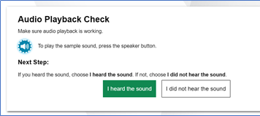
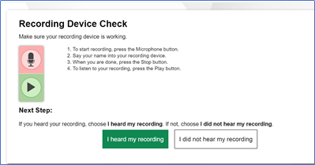
Audio Playback and Recording Device Checks
If an assessment has multimedia features, there will be audio playback and recording device checks that must be completed, before a student can start their test.
For TELPAS listening and speaking, both audio playback and recording device checks are required.
For TELPAS reading writing, audio playback device check will be required for all students. For students with STT, both audio playback and recording device checks will be required.

Slide 16
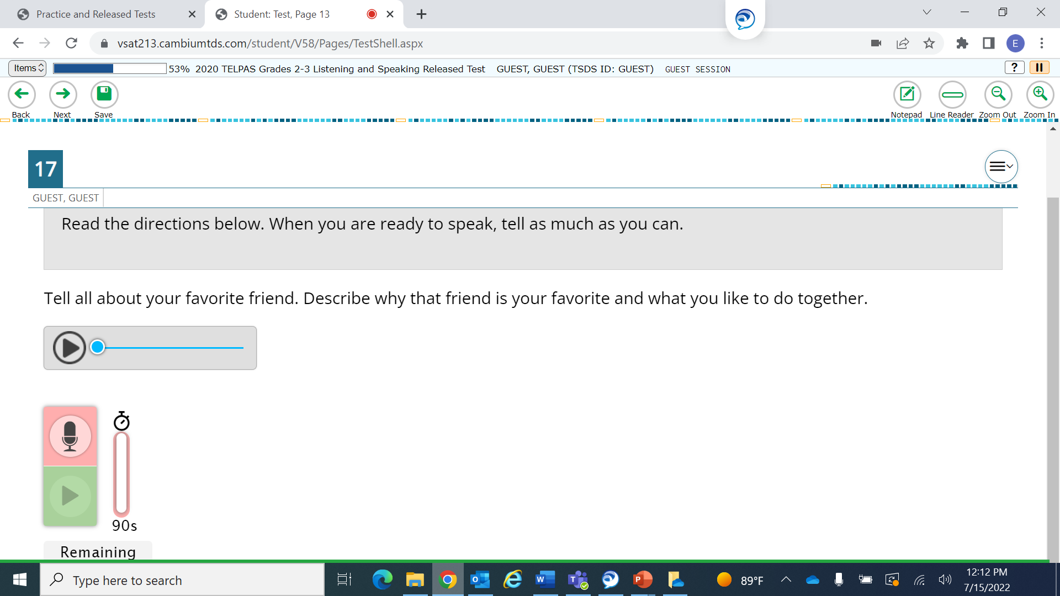
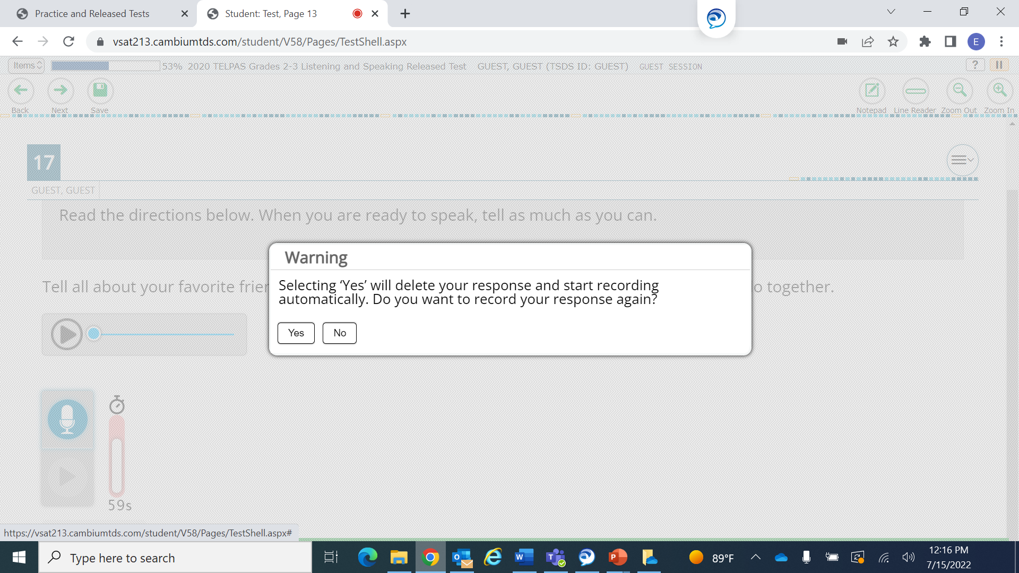
Microphone Functionality

Slide 17
TELPAS Schedules and Administrations
 | District/Campus Testing Schedule: TEA recommends that districts begin testing within one hour of the start of the school day and no test session may exceed seven hours. Districts should exercise judgment about starting a test session after lunch and for late students, as some students may not have sufficient time to complete the test before the end of the school day. TELPAS assessments should be administered on separate days to allow students sufficient time and opportunity to do their best work.
 | Student Test Administration: Must be completed within the same school day; Exceptions exist for eligible students who have an approved Extra Day accommodation. Are expected to complete the TELPAS assessment in about three hours; Students who are still testing after four hours should be consolidated into a general testing area to continue testing.
NEW
NEW

Slide 18
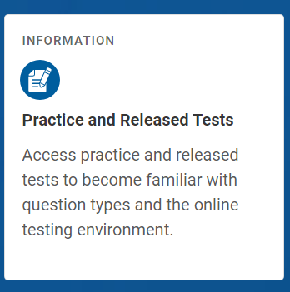
Online Practice and Released Tests
Designed to familiarize students with the online testing environment, available tools, and various types of questions.
Students may sign in with their credentials to practice with their current test attributes, such as a student who is approved for STT. Eligibility needs to be already noted in TIDE, so the attribute is available when the student signs in for his or her practice test.
Includes STAAR redesign practice tests, STAAR released tests, TELPAS Listening and Speaking practice and released tests, and TELPAS Reading and Writing practice sets.

Slide 19
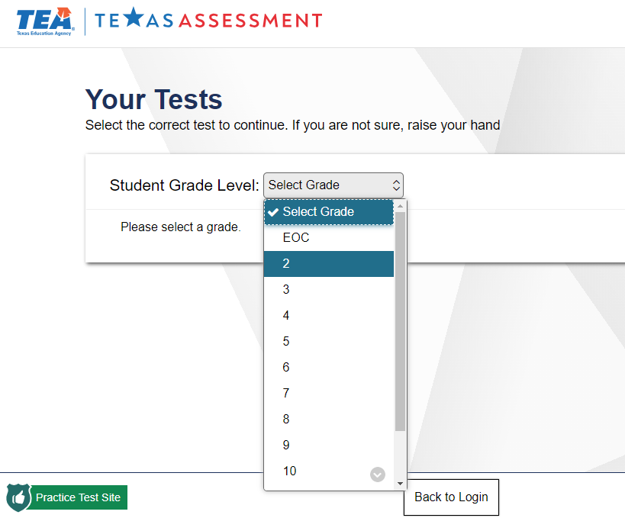
TELPAS Released and Practice Tests

Slide 20
TELPAS Key Dates for Holistic Rater Training and Administrations
TELPAS Assessment Window (Grades K-12 Listening, Speaking, Reading and Writing) | February 19 to March 29
Assembling and Verifying Grades 2–12 Writing Collections course available* | January 8
Online basic training courses for new K–1 and 2–12 raters* available | January 22
Calibration window opens for new and returning K-1 and 2-12* raters | February 5
Earliest eligibility date for TELPAS writing samples* | February 5
*Applicable for 2-12 raters with students with special holistic administration(s)
Refer to the TELPAS Rater Training Activities page in the DCCR for more information on rater training.

Slide 21
Rater Credentials
A teacher (including a substitute teacher) selected to rate an EB student must have the student in class at the time of the spring assessment window be knowledgeable about the student’s ability to use English in instructional and informal settings hold valid Texas education credentials, such as a teacher certificate or permit be appropriately trained in the holistic rating process rate the student in all eligible domains | Raters may include bilingual teachers, ESL teachers, general education teachers, gifted and talented teachers, and teachers of enrichment subjects. Paraprofessional may serve as raters.

Slide 22
Rater Credentials (continued)
Certified and noncertified staff members who are currently employed by the district and routinely work with students in the classroom may serve as raters only if they are trained in test security and administration procedures, complete rater training requirements, and sign an Oath of Test Security and Confidentiality. | Noncertified staff members must be supervised, either directly or indirectly, by a certified staff member on the same campus throughout the test administration. If a noncertified staff member is responsible for a violation of test security or confidentiality, the supervising certified staff member is subject to penalty.
Rater credentials can be found in the Designate TELPAS Raters section on the Campus Test Coordinator Training Activities page in the DCCR and in the 2023-2024 Holistic Rating Training PPT (slides 6-7 and notes) that is posted in the Training section on the TELPAS Resources webpage.

Slide 23
Holistic Rater Training (no changes to training requirements)
NEW RATERS
K–1 Raters Complete an online basic training course, which includes practice rating activities for each language domain – listening, speaking, reading, and writing.
2-12 Raters (for Special Holistic Administrations of Listening, Speaking, and/or Writing) Complete an online basic training course and practice rating activity. Training for listening and speaking includes both domains. Training for writing is only for that domain.
Both K-1 and 2-12 Raters Complete calibration activities to ensure that they are prepared to apply the PLD rubrics consistently and accurately.
RETURNING RATERS
K–1 and 2-12 Raters Raters, who have successfully completed calibration activities at least once, are highly encouraged to complete calibration before rating; however, it’s optional, unless required by campus testing coordinator.
NEW RATERS AND RETURNING RATERS
Annual test security and administration procedures training is strongly encouraged, especially for policies and procedures that have changed.
It is recommended that districts require raters to complete their training requirements by the first day of the TELPAS assessment window.
All raters must sign a test security oath.

Slide 24
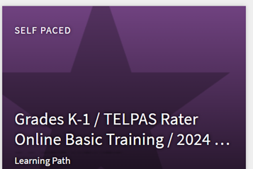
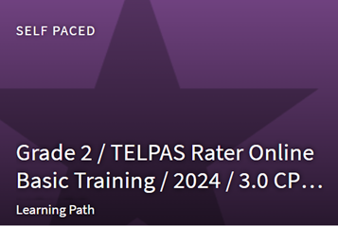
Online Basic Training: K-1 and 2-12
Grades K-1 | Online Basic Training includes all 4 language domains (listening, speaking, reading, and writing).
Grades 2-12* | Online Basic Training includes two separate courses that are grade cluster specific. One course combines the listening and speaking domains (grades 2-3, 4-5, 6-8, 9-12). Both the listening and speaking modules must be completed. The other course is only for the writing domain (grades 2, 3-5, 6-8, 9-12) | Listening and Speaking
 |  | Writing
*Grades 2-12 is for raters who will need to complete a special holistic administration.

Slide 25
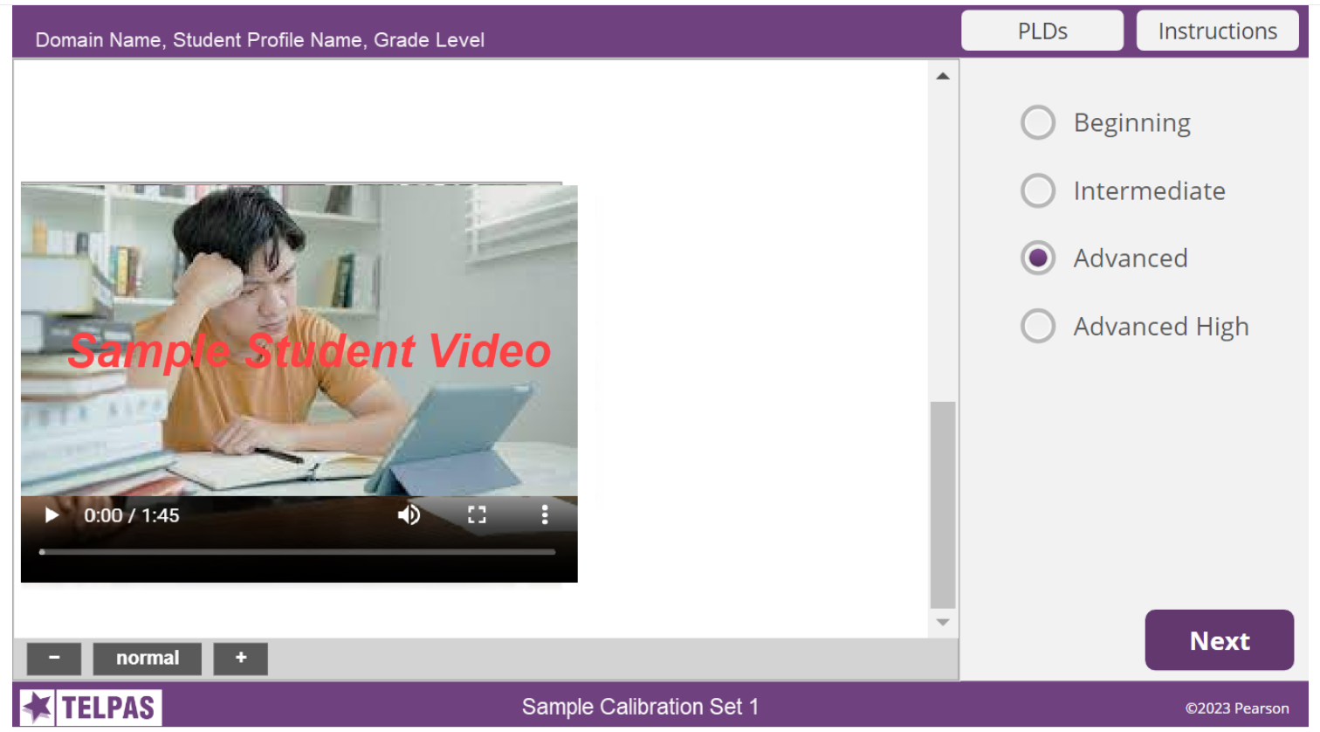
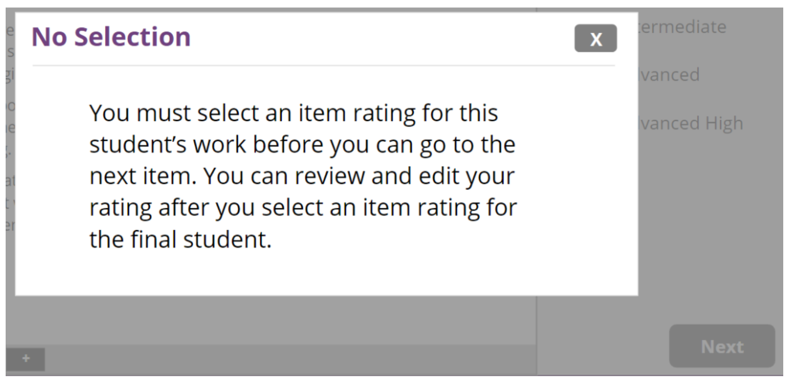
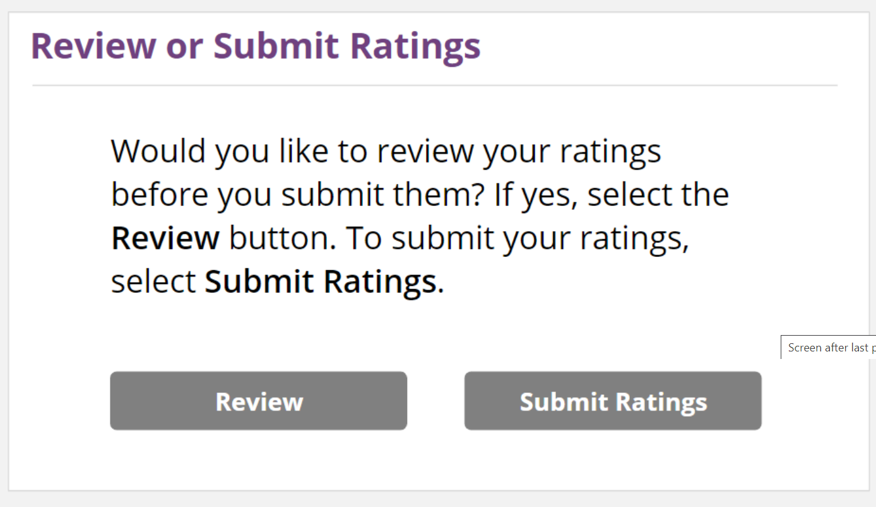
TELPAS Online Rater Training (Practice and Calibration)
NEW
After reviewing the full student profile (text and video/writing samples), the user must select a rating to move on to the next profile.
If no rating is selected, the user will get a message.
Users will be able to change a rating for a student profile BEFORE submitting his or her ratings by clicking on the Review button. Ratings cannot be changed once they are submitted.

Slide 26
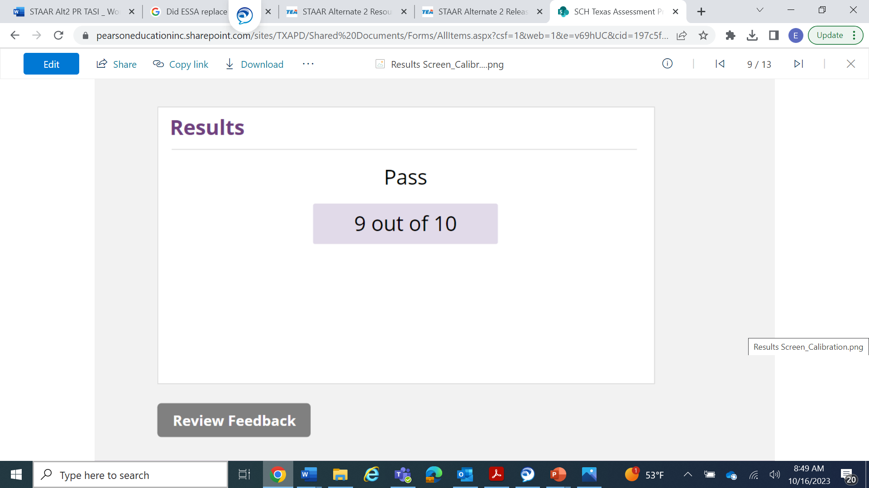
TELPAS Online Rater Training: Results Page
NEW
Online Basic Training Practice Sets
The summary page will indicate how many responses were correct out of the total number of student profiles.
Users can review the feedback and/or retake the practice set. A separate window will open with feedback.
Calibration Sets
The summary page will indicate a Pass or Fail and how many responses were correct out of the total number of student profiles. The user can also review feedback.
There is not an opportunity to retake a calibration set: however, there are two calibration sets. If a user is not successful on the first set, there is another opportunity with the second set. Users should check with the calibration proctor or campus coordinator regarding second opportunity.

Slide 27
Rater Information in TIDE
Rater information needs to be entered in TIDE in the Additional Student Information section. It can be uploaded in TIDE by using the Additional Student Fields data file.
TELPAS Rater A (Relationship)
TELPAS Rater B (Collaboration)

Slide 28
Additional Student Field File: TELPAS Rater Information

Slide 29
TELPAS Rater Manual
Is available online only
Explains the responsibilities of raters for the TELPAS holistic administrations
TELPAS PLDs and the Student Rating Roster will now be standalone documents and will be posted in the What Other Information is Available? section on the TELPAS Resources webpage. They are not included in the manual.
For grades 2-12, the rater manual should be used in conjunction with the holistic information in the TELPAS Paper and Holistic Test Administration Information document.
NEW

Slide 30
TELPAS Paper and Holistic Test Administration Information (grades 2-12)
Available online only and should be used in conjunction with TELPAS Rater Manual
Used for special paper admin (regular, large, and braille*) and for special holistic admin (listening, speaking, and writing)
Standalone Writing Collection Coversheet and Verification Checklist will be posted in the What Other Information is Available? section on the TELPAS Resources webpage. They are not included in the manual.
NEW
*TELPAS Braille Secure Test Instructions, previously called Specific Braille Instructions, were printed and shipped; one per test.

Slide 31
TELPAS PLDs, Student Rating Roster, and Writing Cover Sheet and Verification Checklist
Resources are found on the TELPAS Resources webpage.

Slide 32
TELPAS Test Administrator Manual (grades 2-12 online administrations)
Printed and shipped, as well as posted online
Based on student registration #s with 10% overage
Formula similar to STAAR, 1:15
AO window is 2/12-3/25 (test materials and up to 4/8 (labels)

Slide 33
Students Moving Within the TELPAS Window
Students can only be actively enrolled in one district/campus in TIDE. If a student moves during the administration window, TELPAS tests (including holistic ratings) will follow the student.
Rating information or score code (if applicable) can only be entered by a user in the district/campus where the student is enrolled.
Once the receiving district has enrolled the student in TIDE, the sending district will not be able to upload the student’s rating(s) or submit a score code (if applicable) online.

Slide 34
Collaboration Between Sending and Receiving Districts
Sending districts will need to coordinate with the receiving districts in order to provide them with the rating(s), including the rater information, or score code (if applicable).
Districts can share the information using the secure file center in TIDE, as an attachment (EXCEL spreadsheet, word or PDF document, etc.).
Reminder: If an EB student enrolls in a Texas public school BEFORE February 19 (the start of the TELPAS assessment window), the receiving campus is responsible for all TELPAS assessments. If an EB student enrolls ON or AFTER February 19, the receiving campus is responsible only for the grades 2–12 online tests (if the tests were not already administered). The sending campus is responsible for the holistic components even if the ratings were not yet assigned or uploaded/entered online.

Slide 35
Student’s Grade Level during TELPAS Administration Window
A student should have the same grade level across all domains during the TELPAS administration window (even if the test content is in the same grade band).
It is recommended that once a student begins testing in one grade level, then the student should complete all testing with that same grade level.
A student that does not have the same grade level across all domains will not get a composite rating.

Slide 36
Years in U.S. Schools
The calculation for years in U.S. schools is calculated based on consecutive calendar days.
The Instructions for Years in U.S. Schools Data Collection document is posted on the Assessments for Special Populations webpage.
For TELPAS, years in U.S. schools starts at 1st grade.
For kindergarten students, the Years in U.S. Schools field should be left blank.

Slide 37
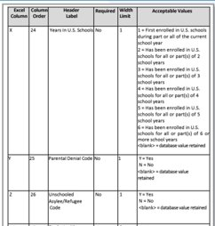
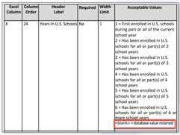
TIDE Enhancement—Student Registration File​
When using the Upload Student Information task to upload student information in TIDE, the template will retain previously uploaded values when specific fields are left blank. ​
Refer to the Student Registration Upload File Format document on the TIDE Upload File Formats webpage for detailed information on whether this applies to a specific field. ​
If applicable, “<blank> = database value retained” is included as an acceptable value. ​
If not applicable, a blank value will replace the previously submitted information. Districts must validate fields that require yearly updates such as Years in U.S. School.

Slide 38
TELPAS Administration Deadline, 3/29, 11:59 p.m. (CT)*
System | Information | Recommendation(s)
TIDE | all student information, including student demographics, years in U.S. schools, program enrollment, and designated supports holistic ratings for students in kindergarten and grade 1 and for students in grades 2–12 who were eligible for a special holistic administration of speaking, listening, or writing score codes for non-participation (see next slide) | Are strongly encouraged to submit their files before 5:00 p.m. (CT) on March 29 Do not resubmit entire uploads on the last day of the testing window; if changes are necessary, limit resubmitted files to only contain altered entries to reduce processing time.
DEI | student responses for special paper administrations of TELPAS reading (regular print, large print, braille contracted, and braille uncontracted) | Reserve the last 2–3 days of the testing window for DEI submissions
*Entered/submitted/uploaded AND processed by this date and time; the How to Upload Holistic Ratings in TIDE video will be available in the DCCR on the week of February 19th.

Slide 39
TELPAS Score Codes in TIDE
Score Codes for Online Tests
X | ARD-decision | An ARD committee, in conjunction with an LPAC, determined that a student should not be assessed in one more language domains due to a disability.
A | Absent | This score code should be used in rare circumstances due to the 6-week admin window. An example would be a student that is absent throughout the entire or most of test admin window.
O | Other | Examples for this score code include a student did not complete test due to illness or a test administration irregularity.
Score Codes for Holistic Assessments
X | ARD-decision | An ARD committee, in conjunction with an LPAC, determined that a student should not be assessed in one more language domains due to a disability.
E | Extenuating Circumstances | An eligible student cannot be rated in the specified domain due to extenuating circumstances. Due to the 6-week testing window, this should be rarely used.
The score codes available in TIDE are by assessment program. It is important to know which TELPAS score codes apply to online tests, and which score codes apply to holistic assessments.

Slide 40
TELPAS Resources
Resource | Purpose | Audience
TELPAS Educator Guide | Provides an overview of TELPAS and serves to support effective implementation of the Texas English Language Proficiency Standards (ELPS) and PLDs to guide instruction. | Administrators, Coordinators, Educators
TELPAS Training PowerPoints | Provide introductory training resources for educators, raters, and administrators/coordinators to use to build foundational knowledge of TELPAS | Administrators, Coordinators, Educators
TELPAS Manuals: Rater, Test Administrator, and Test Administration Information | Provides policies and guidance for raters, test administrators, and TELPAS special administrations (holistic and paper). Manuals and supplement materials are updated annually. | Administrators, Coordinators, Educators, Test Administrators
TELPAS Listening, Speaking, Reading, and Writing Blueprints | Provides districts with the test blueprints (listening, speaking, reading, and writing) including reporting categories | Administrators, Coordinators, Educators

Slide 41
TELPAS Resources (cont.)
Resource | Purpose | Audience
TELPAS 2-12 Speaking Rubrics | Derived from the TELPAS proficiency level descriptors (PLDs) and demonstrates the number of score points that a student can achieve based on their performance on each speaking test item | Administrators, Coordinators, Educators
TELPAS 2-12 Writing Rubrics | Derived from the TELPAS PLDs and demonstrates the number of score points that a student can achieve based on their performance on each writing test item. | Administrators, Coordinators, Educators, Parents
TELPAS 2-12 Speaking Scoring Guides | Provide exemplar student responses for the TELPAS online speaking assessment. It is intended to be used alongside the spring 2020 TELPAS listening and speaking released test. | Administrators, Coordinators, Educators, Parents
TELPAS 2-12 Writing Scoring Guides | Provide exemplar student responses and annotations based on score points that students can achieve on the writing constructed response type items. | Administrators, Coordinators, Educators, Parents

Slide 42
TELPAS Resources (cont.)
Resource | Purpose | Audience
Released TELPAS Listening and Speaking & TELPAS Reading and Writing Tests | Available in the online interface and can be used to administer to students for diagnostic purposes | Administrators, Coordinators, Educators, Parents, Students
Answer Keys for TELPAS Released Tests | Provides answers to released tests, reporting category per item, and ELPS student expectation per item. In addition, there are speaking and writing scoring guides that align with released tests. | Administrators, Coordinators, Educators, Parents, Students
TELPAS Practice Sets/Tests | Assists students to become familiar with online TELPAS tests (navigating through tests, online tools, and interaction with listening and speaking test items, including recording and playing speaking responses and entering writing responses) | Administrators, Coordinators, Educators, Parents, Students
Scoring Process for TELPAS Speaking Responses | Provides information on the 5-step process for scoring TELPAS speaking responses (includes information on reliability and validity components and rescoring information) | Administrators, Coordinators, Educators, Parents

Slide 43
TELPAS Alternate

Slide 44
TELPAS Alternate Updates
There are no changes to the actual TELPAS Alternate assessment.
The TELPAS Alternate administration window is February 19th to March 29th.

Slide 45
TELPAS Alternate Key Dates for 2023-2024
Due Date for Adding All Students in TIDE | By 11/30/23
Due Date for Districts to Indicate TELPAS Alternate Participation in TIDE | By 11/30/23
Districts Receive Initial Order of Paper Test Materials (Observable Behaviors) | 1/22/24—1/26/24
Assessment Window | 2/19/24—3/29/24
Submit Score Codes in TIDE and Submit Student Responses (Observable Behavior rattings) in DEI; (this means entered/submitted and processed by that date and time) | 3/29/24 11:59 p.m. (CT)
Refer to the Student Mobility page in the DCCR for information on sending and receiving district/campus responsibilities for students who enroll or withdraw during the TELPAS Alternate administration window.

Slide 46
What Is TELPAS Alternate?
A holistic inventory that assesses the language domains of listening, speaking, reading, and writing for students with the most significant cognitive disabilities in grades 2–12
Aligned to the Texas English Language Proficiency Standards (ELPS)
Based on alternate Proficiency Level Descriptors (PLDs) created to address the specific access needs of this population

Slide 47
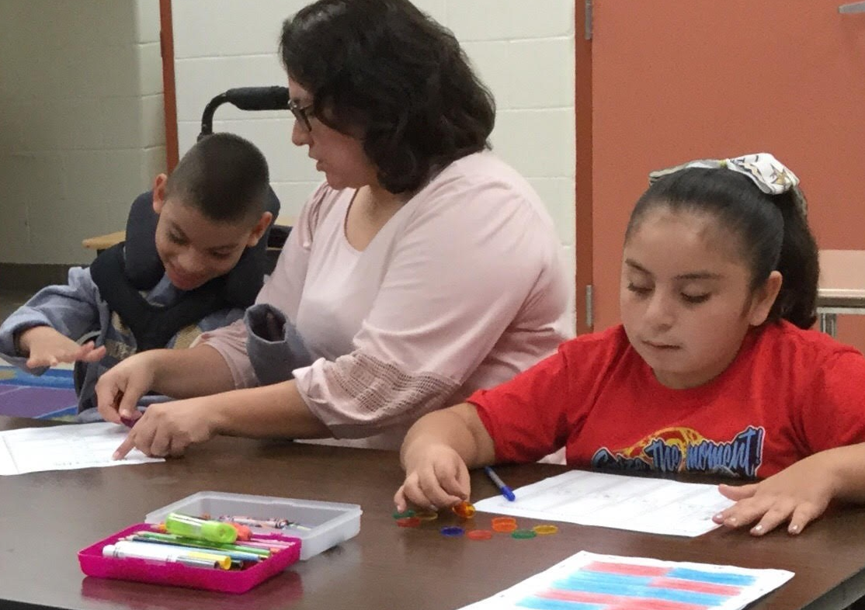
Who Takes TELPAS Alternate?
Students Eligible for TELPAS Alternate
Are EB students in grades 2–12 who have the most significant cognitive disabilities and who are in the process of acquiring English proficiency in listening, speaking, reading, and writing.
Have one or more disabilities that significantly limit their intellectual functioning, as shown by their ability to plan, comprehend, and reason, and their adaptive behavior, as shown by their ability to apply social and practical skills.
Please note: Unlike TELPAS, there are no domain-specific exemptions for TELPAS Alternate. Students must be assessed in all 4 language domains.

Slide 48
Who Is Assessed with TELPAS Alternate?
Grades K–1 | No TELPAS Alternate for K–1. All EB students, including students receiving special education services, will take TELPAS K–1 holistically rated assessment for all four language domains.
Grade 2 | Participation requirements are available on TEA’s TELPAS Alternate Resources webpage. ARD committees, in conjunction with the LPAC, are required to review the participation requirements and determine and document student eligibility for TELPAS Alternate.
Grades 3–12 | Participation requirements are available on TEA’s TELPAS Alternate Resources webpage. ARD committees, in conjunction with the LPAC, are required to determine and document student eligibility for TELPAS Alternate. If the student is EB/EL and is eligible for STAAR Alternate 2, he or she will take TELPAS Alternate.

Slide 49
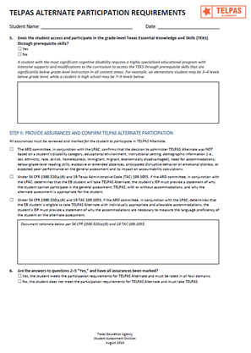
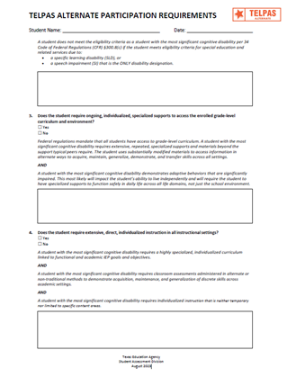
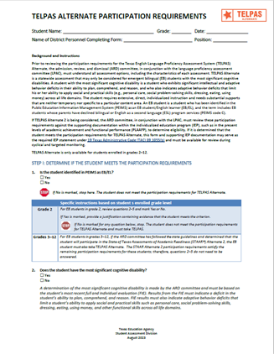
Updated TELPAS Alternate Participation Requirements
The TELPAS Alternate Participation Requirements (for grades 2–12 have been updated and are available on TEA’s TELPAS Alternate Resources webpage.
Participation requirements are intended to guide the ARD committee, in conjunction with the LPAC, when determining the appropriate English language proficiency assessment to administer to EB students.
Documentation of eligibility is different for students in grade 2 compared to students in grades 3–12.
For student in grades 3–12, the LPAC will answer question 1: “Is the student identified in PEIMS as EB/EL?”, initial the assurances in Step II, and answer "Yes" in question 6.

Slide 50
Updated TELPAS Alternate Participation Requirements: Question #1

Slide 51
Alternate Proficiency Level Descriptors (PLDs)
The Alternate PLDs are domain-specific and define how well EB students at the five proficiency levels are able to understand and use English in social and academic settings.
The descriptors show the progression of second language acquisition from one proficiency level to the next and serve as a road map to help teachers tailor instruction to the linguistic needs of EB students.

Slide 52
What Are Observable Behaviors?
The “questions” are called Observable Behaviors. Each Observable Behavior describes characteristics that students learning English demonstrate as they gain proficiency.
Test administrators, based on their knowledge of a student’s English language skills over a period of time, will make holistic judgments across all four domains of English language proficiency (listening, speaking, reading, writing) using alternate ELPS-aligned observable behaviors.

Slide 53
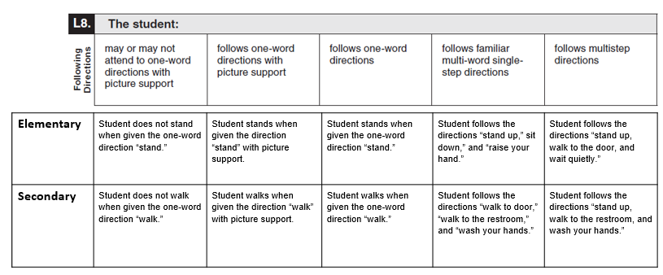
Observable Behaviors with Classroom Examples
Elementary and secondary examples describe one way that students could demonstrate each skill across the five levels of proficiency.
These examples are not intended to be used as test questions or performance tasks for teachers to replicate, although using them for this purpose is acceptable if needed.
Teachers are encouraged to use their own activities in the regular classroom setting when determining a student’s ability to understand and use English.
An accessible version of the Observable Behaviors and classroom examples can be found on TEA’s TELPAS Alternate Resources webpage.

Slide 54
TELPAS Alternate Administration Training
As with TELPAS administration training, testing personnel are required to receive training at least once in test security and administration procedures and are responsible for complying with state assessment requirements.
In addition, testing personnel must receive training at least once in testing policies and procedures specific to each administration and, if applicable, training related to security protocols for authorized viewing of state assessments.

Slide 55
TELPAS Alternate Training
There are two training options.
OPTION 1:
TELPAS Alternate Training Courses in LMS
Part 1 includes 4 modules (one per language domain)
Part 2 includes 4 modules (Introduction, Eligibility, Accessibility, and Test Administration)
Educators will get CPE hours once both parts are completed.
OPTION 2:
A series of training PowerPoints are also available on TEA’s TELPAS Alternate Resources webpage.
There are domain-specific PPTs, eligibility requirements, and test administration info.
Each PPT can be reviewed in about 10–15 minutes.
However, CPE hours are not earned for reviewing PPTs.
While training is not required, TEA highly recommends that test administrators rating students, especially if they are new test administrators or have never administered TELPAS Alternate. There is no calibration for TELPAS Alternate test administrators.

Slide 56
TELPAS Alternate Test Administrator Manual
Manual
available online only
not shipped to districts
Observable Behaviors shipped to districts
Based on registration counts + 10% overage
Observable Behaviors will be packed in 3’s
Districts are not able to place additional order
Observable Behaviors PDF available online for printing
The manual no longer includes the student response modes for this assessment. The student response modes can be found in the TELPAS Alternate Educator Guide.

Slide 57
TELPAS Alternate Observable Behaviors PDF
A standalone TELPAS Alternate Observable Behaviors Inventory PDF can be found in the What is Tested? section on the TELPAS Alternate Resources webpage.
The inventory includes all 40 Observable Behaviors (10 per language domain).
The inventory will no longer be included in the TELPAS Alternate Test Administrator Manual.

Slide 58
Alternate PLDs
The alternate PLDs for TELPAS Alternate will now be a standalone PDF document.
The alternate PLDs will be posted in the What Other Information is Available? section on the TELPAS Alternate Resources webpage.
The alternate PLDs will no longer be included in the TELPAS Alternate Educator Guide or the TELPAS Alternate Test Administrator Manual.

Slide 59
TELPAS Alternate Educator Guide
Is no longer combined with TELPAS
Provides an overview of TELPAS Alternate assessment program
Includes the student response modes that test administrators should be familiar with

Slide 60
TELPAS Alternate Administration Deadline, 3/29, 11:59 p.m. (CT)*
System | Information | Recommendation(s)
TIDE | all student information, including student demographics, years in U.S. schools, program enrollment score codes for non-participation (see next slide) | Reserve time to verify information before the end of the administration window
DEI | student ratings for TELPAS Alternate Observable Behaviors; ratings for all 40 Observable Behaviors must be entered in order for the “test” to be submitted | Reserve the last 2–3 days of the testing window for DEI submissions
*Entered/submitted/uploaded AND processed by this date and time

Slide 61
TELPAS Alternate Score Codes in TIDE
Score Codes for TELPAS Alternate
E | Extenuating Circumstances | An eligible student cannot be rated in all 40 Observable Behaviors due to extenuating circumstances. | Due to the 6-week testing window, this score code should be rarely used as teachers must provide multiple opportunities throughout the assessment window for students to demonstrate their English language proficiency.
M | Medical Exception (ME) | The ARD Committee, in conjunction with the LPAC, has determined that the student has met eligibility criteria for ME or for NAAR and will not participate in TELPAS Alternate. | These decisions should have been made prior to attempting to administer the assessment and requires documentation in the student’s individualized education program.
N | No Authentic Academic Response (NAAR) | Examples for this score code include a student did not complete test due to illness or a test administration irregularity.

Slide 62
TELPAS Alternate Resources
Resource | Purpose | Audience
TELPAS Alternate Educator Guide | Provides an overview of TELPAS Alternate and serves to support effective implementation of the ELPS. | Administrators, Coordinators, Teachers
TELPAS Alternate: Alternate PLDs | Align to the ELPS and present the major characteristics of each language proficiency level in each language domain.
Updated Participation Requirements | Used by ARD committees, in conjunction with the LPAC, to make eligibility/participation decisions about TELPAS Alternate participation. The participation requirements have been updated for the 2023-2024 school year. | Members of ARD committees and LPACs
Observable Behaviors (Classroom Examples) | Provide elementary and secondary classroom examples to help test administrators better understand the descriptions of student performance for each Observable Behavior. | Educators

Slide 63
TELPAS Alternate Resources (cont.)
Resource | Purpose | Audience
Test Administration Manual | Contains instructions covering the responsibilities of test administrators and the observable behaviors used to assess students Required to be read carefully and followed as written Will include a fillable version of the TELPAS Alternate Observable Behaviors | Administrators, Coordinators, Teachers serving as test administrators
TELPAS Alternate Training Modules | Provides training on a variety of topics, including authentic classroom activities for each domain that explain how to rate students with the observable behaviors Includes two parts; both parts must be completed in order to receive continuing professional education (CPE) hours | Administrators, Coordinators, Teachers serving as test administrators
Training PowerPoints | Provides training on a variety of topics, including authentic classroom activities for each domain that explain how to rate students with the observable behaviors Are optional though highly recommended | Administrators, Coordinators, Teachers serving as test administrators
Parent Brochure | Communicates (English and Spanish) basic information about TELPAS Alternate. This information is now on Texas Assessment webpage. | Parents

Slide 64
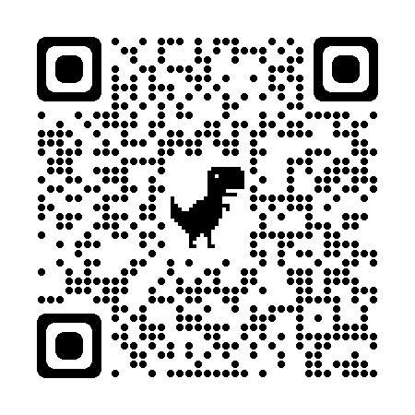
Please register for one of our committees on the Texas Assessment Learning Management System!
Classroom teachers, instructional coaches, campus and district content specialists, and campus administrators can serve in a variety of ways:
Educator item review – each potential question for a state test is reviewed and approved by a committee of Texas educators
Constructed response range-finding – educators are convened to set the scoring boundaries for student essays based on the rubric
Subject-area advisory groups – groups of educators are convened to provide feedback on subject-area-specific topics
Standard-setting – groups of educators are convened to establish cut scores that define the performance levels
Use the QR code or visit the Texas Educator Committees page to register for committee.

Slide 65
Texas Through-year Assessment Pilot (TTAP) will run for the following test titles in SY24-25 (Year 3)
Grade 3 Math
Grade 5 Science
Grade 6 Math
Grade 7 Math
Grade 8 Social Studies
Algebra 1
NEW
Other notes:
To gather a representative sample, we would like to see at least 8K students participate in each test title
Grades 3-5 test titles will have Spanish
Content and language supports will be available for students who need it
Pilot is 100% online
The pilot will run in limited titles and grade levels, but intends to cover all content areas eventually
NEW
Notes:
[Read text aloud and in order]

Slide 66
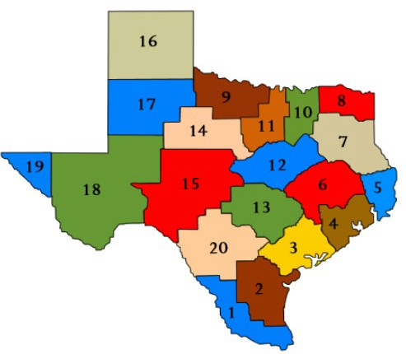
TTAP hopes to see district representation across the entire state of Texas as it expands to elementary and high school next school year
SY23-24 Participation (Year 2)
19 out of 20 regions
93 LEAs
44 rural
21 town
13 suburban
15 urban
56K students
Grade 5 Science: 17K
Grade 6 Math: 9K
Grade 7 Math: 8K
Grade 8 Social Studies: 23K
Participating districts are able to share feedback on the pilot to help TEA improve and measure efficacy of the program
Notes:
We hope to see district representation across the entire state of Texas as TTAP expands to elementary and high school next school year. As a district participant, they are able to share feedback on the pilot to help TEA improve and measure efficacy of the program. 19 regions and over 90 districts are participating in the pilot this school year, totaling over 55,000 students. We hope to partner with districts in all 20 regions and see a more even representation across LEA types in year 3.

Slide 67
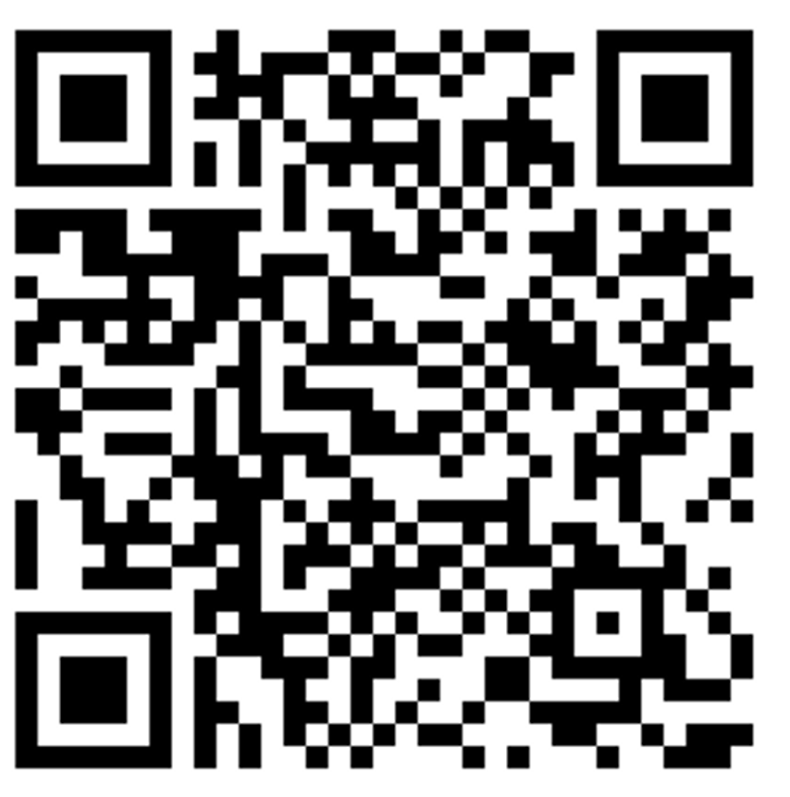
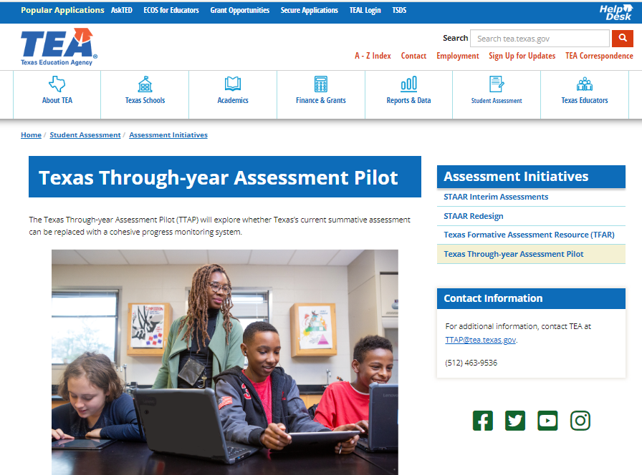
We want you to pilot TTAP with us this fall and have your voice heard!
1. Scan this QR code to ask questions and be notified when applications open mid-February
2. Keep updated on the assessment pilot through the TTAP webpage
Notes:
Link to the form: https://app.smartsheet.com/b/form/03632c43684d4cddaed4641e4d5f9923

Slide 68
Contact Information
Help Desk: Helpdesk.tea.texas.gov
Student Assessment Division: (512) 463-9536
Information on State Assessments for Special Populations: Assessments for Special Populations webpage

Slide 69
Disclaimer
These slides have been prepared by the Student Assessment Division of the Texas Education Agency. You are welcome to use them for local training.
If any of the slides are changed for local use, please remove any TEA logos, headers, or footers. (You may need to edit the Master slide.)
This training is not intended to replace any materials or additional information on the TEA website.

