Slide 1
STAAR Spring Refresher Event #1162

Slide 2
Agenda
STAAR Program Reminders and Updates
General Testing
Accommodations
FAQ
Roll Call and Questions from ESCs
2

Slide 3
December EOC
December Administration
< 1% tests administered on paper
Includes Paper by Request and Special Administration
Great collaboration between districts, regional staff, TEA, and vendors

Slide 4
February 2024 Stand-Alone Field Test
Thank You
Your Students
Your Teachers
Your Campus Leadership
AND You!
Because of you – The February Stand-Alone Field Test was a success!

Slide 5
STAAR Program Reminders and Updates

Slide 6
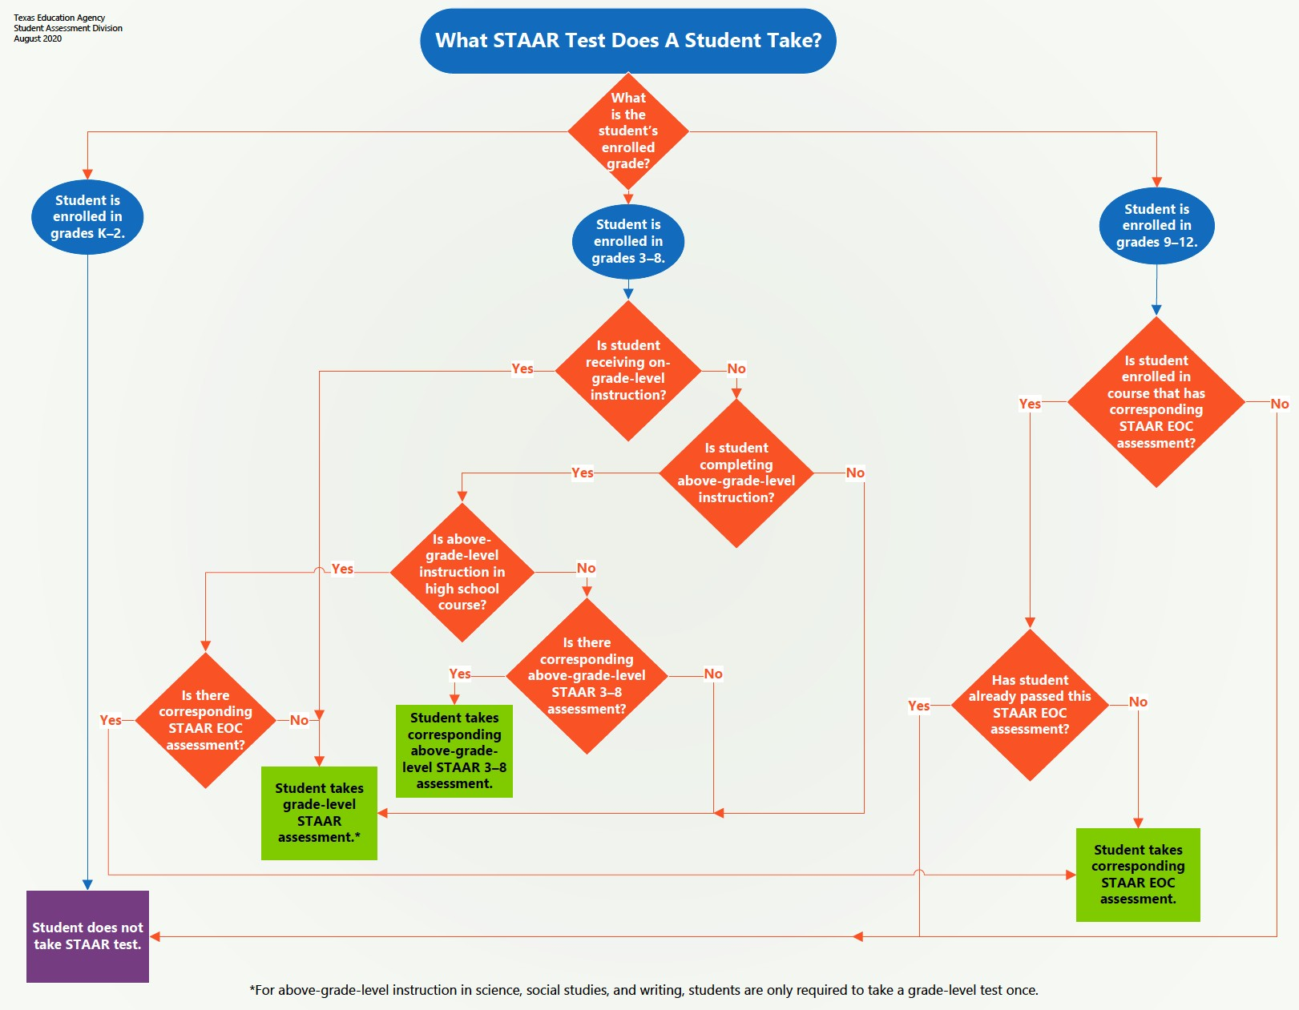
STAAR Testing Requirements Flowchart
To assist districts with STAAR testing requirements, please see this flowchart posted on the STAAR Resources webpage.

Slide 7
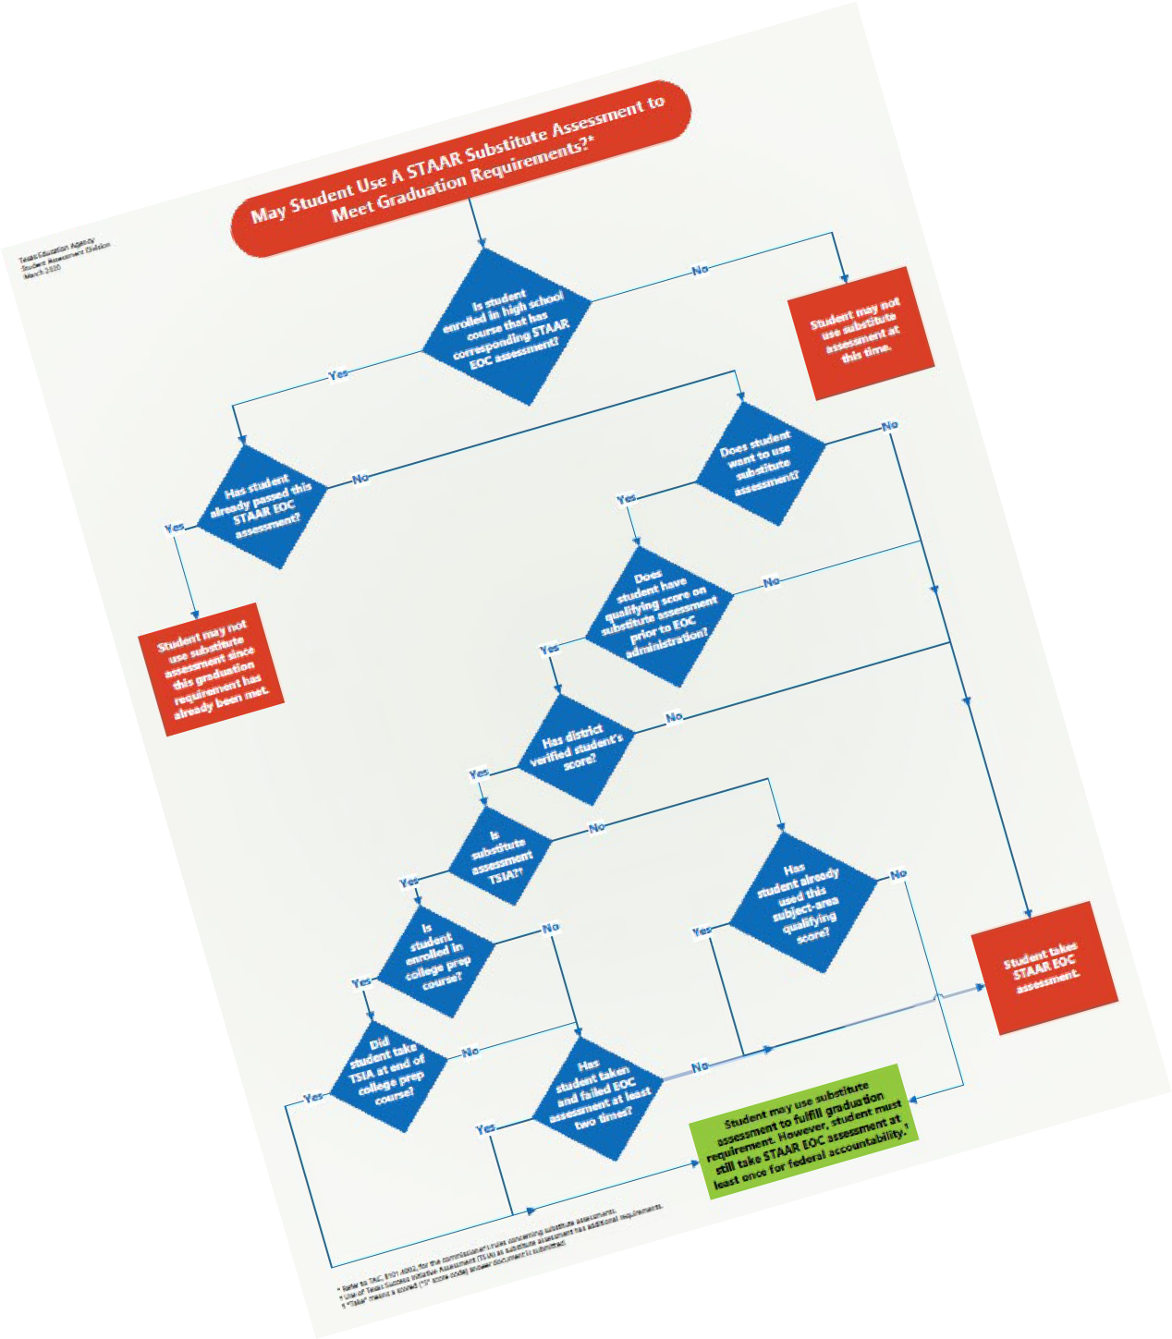
STAAR Substitute Assessment Requirements
The following state law outlines the requirements that pertain to STAAR substitute assessments → TEC §39.025.
See the STAAR Substitute Assessments Flowchart.
The following state rule clarifies the requirements that pertain to STAAR substitute assessments → TAC §101.4002.

Slide 8
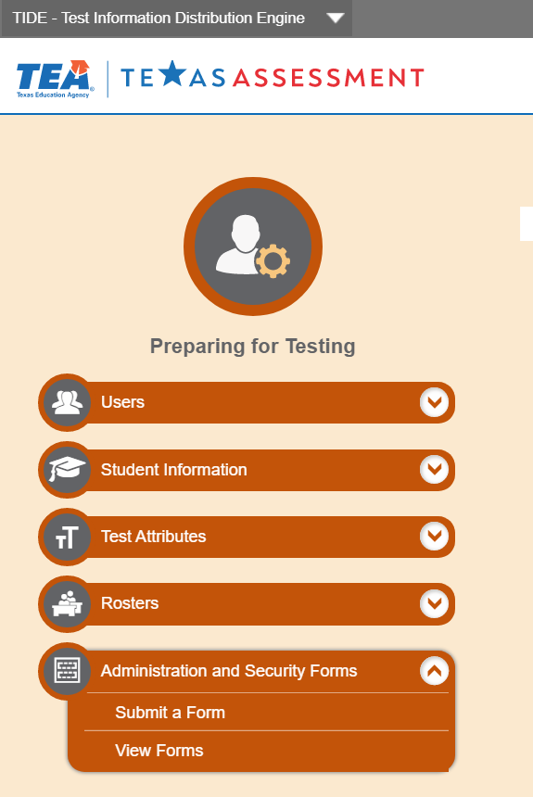
Superintendent Test Security Oath
It is required to be submitted *prior to the administration of the first state assessment for the school year. A procedural training irregularity must be submitted in TIDE if not complete.
It can be accessed and submitted within TIDE.
ALL Superintendents, including “interim” and “acting” must submit this oath.

Slide 9
District Testing Coordinator Test Security Oath
The district coordinator oath is a two-part online form that can be accessed and submitted within TIDE.
Part I is required to be submitted after receiving training and before handling secure test materials.
Part II is required to be submitted after all state testing has been completed for the school year and all materials have been returned to the testing contractor.
Administrator oaths must be submitted in TIDE by July 31st each year.

Slide 10
General Oath of Test Security and Confidentiality
The general oath should be completed by all other school personnel who participate in state-required testing or handle secure test materials.
It is a fillable PDF found in the Security Forms section of the DCCR that can be printed or saved electronically.
It is required to be completed each year after receiving training (if applicable) and before handling secure test materials.
A certified staff member must sign that he or she will be responsible for a noncertified staff member.

Slide 11
2023-2024: Paper Testing
Reminder
“Paper by Request” for STAAR (3% cap of students registered per test)
Requests must have been submitted to the district by December 1 for spring administrations and submitted by district through TIDE by Dec. 15.
There is no late submission process.
OR
“Special Paper Administrations of Online Assessments”
There are no changes to the eligibility requirements.
Accommodations cannot be applied
Technology access precluded
Students' responses for ALL paper administrations will continue to be submitted through the Data Entry Interface.
2

Slide 12
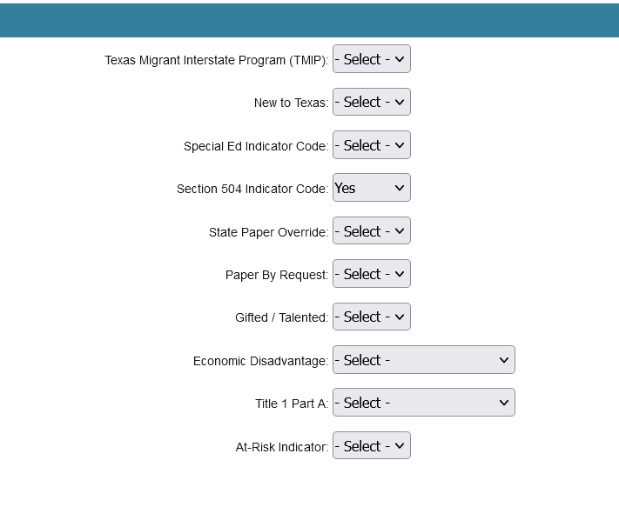
Student’s Record in TIDE for a Special Administration
The student’s test record must have either the Special Ed Indicator Code or the Section 504 Indicator Code turned on in TIDE.

Slide 13
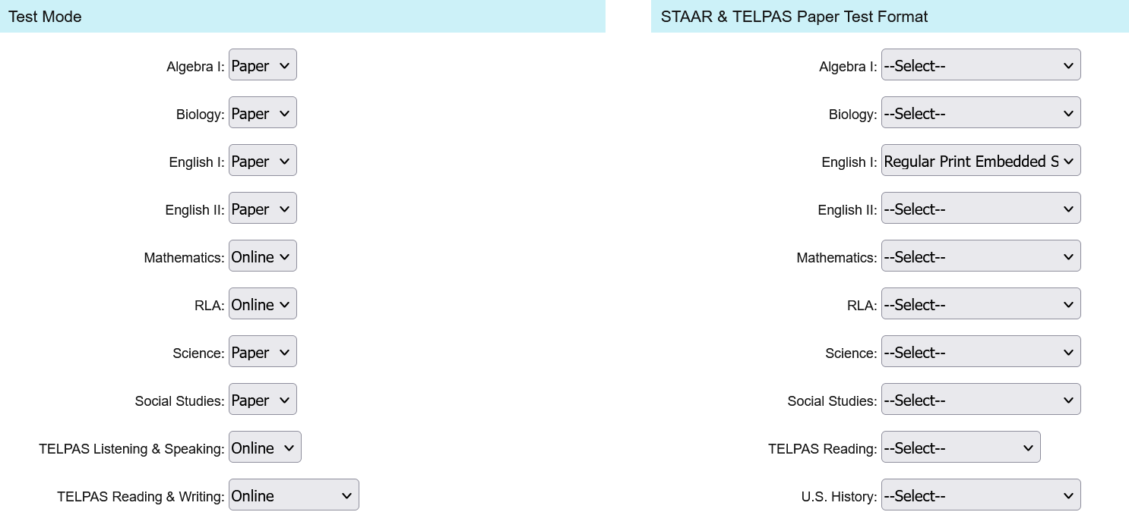
Student’s Record in TIDE for a Special Administration
For STAAR, the district will need to set the Test Mode field to “Paper” and select the specific paper test format in the Paper Test Format field.

Slide 14
Unique Scenarios for Paper Administrations
Juvenile Justice Alternative Education Program
Contact: Texas Testing Support at 833-601-8821
Homebound Student Without Internet
Emergency Medical Situations

Slide 15
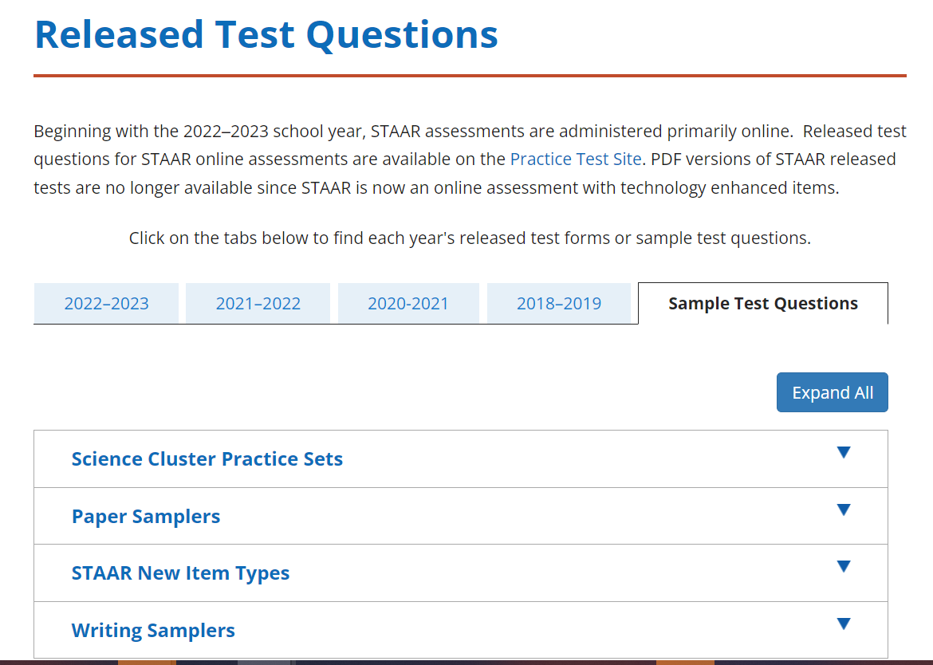
Paper Samplers Available
Students who qualify for a paper administration of STAAR can access samples of the paper versions of new question types.
Students should be familiar with the different response methods and how to record their answers appropriately.

Slide 16
Testing Time
Reminder
There will be a maximum allowable testing time of seven hours for the State of Texas Assessments of Academic Readiness (STAAR®) assessments.
Students are expected to complete the STAAR assessment in about three hours; students who are still testing after four hours should be consolidated into a general testing area to continue testing.
Students must complete the assessment within the same school day, and no test session may exceed seven hours. Exceptions exist for eligible students who have an approved Extra Day designated support.

Slide 17
House Bill 1883
Reminder
HB 1883 allows a district to consider the dates of religious holy days likely to be observed by their students when establishing
District calendars and
Days within the testing windows on which students are administered state assessments.
These are holy days observed by a religion whose places of worship are exempt from property taxation under Section 11.20 of the Tax Code.
HB 1883 requires districts to provide alternative testing dates (i.e., make-up days) within the window for students who are absent from school on scheduled testing dates to observe a religious holy day.

Slide 18
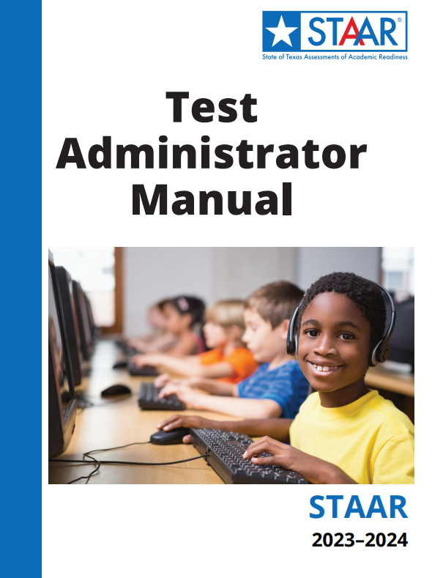
STAAR Test Administrator Manual
Available online at: Test Administration Resources | Texas Education Agency
Scheduled to arrive in districts
02/20/24–02/23/24

Slide 19
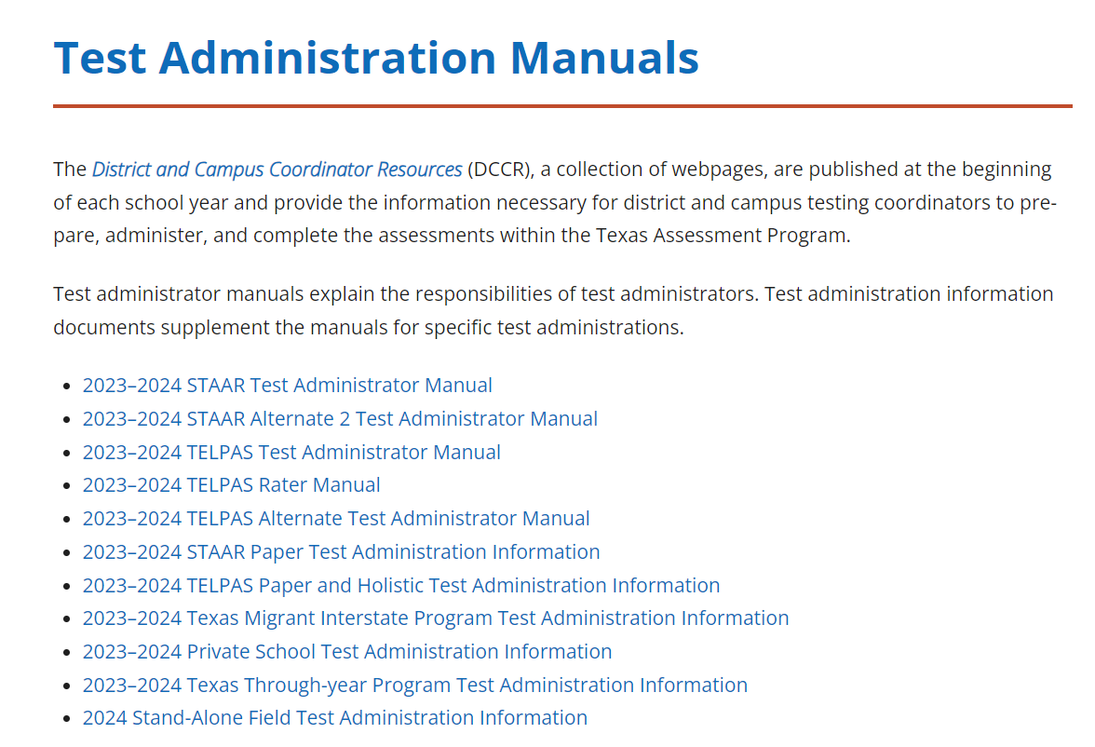
Test Administration Information
These are supplements to test administrator manuals. These can be found on the TEA Test Administration Manuals page.
STAAR Paper Test Administration Information
For all special paper administrations: regular-print, large-print, embedded supports, and braille
Available online only
STAAR Texas Migrant Interstate Program Test Administration Information
Available online only
Private Schools Test Administration Information
Available online only

Slide 20
Secure Test Instructions
STAAR Paper with Embedded Supports Secure Test Instructions
One per test
Printed and shipped
STAAR Braille Secure Test Instructions
One per test
Printed and shipped

Slide 21
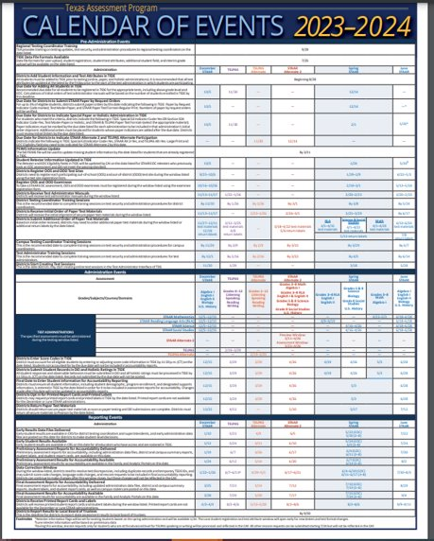
Test Administration Cycle of Events
Before
Registration
Pre-administration
Administration
Post-administration
Scoring and Reporting
During
After

Slide 22
Before Testing - Key Date Reminders
Event | Date
Districts Receive Test Administration Manuals | 2/20 – 2/23
Districts Start Creating Test Sessions | 3/18
Districts Receive Initial Order of Paper Test Materials | 3/25 – 3/29
RLA Additional Order Window | 4/1 – 4/15
Science and Social Studies Additional Order Window | 4/1 – 4/22
Math Additional Order Window | 4/1 – 4/29
Before
Registration
Pre-administration
Additional Order Window applies to Special Administration of an Online Assessment ONLY

Slide 23
During Testing - Key Date Reminders
Event | Date
RLA Administration Window | 4/9 – 4/19
RLA – Score Codes and Student Responses entered in TIDE | 4/19 by 11:59 p.m. (CT)
Science and Social Studies Administration Window | 4/16 – 4/26
Science and Social Studies – Score Codes and Student Responses entered in TIDE | 4/26 by 11:59 p.m. (CT)
Math Administration Window | 4/23 – 5/3
Math – Score Codes and Student Responses entered in TIDE | 5/3 by 11:59 p.m. (CT)
Final Date to Enter Student Information for Accountability | 5/3
Districts Return Paper Materials | By 5/17
During
Administration
Post-Administration

Slide 24
After Testing - Key Date Reminders
Event | Date
` | EOC | 3-8
Early Results in Centralized Report System (CRS)​ | 5/22 | 5/30
Preliminary Assessment Results (data files & standard reports)​ | 6/4 | 6/11
Data Correction Window | 6/4 – 6/10 | 6/11 – 6/17
Final Assessment Results (data files & standard reports)​ | 7/10 | 7/19
Districts Receive Printed Report Cards and Labels | 8/2 – 8/6
After
Scoring and Reporting

Slide 25
Standard Reports
Reminder
Spring EOC/3-8
 | Preliminary File Delivery | Final File Delivery
Student Rosters |  | x
Summary Reports | x | x
Enhanced Item Analysis |  | x
ECR Student Responses |  | x
Printed SRCs and Labels |  | x
CRS provides student level performance information, like the Student Roster deliverable.
Item Analysis reports have been updated for Spring 2024.

Slide 26
Student Test Sessions
Proctored Test Sessions | Unproctored Test Sessions
The test administrator selects tests and starts a test session in the Test Administrator Site. Students sign in to the Student Testing Site with the provided session ID and request approval for tests. The test administrator reviews students’ requests and approves them for testing. Students complete and submit their tests. 5. The test administrator stops the test session and logs out. | The test administrator selects the tests to be administered and schedules a test session in the Test Administrator Site. The test administrator provides the session ID to the students. Students sign in to the Student Interface using their first name, TSDS ID, and session ID. 4. Students complete and submit their tests.
Reminder – The Teacher role can create sessions for Interim assessments, and Texas Formative Assessment Resource (TFAR) assessments.

Slide 27
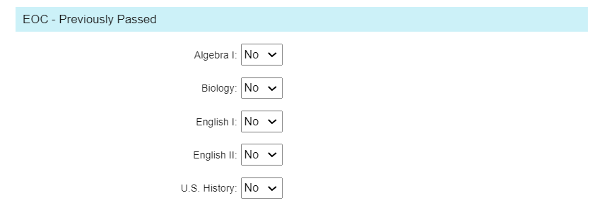
TIDE Enhancements—EOC Previously Passed
Reminder
EOC Previously Passed – Cambium will load EOC passing information in TIDE. This will prevent students from participating in EOC(s) in TDS.
Cambium updated the EOC – Previously Passed field on January 24th to reflect Dec. EOC testing information.

Slide 28
TIDE Enhancements—Above Grade-Level
Reminder
Above Grade-Level
When selected – students will be unable to participate in the assigned grade level test in TDS. Students will only see the applicable Above Grade-Level assessment.
Same for EOC. Example: 8th grader taking Algebra. If EOC Eligibility flag is set, the student will only see the Algebra assessment.

Slide 29
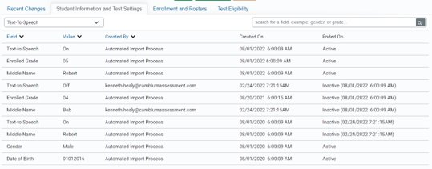
TIDE Enhancements—Student History
Reminder
Appropriate roles can now view student changes made in TIDE.

Slide 30
TDS Enhancement: Tool Strip
Reminder
Students with ASL videos or TTS enabled can now access those tools outside the drop-down menu. Icons have been added to the options line for ease of use.

Slide 31
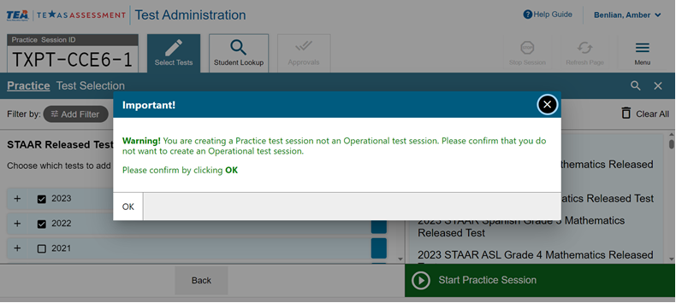
TDS Enhancements—Pop-up Reminder Window
Reminder
To assist districts in adding the appropriate tests to test sessions within the Test Administrator Interface of TDS, we have added a pop-up window.
When creating a test session, a pop-up window will appear when a practice test or a STAAR Interim Assessment is selected.
The pop-up window will ask the user to confirm that he or she did not want to create an operational test session.

Slide 32
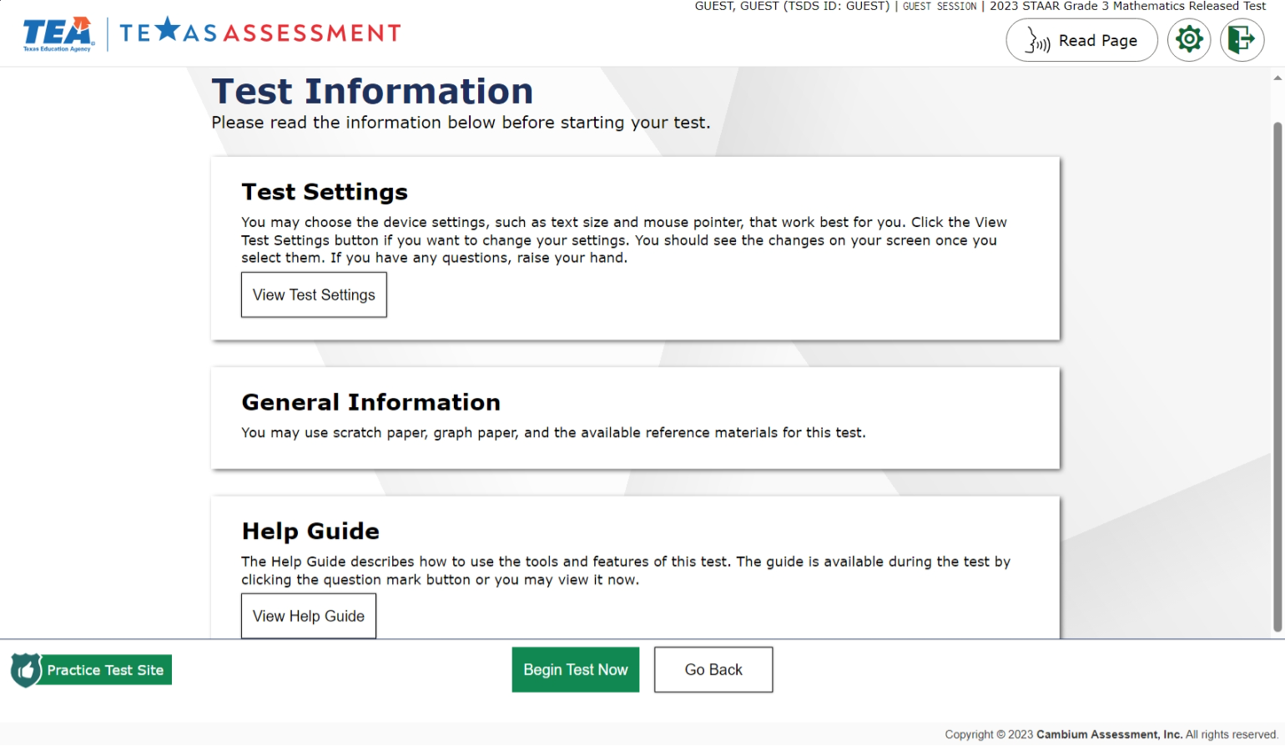
TDS Enhancements—Text-to-Speech
Reminder
Pre-test instruction pages can now be read to students who have TTS.

Slide 33
TDS Enhancements—"Are you still there?"
Reminder
New 'Warning' message
Message will appear after 5 minutes of inactivity.
Student will be logged out after 20 minutes of inactivity.

Slide 34
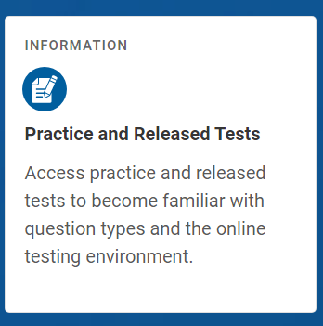
Online Practice Tests
Designed to familiarize students with the online testing environment, available tools, and various question types.
Students may sign in with their credentials to set up their current test attributes.
Includes STAAR redesign practice tests and 2023 STAAR released tests.
Test permissive mode- ensure your operating system and the platform work together.

Slide 35
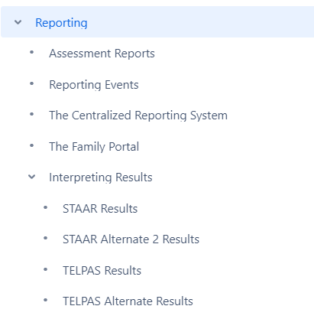
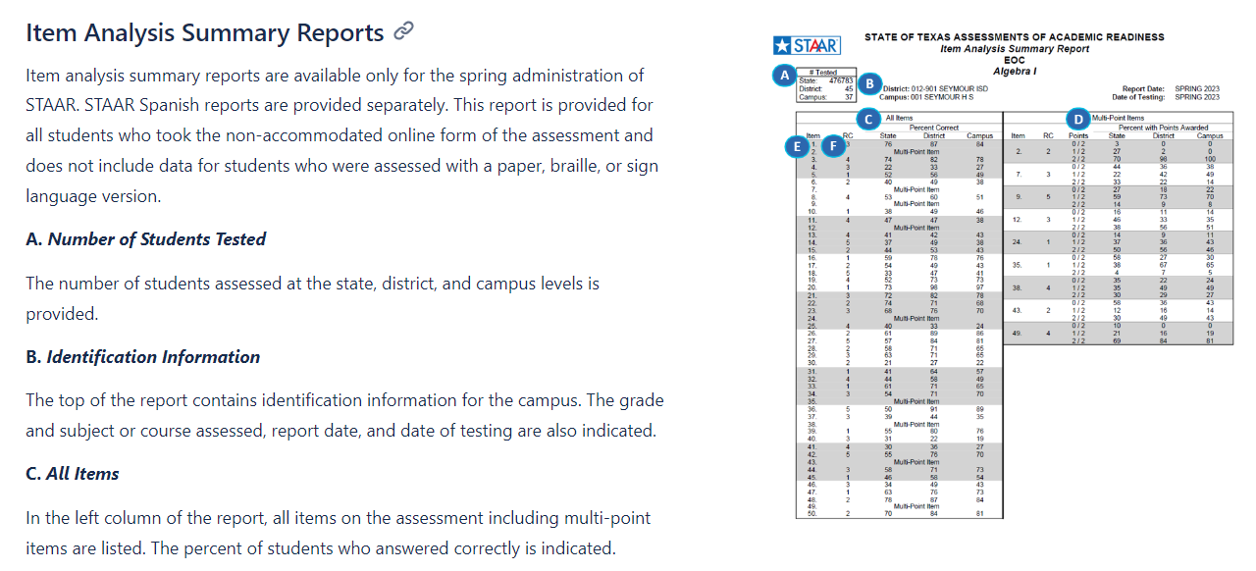
DCCR – Reporting
Available Now
Reporting section in the DCCR
Interpretive Guides

Slide 36
Google Spanish Voice Pack
Update
With the release of Google’s Chrome OS version 121, the Spanish voice pack, which is used for text-to-speech (TTS) functionality, will be available for the spring STAAR administration.
Students who use Chromebooks for testing and who need Spanish TTS should have their devices updated to Chrome OS version 121.
For devices that cannot be updated, district staff may continue to manually install the Spanish voice pack with the instructions provided in the communication sent on January 17, 2024.

Slide 37
Accommodations Reminder

Slide 38
Accessibility Materials
Update
If a student has shown success with an accessibility feature (e.g., color overlays) during instruction, these materials should be made available at request during testing. Students cannot be required to use these supports, but they should have the option.
Because these accessibility materials are intended for students who routinely use them in the classroom, providing ALL students with these materials at the beginning of a testing session would not be appropriate and would likely cause more distraction than assistance.
Note: Although these materials are meant for the students previously identified as having a specific need, any student may request an available accessibility resource during testing if the student believes it would benefit their ability to interact with the test.

Slide 39
Testing Materials
Update
Testing materials, such as blank scratch paper, blank graph paper, paper reference materials, calculators, dictionaries, and writing/highlighting tools are allowed on specific STAAR assessments and are embedded in the online testing system. However, handheld or paper versions of these materials (as appropriate) may be distributed to all students prior to the assessment or as requested during the assessment.
New slide as of 2/15/2024

Slide 40
RTI, Student Assistance Team, or other related support (struggling learners)
Basic Transcribing Braille Individualized Structured Reminders Manipulating Test Materials Mathematics Manipulatives Oral/Signed Administration Supplemental Aids
Section 504 Committee (students with other health impairments, dyslexia)
Basic Transcribing Braille Calculation Aids Content and Language Supports Individualized Structured Reminders Large Print Manipulating Test Materials Mathematics Manipulatives Oral/Signed Administration Spelling Assistance Supplemental Aids
Available Accommodations by Academic Committee
Admission, Review, and Dismissal (ARD) Committee (special education students)
Basic Transcribing Braille Calculation Aids Content and Language Supports Individualized Structured Reminders Large Print Manipulating Test Materials Mathematics Manipulatives Oral/Signed Administration Spelling Assistance Supplemental Aids
Language Proficiency Assessment Committee (LPAC) (EB students)
Content and Language Supports Oral/Signed Administration

Slide 41
Accommodations and Resources
Extra Day
Complex Transcribing
Mathematics Scribe
Other
These four designated supports require the submission and approval of an Accommodation Request Form, which can be found under the Administration and Security Forms module in TIDE.
Remember that “Other” submissions are for students with unique needs not addressed explicitly with any accessibility features or another designated support.
Your Accommodations Task Force is Here to Help!
Members are available to talk you through policy documents and the submission process.
Do not hesitate to reach out for support.

Slide 42
Spelling Assistance and the Use of Text-to-Speech: Reminder
Why is TTS not considered an effective form of spelling assistance?
TTS does not consistently identify misspelled words. It relies on the student’s ability to pick up possible auditory cues from the voice pack’s pronunciation which often will read through misspellings if phonetically correct
TTS does not provide a visual indicator, such as the red underline in TDS, that a word has been misspelled
TTS does not assist the student by offering correctly spelled words to choose from.
Text-to-Speech (TTS) is not available as an option for spelling assistance except for students with visual impairments who are unable to access the approved spell check tools listed in the policy document.

Slide 43
Grammar and Mechanics Supplemental Aid: REMINDER
Reading Language Arts - Extended Constructed Responses ONLY
Students who are eligible for this support should be familiar with the policy and know when to raise their hand to ask for their materials and when to return them to the test administrator. It is important that students have exposure to the look of the constructed response question prior to the day of testing so there is no confusion about when they can request this support.
Test Administrators should NOT view the test content on the screen when providing these materials.

Slide 44
FAQ

Slide 45
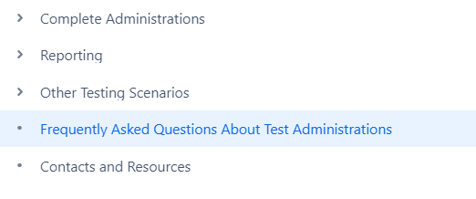
Frequently Asked Questions
The DCCR contains a Frequently Asked Questions!!!!
Texasassessment.gov

Slide 46
Who can serve as a test administrator?
Any district staff member holding valid education credentials (e.g., a Texas educator certificate or permit) may serve as a test administrator. Staff members who do not hold valid education credentials may serve as test administrators if they are supervised by a district staff member who holds valid education credentials.
Test administrators may include:
teachers (including those who hold teaching permits, probationary certificates, or any other educator certificate from the State of Texas)
school counselors
school librarians
paraprofessionals
substitute teachers
other professional educators (such as retired teachers)
Additional information can be found on the FAQ page and the CTC Activities page in the DCCR

Slide 47
What ‘Score Code’ should I use?
As all eligible students must be accounted for, district personnel should enter score codes in the Appeals/Score Codes module in TIDE during the administration window for students who are not tested, according to the following criteria:
If a student is absent on the district-assigned testing days, including make-up days, use “A” for “Absent.”
If a student is present but does not test, use either "S" for "Score" or "O" for "Other" depending on the specific scenario:
For students taking a STAAR grade 3–8 assessment, use "S."
For students taking a STAAR EOC assessment for the first time, use "S."
For students taking a STAAR EOC retest in spring or December, use "O."
For students taking STAAR Alternate 2, use "S."
Question 14 - FAQ
Reminder – All Score Codes must be entered by 11:59 p.m. (CT) on the last day of the testing window.

Slide 48
My students started the wrong test – What now?
What should a district do if a student begins an operational test that the student is scheduled to take on a different day (e.g., a student starts a science test instead of a social studies test)?
If the student has already begun responding to test questions on the wrong test, the student should complete that test on the same day. The student may then take the correct test on a different day within the testing window.
Question 11 - FAQ

Slide 49
My student was not provided their Accommodation, What now?
What should a district do if it fails to provide a student with an online accommodation that is required by his or her individualized education program (IEP)?
If the error is discovered while the student is testing, the error may be able to be fixed, and the student will be able to continue testing with the required accommodation.
For content and language supports, refreshable braille, and American Sign Language, if the student has answered five or more questions, the accommodation error CANNOT be fixed and the test cannot be reset.
For these circumstances, a procedural testing irregularity form for an accommodation error must be completed. This form can be accessed through the Submit a Form task in the Administration and Security Forms module in TIDE.
Question 24 - FAQ

Slide 50
Incorrect Accommodation – What Now?
What should a district do if an accommodation has been incorrectly provided to a student (e.g., a calculator is provided to a grade 7 student taking a mathematics assessment)?
If the student is still testing, the test administrator must remove or disable the accommodation and allow the student to complete the test. The test should be submitted, and a procedural testing irregularity form for an accommodation error must be completed. If the student has completed and submitted the test, a procedural testing irregularity form must still be completed. This form can be accessed through the Submit a Form task in the Administration and Security Forms module in TIDE.
Question 23 - FAQ

Slide 51
What should I do in Schoolwide Emergencies?
If a schoolwide emergency disrupts testing, ensuring student safety is the top priority. Students should leave their assessments where they are and follow the school’s emergency procedures. Testing staff should not instruct students to pause their assessments. Test administrators must caution their testing groups to avoid discussing the assessment.
Online assessments will automatically pause when the testing devices have been idle for 20 minutes. Once the emergency has been resolved, students should resume testing on the same day when possible.
If testing cannot be resumed on the same day, students’ test tickets should be collected. Students can then resume testing the following day using their original test tickets. If the test session has ended, a new session must be created. Students will resume the assessment from where they left off. Test questions previously responded to will be locked.
Schoolwide Emergencies section in the DCCR

Slide 52
What should I do in a Power Outage or System Interruption?
If a campus loses power or internet connectivity during testing, district personnel should determine whether to release students or have them remain in the testing room until the outage has been resolved. If students are released from the testing room, their test tickets must be collected. Test administrators must caution their testing groups to avoid discussing the assessment.
If testing cannot be resumed on the same day, students can resume testing the following day using their original test tickets. If the test session has ended, a new session must be created.
If the interruption prevents students from resuming testing on the same day, the district coordinator should contact Texas Testing Support to request that the affected students’ previously responded to test questions be unlocked.
Online assessments will automatically pause when testing devices have been idle for 20 minutes. Once the interruption has been resolved, students should resume testing on the same day when possible.
Power Outages section in the DCCR

Slide 53
Signed Administrations
Previewing test content is allowed only on the day the test is administered via proctor code that allows them to view the same test opportunity that is being provided to the student​
Proctor codes should also be used for small-group signed administrations​

Slide 54
Texas Through-year Assessment Pilot (TTAP) Recruitment

Slide 55
TTAP will run for the following test titles in SY24-25 (Year 3)
Grade 3 Math
Grade 6 Math
Grade 7 Math
Grade 8 Math
Grade 8 Social Studies
Algebra 1
NEW
Other notes:
To gather a representative sample, we would like to see at least 8K students participate in each test title
Grades 3-5 test titles will have Spanish
Content and language supports will be available for students who need it
Pilot is 100% online
The pilot will run in limited titles and grade levels, but intends to cover all content areas eventually
NEW
NEW
Notes:
[Read text aloud and in order]
(If districts ask about Grade 5 Science - Given that next year is a bridge year, we would need to build a whole new form for next year and then we start fresh with new forms and a new blueprint and new scales the following...which will give us nothing in terms of research for implementing TTAP for 2-3 years. )

Slide 56
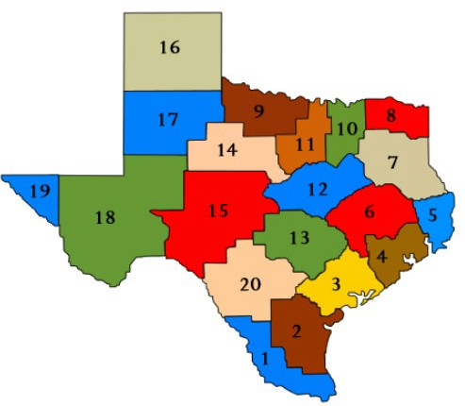
TTAP hopes to see district representation across the entire state of Texas
SY23-24 Participation (Year 2)
19 out of 20 regions
93 LEAs
44 rural
21 town
13 suburban
15 urban
56K students
Grade 5 Science: 17K
Grade 6 Math: 9K
Grade 7 Math: 8K
Grade 8 Social Studies: 23K
Participating districts are able to share feedback on the pilot to help TEA improve and measure efficacy of the program
Notes:
We hope to see district representation across the entire state of Texas as TTAP expands to elementary and high school next school year. As a district participant, they are able to share feedback on the pilot to help TEA improve and measure efficacy of the program. 19 regions and over 90 districts are participating in the pilot this school year, totaling over 55,000 students. We hope to partner with districts in all 20 regions and see a more even representation across LEA types in year 3.

Slide 57
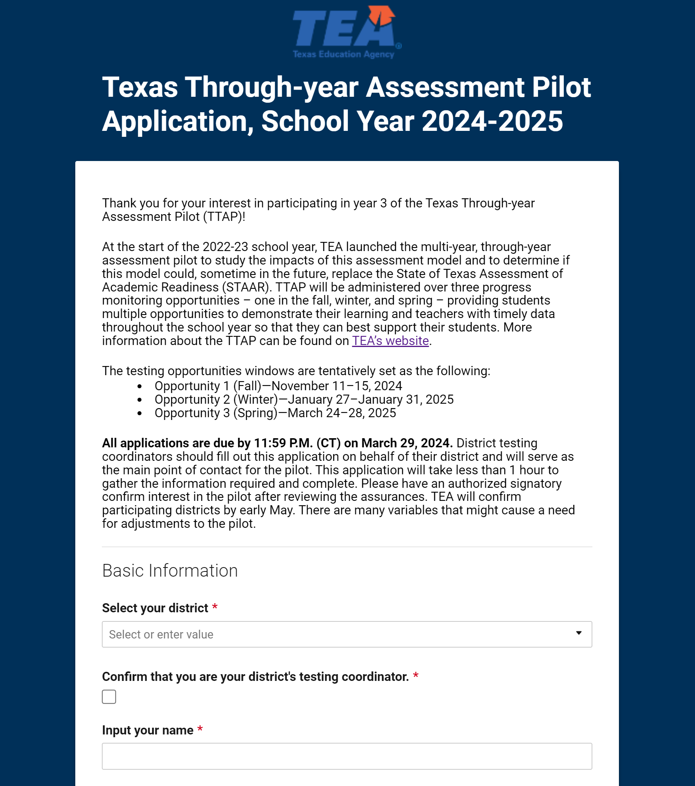
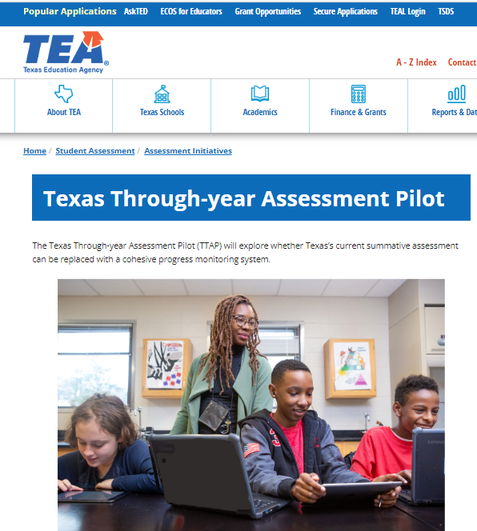
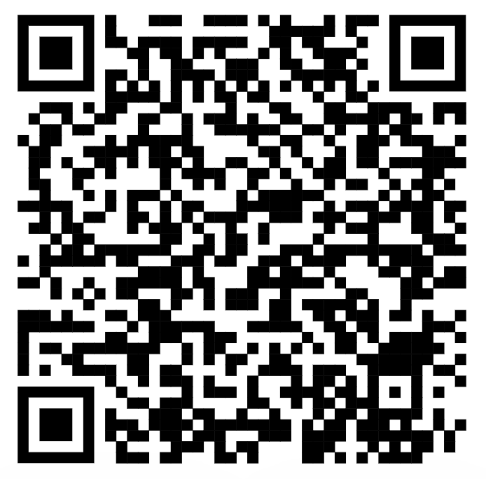
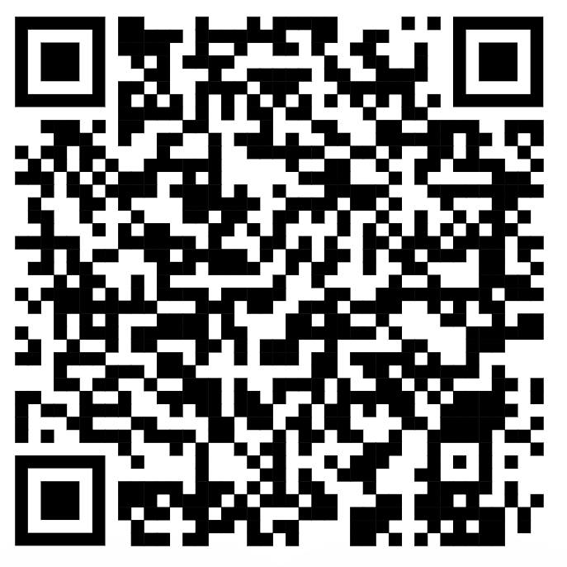
We want you to pilot TTAP with us this fall and have your voice heard!
1. Attend an informational webinar on Zoom
2. Complete the application (district testing coordinators)
3. Stay updated through the TTAP webpage
Option 1—February 20, 2024, 4:00–5:00 p.m. (CT)
Option 2—February 21, 2024, 12:00–1:00 p.m. (CT)
Notes:
Link to the form: https://app.smartsheet.com/b/form/03632c43684d4cddaed4641e4d5f9923
If you submit an interest form,

Slide 58
Contact Information and Collaboration Opportunities

Slide 59
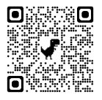
Support student success by serving on an assessment committee.
Teachers, instructional coaches, content specialists, and administrators play an essential role:
Passage Review: reviewing Reading Language Arts (RLA) each test passage.
Item Review: reviewing and approving each potential test question.
Constructed Response Range-Finding: setting scoring boundaries for essays.
Subject-Area Advisory Group providing feedback on subject-area-specific topics.
Standard-Setting: establishing cut scores that define performance levels.
Visit TexasAssessment.gov or https://bit.ly/406DvwE or use the QR code to sign up.

Slide 60
TEA Contact Information
For inquiries related to development and
administration of state assessments, reporting activities, or data corrections, please contact:
Student Assessment Help Desk
(512) 463-9536
https://tea.Texas.gov/student.assessment/

Slide 61
Thank you for everything
you do for our Texas students!

Slide 62
Disclaimer
These slides have been prepared by the Student Assessment Division of the Texas Education Agency. You are welcome to use them for local training.
If any of the slides are changed for local use, please remove any TEA logos, headers, or footers. (You may need to edit the Master slide.)
This training is not intended to replace any materials or additional information on the TEA website.

