Slide 1
Fall Updates: STAAR Alternate 2, TELPAS, and TELPAS Alternate
October 19, 2023
Event #1135

Slide 2
Agenda
STAAR Alternate 2 Updates
TELPAS Updates
TELPAS Alternate Updates
Questions

Slide 3
STAAR Alternate 2 Updates

Slide 4
STAAR Alternate 2
STAAR Alternate 2 is an alternate assessment based on alternate academic achievement standards. It is a standardized item-based assessment administered individually to eligible students with the most significant cognitive disabilities who are receiving special education services.
STAAR Alternate 2 is a paper assessment. Only students who meet the Texas Education Agency (TEA) definition of a student with the most significant cognitive disability may be assessed with STAAR Alternate 2 and are:
enrolled in grades 3–8; or
enrolled in high school EOC courses Algebra I, Biology, English I, English II, U.S. History.
Students who meet participation requirements are assessed with STAAR Alternate 2 for all subjects.

Slide 5
ESSA Waiver Denial Notification
(2023 Texas One Percent Waiver Denial Letter)

Slide 6
Revised STAAR Alternate 2 Participation Requirements
WHEN AND WHO | WHY
In August 2023, STAAR Alternate 2 Participation Requirements were revised using recommendations and feedback that included the following stakeholders across the state: Special education educators and administrators ESC administrators and specialists Special education advocates TEA Special Populations personnel | The purpose of revising the participation requirements was to clarify the scope of students that are assessed with STAAR Alternate 2, and to satisfy the Every Student Succeeds Act (ESSA) requirements.
Notes:
The “why” is not to reduce the number of students who are appropriately determined to need the alternate test.

Slide 7
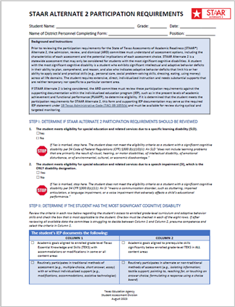
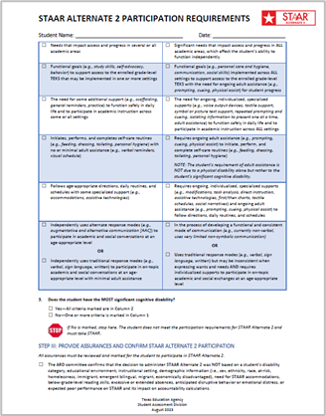
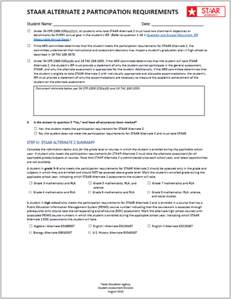
STAAR Alternate 2 Participation Requirements

Slide 8
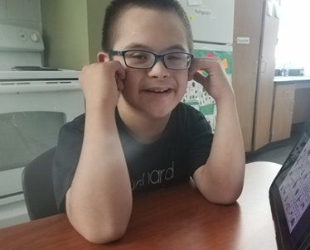
STAAR Alternate 2 Eligibility Decisions
STAAR Alternate 2 Eligibility Resources
Revised STAAR Alternate 2 Participation Requirements
STAAR Alternate 2 Participation Requirements Companion Document
STAAR Alternate 2 Overview and Eligibility Module (coming soon)
STAAR Alternate 2 Before, During, and After the Assessment Course (coming soon)
STAAR Alternate 2 FAQs (coming soon)

Slide 9
STAAR Alternate 2 Key Dates 2023-2024
Due Date for Districts to Indicate STAAR Alternate 2 Participation | By 12/14/23
Districts Receive Initial Order of Paper Test Materials | 2/26/24—3/1/24
Districts submit Additional Order of Paper Test Materials | 3/18/24—4/22/24 Test Materials By 5/6/24 Return Labels
Preview Window | 3/11/24—4/26/24
Assessment Window | 3/25/24—4/26/24
Submit Score Codes in TIDE and Scoring Information in DEI | 4/26/24 11:59 p.m. (CT)
Districts Return Paper Test Materials | By 5/10/24

Slide 10
STAAR Alternate 2 Additional Order (AO) Window
When and What
The STAAR Alternate 2 additional order window is 3/18-4/22. As a reminder, the initial order materials are based on the number of STAAR Alternate 2 eligible students noted in TIDE by 12/14. Form numbers are assigned for initial order materials.
The additional order window is an opportunity for a district to order test materials for any additional eligible students that have enrolled in the district after the 12/14 due date.
Things to Know about AO window
District personnel:
Should only place an AO after the district’s overage materials have been exhausted
Must verify that the additional STAAR Alternate students have been entered in TIDE, and
Use the previously provided form number assignments from the initial order materials.
If not, then additional orders may be rejected.

Slide 11
Distribution of Materials
Use the Materials Control Form for the Texas Assessment Program which includes STAAR Alternate 2; it will be used for all test programs with paper test materials during the testing window (and preview window for STAAR Alternate 2).
Materials control form is available in the Paper Administration section of the DCCR.

Slide 12
STAAR Alternate 2 Program Resources Webpage
The STAAR Alternate 2 webpage has been updated.
The Who is Tested? section includes:
Revised STAAR Alternate 2 Participation Requirements in English and Spanish
Updated STAAR Alternate 2 Companion Document in English and Spanish
STAAR Alternate 2 No Authentic Academic Response (NAAR) in English and Spanish
STAAR Alternate 2 Medical Exception in English and Spanish

Slide 13
STAAR Alternate 2 Program Resources Webpage
(continued)
There are separate tabs in the What is Tested? Section. Most of the information found within each tab used to be found on separate webpages.
The tabs include
Blueprints
Curriculum Framework
Essence Statements (coming soon)
TEKS Vertical Alignment
Instructional Terms Lists

Slide 14
STAAR Alternate 2 Test Administrator Manual and Educator Guide
The STAAR Alternate 2 Test Administrator Manual will be posted in the Test Administration Manuals section of the DCCR.
The STAAR Alternate 2 Educator Guide is posted on the STAAR Alternate 2 Resources webpage.

Slide 15
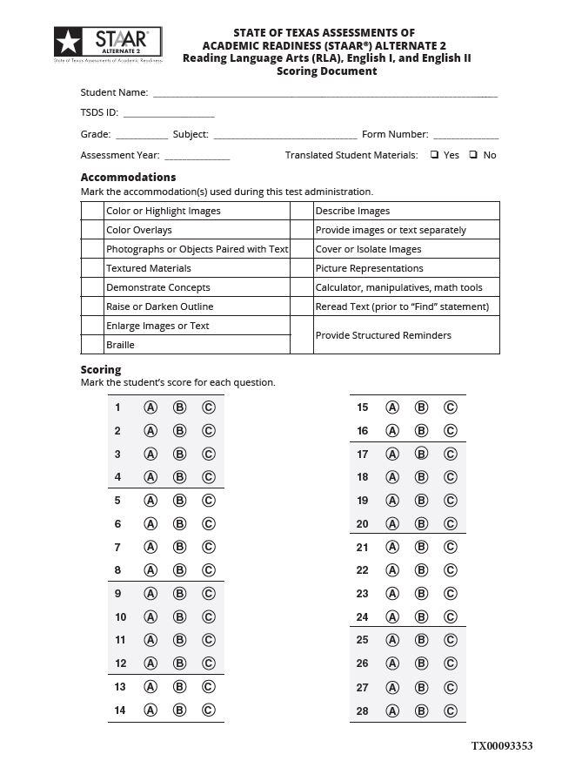
STAAR Alternate 2 Scoring Documents
STAAR Alternate 2 Scoring Documents are specific by subject
RLA and English I & II assessments will have 28 questions (two additional field test clusters)
All other subjects (Mathematics, Science and Social Studies) will have 24 questions.
Scoring Documents are found in the back of the accompanying Teacher Test Booklets or the online Test Administrator Manual

Slide 16
Test Administrator Training Key Topics
Use Online STAAR Alternate 2 Test Administrator Manual
Preparation for Test Administration (Preview Window 3/11/24-4/26/24)
Roles and Responsibilities
Test Security
Scheduling Test Administrations
Testing with Accommodations
Monitoring Test Administrations
Returning Materials to District Coordinator
TA Training completed by 3/22/24

Slide 17
STAAR Alternate 2 Test Administrators
Ideally, the test administrator should be the student's teacher for the subject tested because of the high level of familiarity with the student.
Accommodations must be prepared and delivered appropriately so that student responses can be understood.
Paraprofessionals may serve as test administrators if they are supervised by a certified professional on the same campus throughout the test administration.
For additional information on test administrators and their responsibilities, refer to the STAAR Alternate 2 Test Administrator Training section in the DCCR.

Slide 18
Key Points—Preview Window
Preview Window | 3/11—4/26/24
 | Practice reading the script and following the presentation instructions before presenting the test stimulus in front of the student.
 | Review the scoring instructions for the 3rd item in each cluster in order to plan the teacher assistance that will be used for each individual student.
 | Review the student booklet and image cards to plan and prepare accommodations for students as needed.
 | May preview and prepare for the test during the administration window as long as testing has not begun for a particular student (generally for new students).
 | The preview window is NOT a pre-teach window. Any presentation of secure test items or secure test material/information to a student prior to the administration of the test is considered a serious irregularity and should be reported as such.

Slide 19
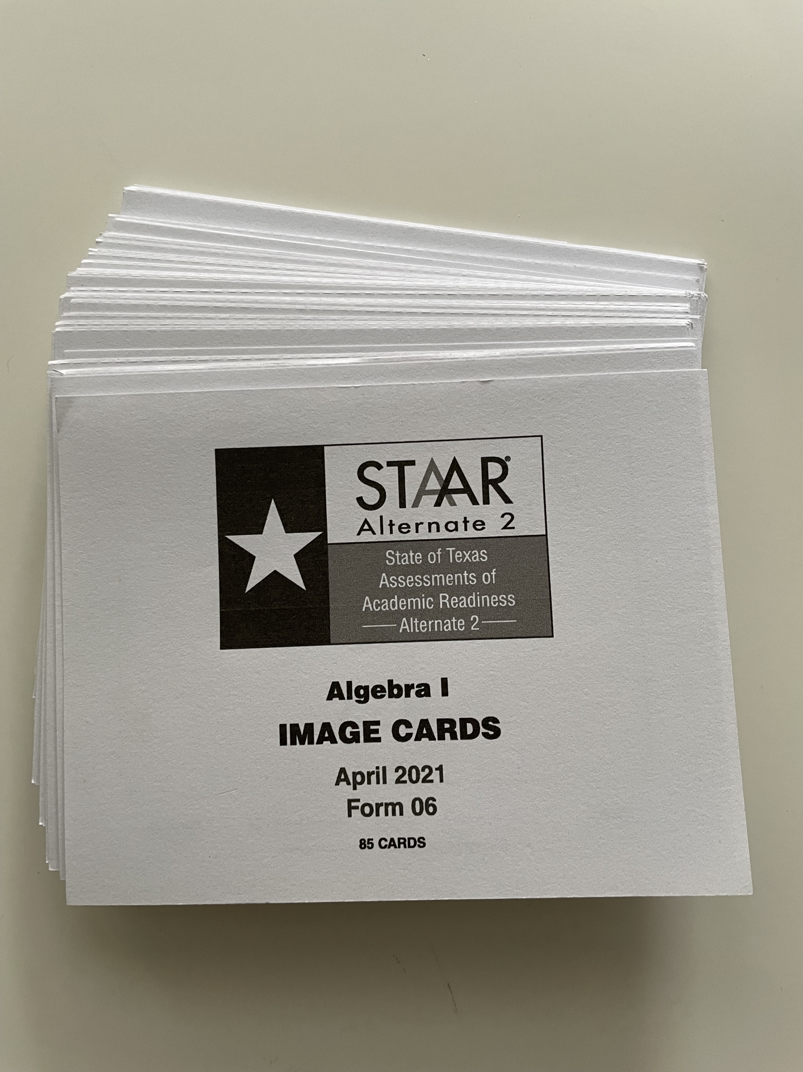
Key Points—Image Cards
Image Cards
Students must be presented the test stimulus from the Student Booklet, with Image Cards as an optional support.
A test administrator may use the same set of image cards for multiple students in the same grade level.
Completely clean card
NO appearance whatsoever of accommodations applied (highlighting, texture applied, etc.)
Image cards are returned as a part of non-scorable materials after test administration is complete.
There is a barcode on the plastic film used to wrap the image cards. There is no need to keep barcode.

Slide 20
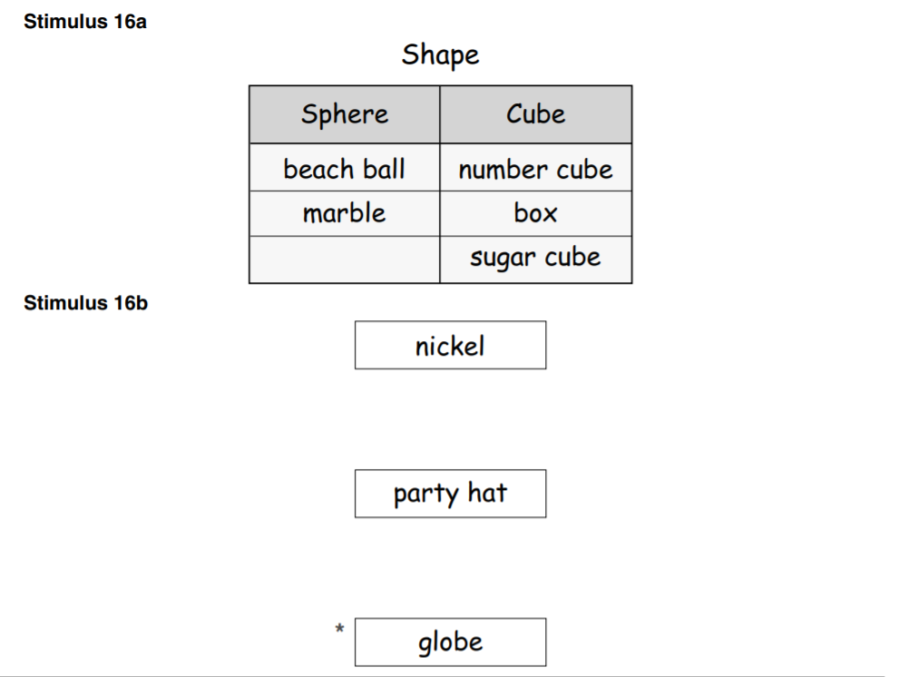
Key Points—Image Cards (cont.)
Image Cards
Every test "Stimulus A" DOES NOT necessarily have an accompanying image card.
Every test item will have accompanying image cards that represent answer choices.
The number of cards in each set is printed on the front of each "cover card" to aid in collection of the entire set at the end of the testing window.
sample from Teacher Test Instructions
A STAAR Alternate 2 Image Card List will be posted in TIDE under Resources before the spring administration. The list includes the number of image cards per each grade level assessment and form number.

Slide 21
Testing Environment
 | Prepare the testing environment. To minimize distractions To maintain the confidentiality of test material and the responses of individual students
 | STAAR Alternate 2 is administered to each student in a one-to-one setting. May need to complete test in a separate setting to eliminate distractions

Slide 22
Key Points—Testing Environment (cont.)
Cameras in the Classroom
Districts with cameras in self-contained classrooms may administer STAAR Alternate 2 in the room with a camera.
The "camera in the classroom" rule does not allow for student removal from the camera view for state testing.
In the case that a request is made to view the video, districts should implement locally developed procedures which communicate the penalties for breaching confidential test material.
TEC, §29.022

Slide 23
New Enrollment or New Campus Within Testing Window
Students must be provided the opportunity to participate in testing. This includes​
Students who move within the school district on/after the first day of the STAAR Alternate 2 testing window; AND​
Students who enroll in a new school district on/after the first day of the STAAR Alternate 2 testing window.
In the case of a student who arrives late in the testing window and the school district is unable to complete one or more of the required assessments
Contact TEA through the Student Assessment Help Desk if the student arrived so late in the window that testing cannot be completed.

Slide 24
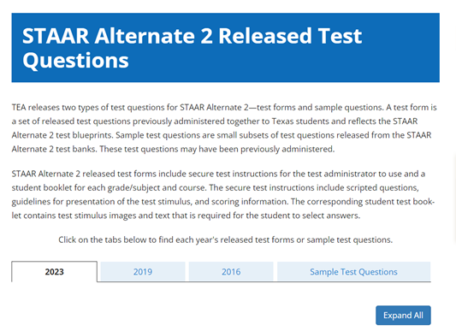
2023 STAAR Alternate 2 Released Tests
The 2023 STAAR Alternate 2 tests were released.
STAAR Alternate 2 released test forms include secure test instructions for the test administrator to use and a student booklet for each grade/subject and course.
The secure test instructions include scripted questions, guidelines for presentation of the test stimulus, and scoring information.
The corresponding student test booklet contains test stimulus images and text that is required for the student to select answers.

Slide 25
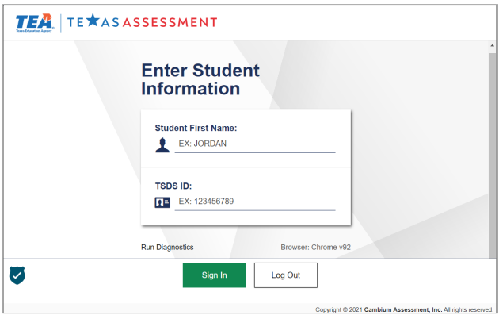
Student Responses in DEI
All student responses must be entered into DEI and processed by 11:59 p.m. (CT) on 4/26.
Responses not submitted by the due date will not be scored.
It is highly recommended that districts reserve the last 2–3 days of the testing window for DEI submissions.

Slide 26
Score Codes in TIDE
If a student does not complete a STAAR Alternate 2 assessment, one of the following “do not score” designations must be selected:
Absent (A) | The student is absent throughout the testing window. An "A" score code should not be used if the student was absent on the testing days but also fits one of the score designations below.
Medical Exception (M) | The ARD committee has determined that the student met the STAAR Alternate 2 Medical Exception criteria and is documented in the student's IEP. Decision should be made before administering the test.
No Authentic Academic Response (N) | The ARD committee has determined that the student met the STAAR Alternate 2 NAAR criteria and is documented in the student's IEP. Decision should be made before administering the test.
Other (O) | The student experiences a test administration irregularity or illness during testing.

Slide 27
Accommodations in TIDE
After testing has been completed, accommodations need to be entered into TIDE.
Only accommodations that were used during the test administration are noted in TIDE.
There are two options to note accommodations in TIDE.
Enter accommodations manually for an individual student
Upload multiple students by using the Additional Student Fields upload file
A short training video on how to enter accommodations in TIDE will soon be available.

Slide 28
Can the STAAR Alternate 2 be administered in the language the student is routinely instructed in?
Only the presentation instructions may be translated. The test is an English assessment so only the “bold” print in the presentation instructions may be translated into the language the student primarily communicates in.

Slide 29
STAAR Alternate 2 Participation Requirement Resources
Resource | Purpose | Audience
STAAR Alternate 2 Participation Requirements | Used by the ARD committee to determine if a student meets the eligibility for STAAR Alternate 2. The form is available in English and Spanish. | Administrators, Coordinators, Teachers, Parents
STAAR Alternate 2 Companion Document | Used in conjunction with the State of Texas Assessments of Academic Readiness (STAAR®) Alternate 2 Participation Requirements. Sources of evidence for a student’s eligibility for STAAR Alternate 2 are on page 2 of this document. The document is available in English and Spanish. | Administrators, Coordinators, Teachers, Parents
STAAR Alternate 2 Participation Requirements FAQs | Will include FAQs related to the updated STAAR Alternate 2 Participation. The document will be posted on the STAAR Alternate Resources webpage. (coming soon) | Administrators, Coordinators, Teachers
STAAR Alternate 2 Overview and Eligibility Module | Assists the members of the ARD committee to better understand the unique features of STAAR Alternate 2 and thereby determine the most appropriate assessment for each student. (coming soon to Learning Management System, LMS) | Administrators, Coordinators, Teachers
STAAR Alternate 2: Before, During, and After the Assessment Course | Is designed for STAAR Alternate 2 test administrators. This course is helpful for those new to the test administration process and may also serve as a refresher to experienced test administrators. (coming soon) | Administrators, Coordinators, Teachers

Slide 30
STAAR Alternate 2 Resources
Resource | Purpose | Audience
STAAR Alternate 2 Test Administrator Manual | Provides an overview of the STAAR Alternate 2 program and provides guidance regarding the entire administration of the assessment including scoring instructions. (coming soon) | Administrators, Coordinators, Teachers
STAAR Alternate 2 Educator Guide | Provides in-depth guidance regarding presentation of test stimulus, communicating the directions, and administering accommodations. (coming soon) | Administrators, Coordinators, Teachers
STAAR Alternate 2 Curriculum Framework documents | The STAAR Alternate 2 Curriculum Framework documents list the reporting categories, and TEKS for each grade/subject and EOC tested in STAAR. The Curriculum Framework documents the access points the Teacher Test state curriculum by which students who are assessed with STAAR Alternate 2 are tested. | Administrators, Coordinators, Teachers
STAAR Alternate 2 Released Tests | The STAAR Alternate 2 released tests include a test administrator manual and a student booklet for each subject/grade or course. The corresponding student booklet contains test stimulus images and text that is required for the student to select answers. | Coordinators, Teachers

Slide 31
STAAR Alternate 2 Resources (continued)
Resource | Purpose | Audience
STAAR Alternate 2 Essence Statements | Provide the "big idea" of topics to be assessed on the spring's STAAR Alternate 2 assessment. (coming soon) | Administrators, Coordinators, Teachers
TEKS Vertical Alignment | Provide a total overview of the knowledge and skills statements and align student expectations across the grades. The student expectations provide access points to the general education curriculum by serving as prerequisite skills for STAAR Alternate 2. | Coordinators, Teachers

Slide 32
TELPAS

Slide 33
TELPAS Overview
TELPAS annually assesses the progress that emergent bilingual (EB) students make in learning the English language.
All K–12 students classified as emergent bilingual EB/EL in the Public Education Information Management System (PEIMS) are required to participate in TELPAS, including those who have parents who have declined bilingual/English as a Second Language (ESL) program services.
The TELPAS testing window is February 19th to March 29th.

Slide 34
Exceptions to an EB Student Being Assessed in One or More Language Domains
An EB student receiving special education services
Decision must be made by ARD committee in conjunction with the LPAC.
Participation must be considered on a domain-by-domain basis.
Reason for not assessing student must be well-supported and documented.
An EB student from another Texas school district, state, or country who enrolls on or after the first day of the TELPAS testing window
Will not be assessed by receiving district in the holistically-rated domains.
Is required to take the TELPAS listening and speaking test and the reading and writing test.
Notes:
DONE

Slide 35
TELPAS Components
Grades K–1
Grades 2–12
Holistically-rated Assessments
Online Tests
Listening
Speaking
Listening and Speaking
(2-3, 4-5, 6-8, 9-12)
Reading
Writing
Reading and Writing
(2, 3, 4-5, 6-7, 8-9, 10-12)

Slide 36
TELPAS Key Dates for 2023-2024
Due Date for Adding All Students in TIDE | By 11/30/23
Due Date for Districts to Indicate Special Administration (paper and holistic) in TIDE | By 11/30/23
Districts Receive Test Administrator Manuals | 1/22/24—1/26/24
Districts submit Additional Order of Paper Test Materials | 2/12/24—3/25/24 Test Materials By 4/8/24 Return Labels
Assessment Window | 2/19/24—3/29/24
Submit Score Codes and Upload Holistic Ratings in TIDE and Submit Student Responses (paper admin) in DEI; (this means entered/submitted and processed by that date and time) | 3/29/24 11:59 p.m. (CT)
Districts Return Paper Test Materials | By 4/12/24

Slide 37
TELPAS Additional Order Window
When is the TELPAS AO window? | The TELPAS additional order window is 2/12-3/25 for test materials and by 4/8 for return labels.
What should I know about the TELPAS AO window? | TELPAS reading paper tests (regular print, large print, braille contracted, and braille uncontracted must be ordered during the additional order window (even if the TELPAS paper test format was indicated in TIDE by 11/30).
What should I take into consideration when placing an AO? | When placing an AO, a district must consider the time it will take to ship materials, administer the assessment, and enter the responses in DEI by 3/29/24

Slide 38
Special Administration of a TELPAS Online Test
In rare circumstances that prevent a student from testing online, the student must meet eligibility criteria for a special administration of a TELPAS online test (listening and speaking or reading and writing) for grades 2–12.
Accommodations cannot be applied
Technology access is precluded*
Unable to participate in one domain
A student may receive a special administration (paper test or holistic assessment) of an online test ONLY if this it is noted in the student’s individualized education program (IEP) or Section 504 plan.
Special administrations for TELPAS reading are paper tests (regular print, large print, or braille), while TELPAS listening, speaking, and writing special administrations are holistic assessments that require training and calibration to administer.
*This applies in rare situations where computers or technology are absolutely not available such as homebound students without internet access, JJAEPs, jails, or detention centers.

Slide 39
Special Administrations for Online TELPAS Tests
Special Administration for TELPAS
Both online TELPAS tests have two language domains combined. If a student is eligible for a special administration in one of the test’s domains, the student will need to have a special administration in both domains (if applicable).
TELPAS Listening and Speaking | Holistic for listening and speaking | Holistic administrations conducted by raters that have completed training and calibration successfully
TELPAS Reading and Writing | Paper for reading | Regular print, large print, and braille (contracted and uncontracted)
 | Holistic for writing | Holistic administration conducted by raters that have completed training and calibration successfully. Will require writing samples that meet the writing collection criteria.
More information about special administration of an online TELPAS assessment can be found in the DCCR and in the TELPAS Test Administration Instructions (coming soon).

Slide 40
Test Mode and Paper Test Format in TIDE
The due date for districts to indicate TELPAS special paper or holistic administration of an online assessment in TIDE is 11/30. As a reminder, a district will need to submit an AO for TELPAS paper reading test materials.

Slide 41
Administrations in Alternative Education Settings: Before Testing
Home District Personnel Responsibilities
Inform the alternative education setting of all students who will be testing at that location
Ensure that students who will be testing at an alternative education setting are appropriately registered in their home district in TIDE.
Ensure that all test administrators, raters, and personnel handling secure test materials in alternative education settings have been trained and that they complete an Oath of Test Security and Confidentiality.
Provide a student test ticket to the alternative education setting for each student testing online.
Alternative Education Personnel Responsibilities
Ensure that the campus coordinator and all test administrators, raters, and verifiers have been trained and complete an Oath of Test Security and Confidentiality.
Ensure that the technology staff has completed the appropriate online testing systems are in place.
Receive test materials from the state’s testing contractor. All test materials are shipped to the alternative education setting for eligible students who have the alternative education setting set by home district personnel by the deadline.
NOTE: Refer to the Administrations in Alternative Education Settings section in the DCCR for additional and specific information. The information noted on the slide is just an overview.

Slide 42
Administrations in Alternative Education Settings: During Online Testing
Home District Personnel Responsibilities
Monitor testing by using TIDE to generate reports that provide information about a test administration’s progress, as needed.
Be available to respond to calls from the alternative setting and to contact Texas Testing Support, as needed.
Alternative Education Personnel Responsibilities
Provide student test tickets to students.
Administer the assessment.
If a student takes a break, follow the instructions in the appropriate test administrator manual to ensure that the student clicks the Pause button. To resume an assessment that has been paused, the student should log back in to the assessment using the original test ticket.
NOTE: Refer to the Administrations in Alternative Education Settings section in the DCCR for additional and specific information. The information noted on the slide is just an overview.

Slide 43
Administrations in Alternative Education Settings: After Testing
Home District Personnel Responsibilities
Verify that all students have completed and submitted their assessments, that all data have been submitted in DEI, and that TELPAS holistic ratings have been uploaded into TIDE.
Clean up data by adding or editing nonparticipation codes for students who did not participate in or complete an administration as intended.
Results will be reported in the data file to the home campus and district.
Alternative Education Personnel Responsibilities
Advise the home district that the students have completed testing. Notify the home district coordinator of any needed updates to score codes, rater information, or use of accommodations.
Submit students’ responses for STAAR Alternate 2 and for paper administrations of STAAR and TELPAS in DEI by the last day of the testing window to ensure that they are scored.
Submit students’ ratings for TELPAS holistic administrations in TIDE and for TELPAS Alternate in DEI by the last day of the testing window.
NOTE: Refer to the Administrations in Alternative Education Settings section in the DCCR for additional and specific information. The information noted on the slide is just an overview.

Slide 44
Student’s Grade Level during TELPAS Administration Window
A student should have the same grade level across all domains during the TELPAS administration window (even if the test content is in the same grade band).
It is recommended that once a student begins testing in one grade level, then the student should complete all testing with that same grade level.
A student that does not have the same grade level across all domains will not get a composite rating.

Slide 45
Grades 2-12 TELPAS Online Listening and Speaking Tests
Listening and speaking test grade clusters include 2-3, 4-5, 6-8, and 9-12.
Listening test questions include passage-based and non-passage-based questions, picture-based questions, and drag-and-drop questions, among others.
The speaking test questions include a variety of picture-, passage-, and text-based speaking prompts.
The variety of question types gives EB students the opportunity to show their comprehension and communication skills in various ways.

Slide 46
Grades 2-12 Online Reading and Writing Tests
Reading and writing tests grade clusters include 2, 3, 4-5, 6-7, 8-9, and 10-12.
Writing items are interspersed within the reading tests.
Text-to-speech (TTS) feature is provided for writing direction lines and for constructed responses questions.
TTS is available for all students, not based on eligibility, and does not need to be noted in TIDE. It is considered an online tool for online TELPAS writing.
If a student is eligible for speech-to-text (STT), this attribute does need to be noted in TIDE.

Slide 47
Blank Graphic Organizers for Online TELPAS Tests
NEW
Starting in Spring 2024, students will be allowed to use blank graphic organizers (paper only) for online TELPAS tests (listening and speaking and/or reading and writing). Students could use the blank graphic organizers to plan their speaking and writing responses. ​
TELPAS has been added to the Supplemental Aids policy document.
Only blank graphic organizers will be allowed. Supplemental aides such as mnemonic devices and organizers with graphics or text will not be allowed. ​
Refer to the policy document for additional information on student eligibility and which committee can make the decision.
Blank graphic organizers will need to be noted in TIDE as part of the non-embedded supports for TELPAS.

Slide 48
Designated Supports for TELPAS Online Tests
Designated Support | Listening and Speaking | Reading and Writing | Non-embedded Support in TIDE | TEA Approval
Basic Transcribing | X | X | X
Individualized Structured Reminders | X | X | X
Manipulating Test Materials | X | X | X
Complex Transcribing |  | X | X | X
Extra Day | X | X | X | X
Blank Graphic Organizer, paper only (New for Spring 2024) | X | X | X
NEW
Specific information, such as student eligibility criteria and special considerations and instructions, can be found in the Accessibility section of DCCR.

Slide 49
Headsets/Headphones, Microphones, and Keyboards
Headsets | Headphones with Microphones | Keyboards
Required for the writing domain on the reading and writing test. | Required for both domains on the TELPAS listening and speaking test Required for a student that is eligible for speech-to-text (STT) for the online writing domain in TELPAS reading and writing test. | Are highly recommended for the TELPAS reading and writing test due to the writing domain.

Slide 50
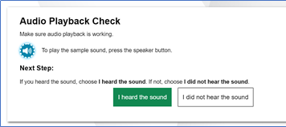
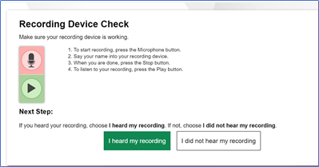
Audio Playback and Recording Device Checks
If an assessment has multimedia features, there will be audio playback and recording device checks that must be completed, before a student can start their test.
For TELPAS listening and speaking, both audio playback and recording device checks are required.
For TELPAS reading writing, audio playback device check will be required for all students. For students with STT, both audio playback and recording device checks will be required.

Slide 51
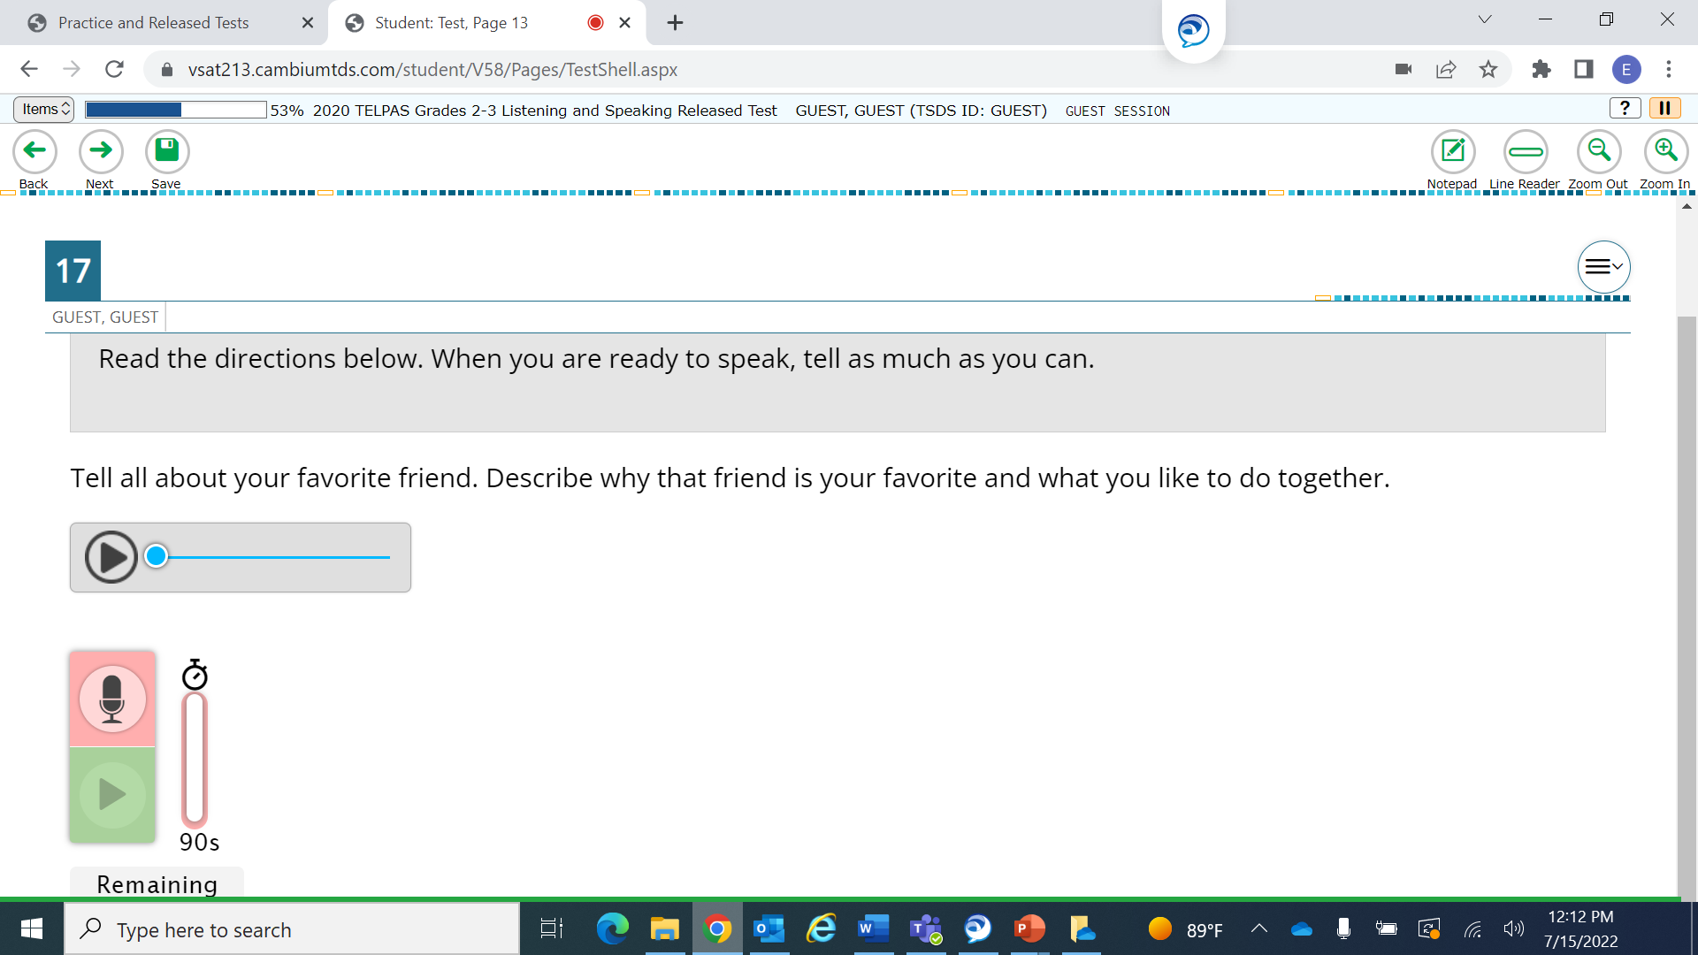
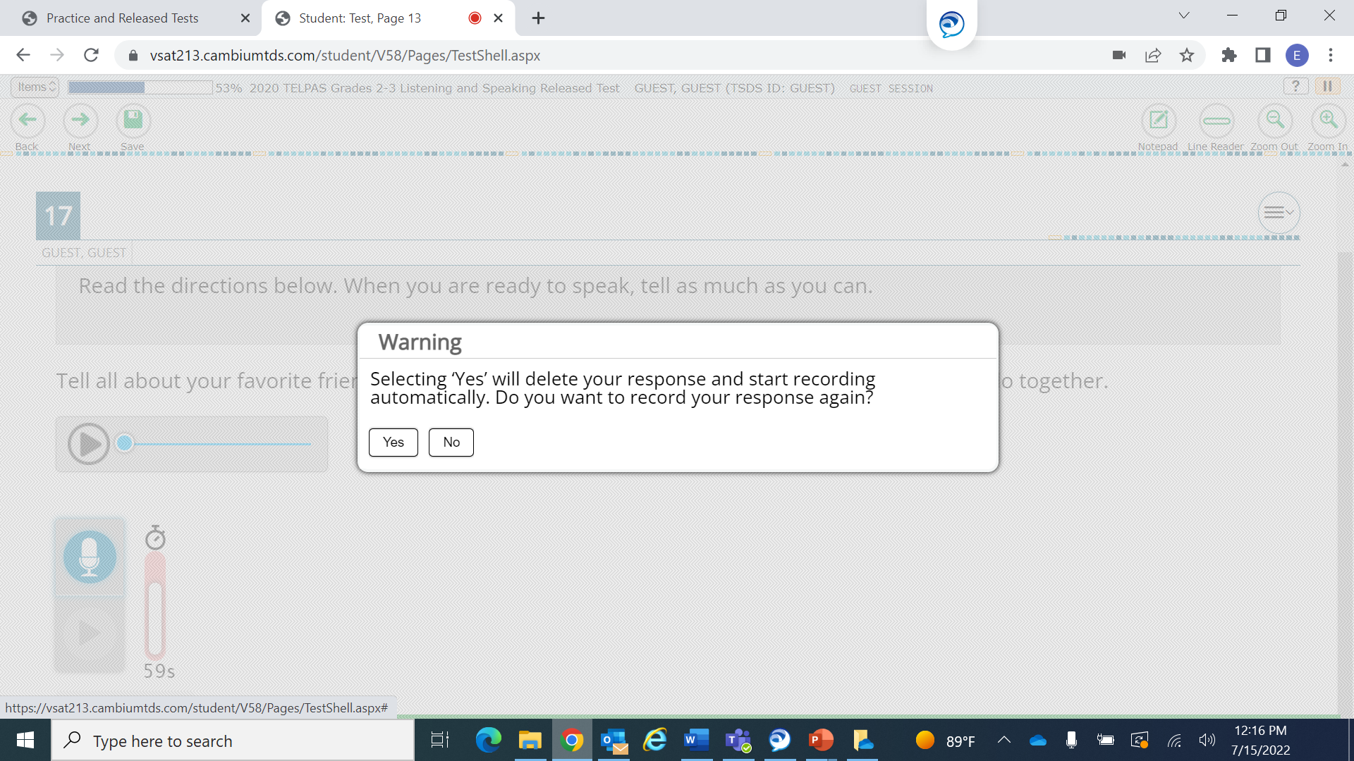
Microphone Functionality

Slide 52
TELPAS Schedules and Administrations
NEW
Based on stakeholder feedback, we will be aligning our scheduling policy for TELPAS with our scheduling policy for STAAR.
TELPAS assessments should be administered on separate days to allow students sufficient time and opportunity to do their best work (unless there is an extenuating circumstance towards the end of the test administration window).

Slide 53
TELPAS Test Session Time Limit
NEW
There is a maximum allowable testing time of seven hours for the Texas English Language Proficiency Assessment System (TELPAS) assessment.
Students are expected to complete the TELPAS assessment in about three hours; students who are still testing after four hours should be consolidated into a general testing area to continue testing.
Students must complete the assessment within the same school day, and no test session may exceed seven hours. Exceptions exist for eligible students who have an approved Extra Day accommodation.

Slide 54
Scheduling of Online Tests
NEW
TEA recommends that districts begin testing within one hour of the start of the school day.
Districts should exercise judgment about starting a test session after lunch and for late students, as some students may not have sufficient time to complete the test before the end of the school day.

Slide 55
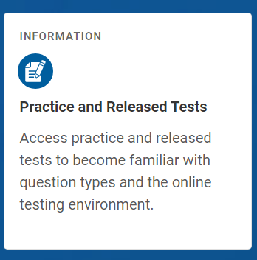
Online Practice and Released Tests
Designed to familiarize students with the online testing environment, available tools, and various types of questions.
Students may sign in with their credentials to practice with their current test attributes, such as a student who is approved for STT. Eligibility needs to be already noted in TIDE, so the attribute is available when the student signs in for his or her practice test.
Includes STAAR redesign practice tests, STAAR released tests, TELPAS Listening and Speaking practice and released tests, and TELPAS Reading and Writing practice sets.

Slide 56
Released Spring 2023 Online Tests
NEW
TELPAS Reading and Writing Test for Grades 2, 3, 4-5, 6-7, 8-9, 10-12
TELPAS Listening and Speaking Test for Grades 2-3, 4-5, 6-8, 9-12
Available in the online testing platform
Answer Keys are available on the TELPAS Released Test Questions webpage

Slide 57
Released Spring 2023 Online Tests: Scoring Guides
TELPAS Speaking Scoring Guides and Writing Guides provide exemplar student responses to be used alongside the applicable online test.
NEW

Slide 58
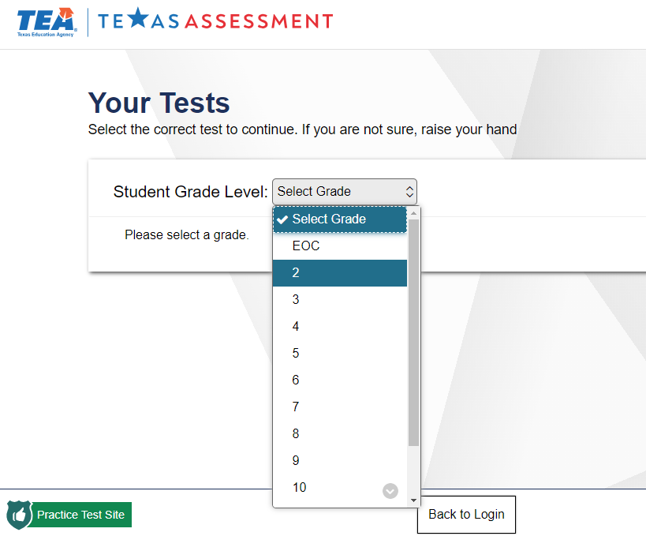
TELPAS Released and Practice Tests

Slide 59
TELPAS Key Dates for Holistic Rater Training and Administrations
TELPAS Assessment Window (Grades K-12 Listening, Speaking, Reading and Writing) | February 19 to March 29
TELPAS online training opens in LMS | January 8
Assembling and Verifying Grades 2–12 Writing Collections course available* | January 8
Online basic training courses for new K–1 and 2–12 raters* available | January 22
Calibration window opens for new and returning K-1 and 2-12* raters | February 5
Earliest eligibility date for TELPAS writing samples* | February 5
*Applicable for 2-12 raters with students with special holistic administration(s)

Slide 60
Holistic Rater Training
NEW RATERS
K–1 Raters Complete an online basic training course, which includes practice rating activities for each language domain – listening, speaking, reading, and writing.
2-12 Raters (for Special Holistic Administrations of Listening, Speaking, and/or Writing) Complete an online basic training course and practice rating activity. Training for listening and speaking includes both domains. Training for writing is only for that domain.
Both K-1 and 2-12 Raters Complete calibration activities to ensure that they are prepared to apply the PLD rubrics consistently and accurately.
RETURNING RATERS
K–1 and 2-12 Raters Raters, who have successfully completed calibration activities at least once, are highly encouraged to complete calibration before rating; however, it’s optional, unless required by campus testing coordinator.
NEW RATERS AND RETURNING RATERS
Annual test security and administration procedures training is strongly encouraged, especially for policies and procedures that have changed.
It is recommended that districts require raters to complete their training requirements by the first day of the TELPAS assessment window.
All raters must sign a test security oath.

Slide 61
Holistic Rater Training Flowchart
The Holistic Rater Training Flowchart and additional information on rater training can be found in TELPAS Rater Training section of the DCCR.
Information on holistic administrations will be posted in the Holistic Administrations section of DCCR and in the TELPAS Test Administration Information.
Online rater basic training and calibration will be in the LMS.
No changes to rater training requirements for 2023-2024

Slide 62
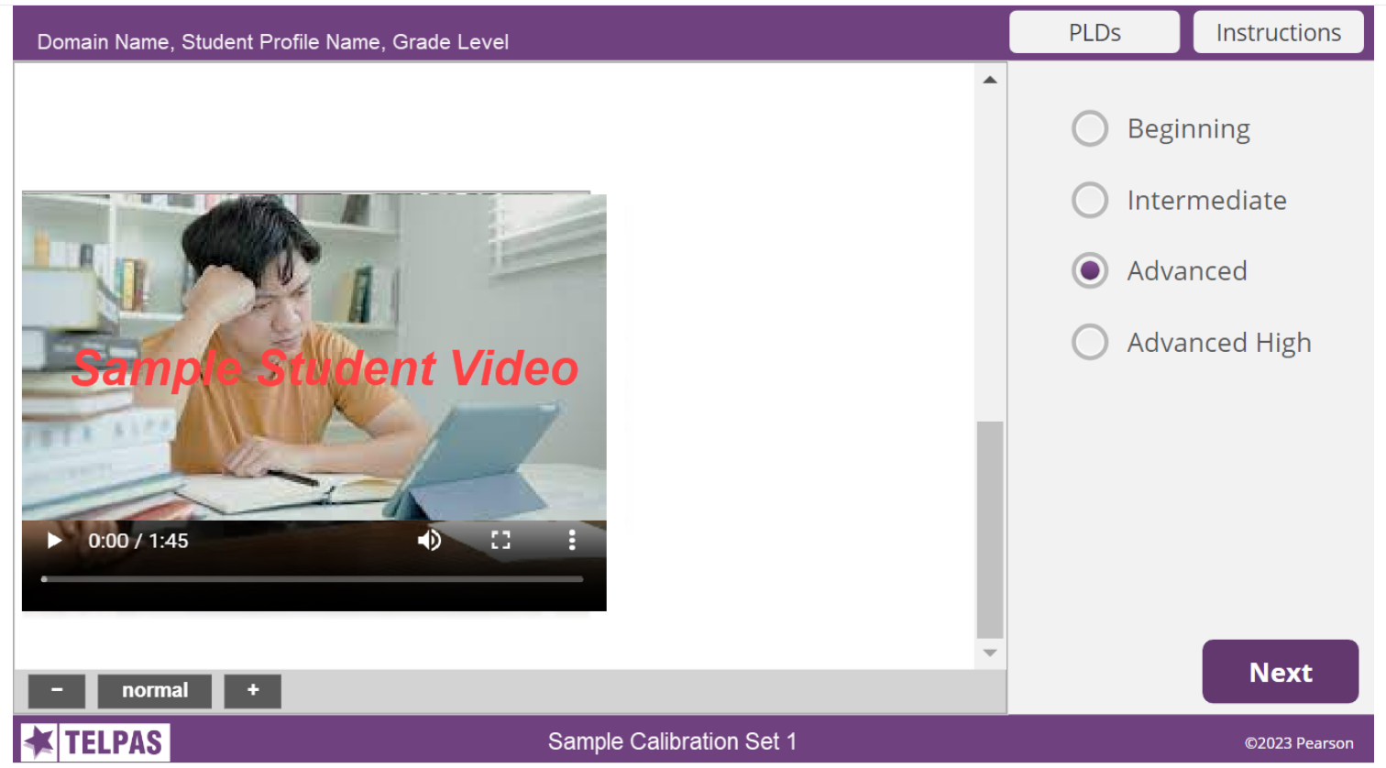
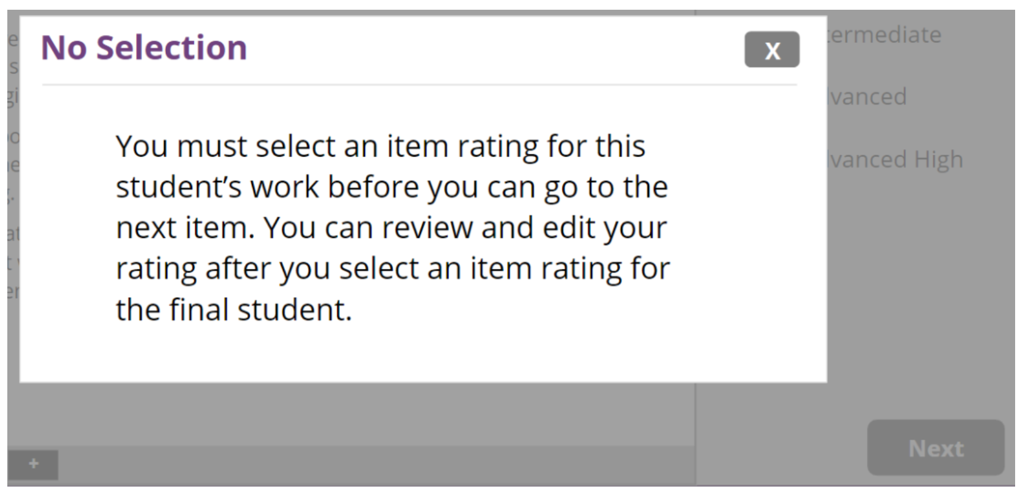
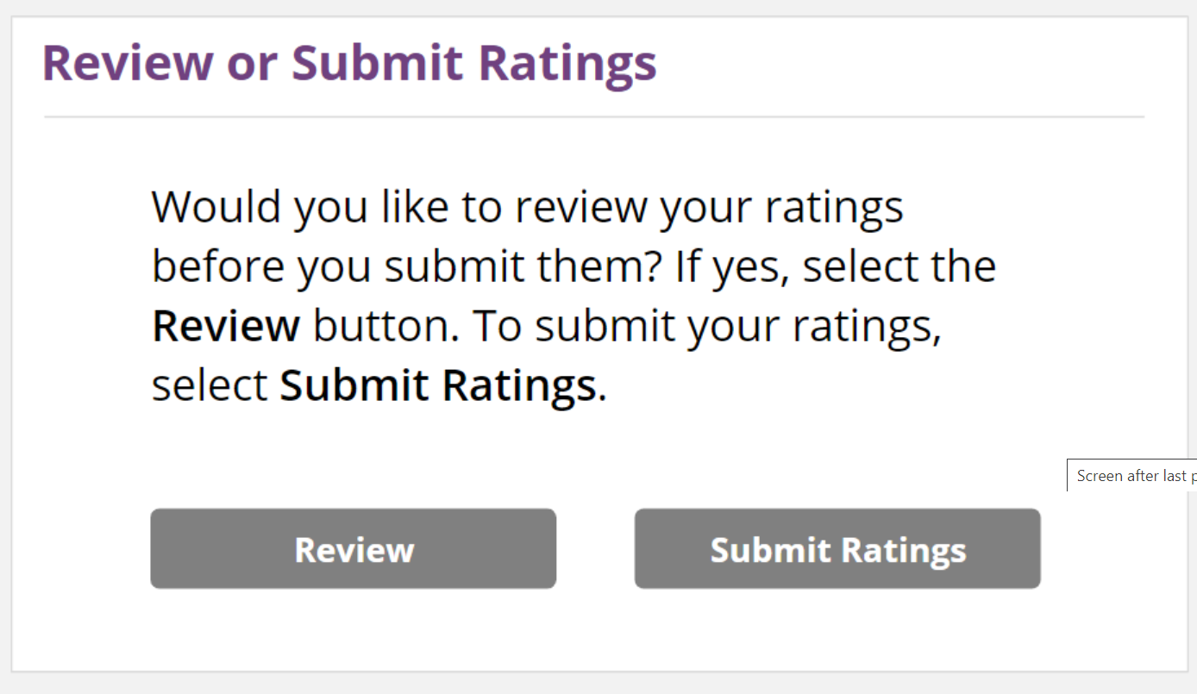
TELPAS Online Rater Training (Practice and Calibration)
After reviewing the full student profile (text and video/writing samples), the user must select a rating to move on to the next profile.
If no rating is selected, the user will get a message.
Users will be able to change a rating for a student profile BEFORE submitting his or her ratings by clicking on the Review button. Ratings cannot be changed once they are submitted.

Slide 63
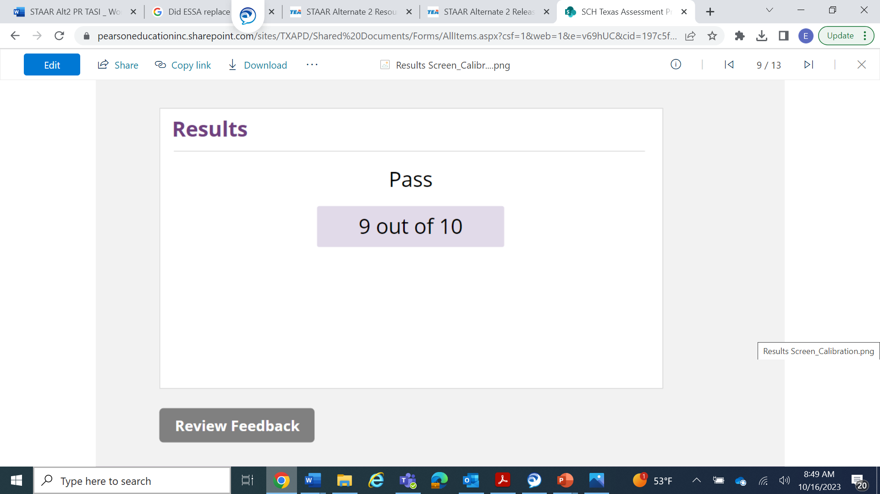
TELPAS Online Rater Training: Results Page
Online Basic Training Practice Sets
The summary page will indicate how many response were correct out of the total number of student profiles.
Users can review the feedback and/or retake the practice set. A separate window will open with feedback.
Calibration Sets
The summary page will indicate a Pass or Fail and how many responses were correct out of the total number of student profiles. The user can also review feedback.
There is not an opportunity to retake a calibration set: however, there are two calibration sets. If a user is not successful on the first set, there is another opportunity with the second set. Users should check with the calibration proctor or campus coordinator regarding second opportunity.

Slide 64
Rater information in TIDE
Rater information needs to be entered in TIDE in the Additional Student Information section. It can be uploaded in TIDE by using the Additional Student Fields data file.
TELPAS Rater A (Relationship)
TELPAS Rater B (Collaboration)

Slide 65
TELPAS Manuals
Available online only to be used in conjunction with TELPAS Rater Manual
Used for special paper admin (regular, large, and braille*) and for special holistic admin (listening, speaking, and writing)
Standalone Writing Collection Coversheet and Verification Checklist posted online (new)
Printed and shipped, as well as posted online
Based on student registration #s with 10% overage
Formula similar to STAAR, 1:15
AO window is 2/12-3/25 (test materials and up to 4/8 (labels)
Available online only
Includes the K-12 Listening PLDs, K-12 Speaking PLDs, K-1 Reading PLDs, K-1 Writing PLDs, and TELPAS Rating Roster (which also need to be used for special holistic administrations)
*TELPAS Braille Secure Test Instructions, previously called Specific Braille Instructions, were printed and shipped; one per test.

Slide 66
Students Moving Within the TELPAS Window
Students can only be actively enrolled in one district/campus in TIDE. If a student moves during the administration window, TELPAS tests (including holistic ratings) will follow the student.
Rating information or score code (if applicable) can only be entered by a user in the district/campus where the student is enrolled.
Once the receiving district has enrolled the student in TIDE, the sending district will not be able to upload the student’s rating(s) or submit a score code (if applicable) online.

Slide 67
Collaboration Between Sending and Receiving Districts
Sending districts will need to coordinate with the receiving districts in order to provide them with the rating(s), including the rater information, or score code (if applicable).
Districts can share the information using the secure file center in TIDE, as an attachment (EXCEL spreadsheet, word or PDF document, etc.).
Reminder: If an EB student enrolls in a Texas public school BEFORE February 19 (the start of the TELPAS assessment window), the receiving campus is responsible for all TELPAS assessments. If an EB student enrolls ON or AFTER February 19, the receiving campus is responsible only for the grades 2–12 online tests (if the tests were not already administered). The sending campus is responsible for the holistic components even if the ratings were not yet assigned or uploaded/entered online.

Slide 68
TELPAS Information in TIDE
Deadline is 3/29 at 11:59 p.m. (CT).
Score codes and student demographic information must be submitted in TIDE.
Holistic ratings must be uploaded and processed in TIDE using the Holistic Ratings Upload File Format.

Slide 69
TELPAS Score Codes in TIDE
Score Codes for Online Tests
X | ARD-decision | An ARD committee, in conjunction with an LPAC, determined that a student should not be assessed in one more language domains due to a disability.
A | Absent | A student was absent each time he or she was scheduled to test or absent throughout the entire testing window.
O | Other | Examples for this score code include a student did not complete test due to illness or a test administration irregularity.
Score Codes for Holistic Assessments
X | ARD-decision | An ARD committee, in conjunction with an LPAC, determined that a student should not be assessed in one more language domains due to a disability.
E | Extenuating Circumstances | An eligible student cannot be rated in the specified domain due to extenuating circumstances. Due to the 6-week testing window, this should be rarely used.
The score codes available in TIDE are by assessment program. It is important to know which TELPAS score codes apply to online tests, and which score codes apply to holistic assessments.

Slide 70
TELPAS and DEI Entries
DEI entries for TELPAS include student responses for paper tests (regular print, large print, and braille).
If the reading test does not appear in DEI for an eligible student, verification will need to be made that the correct test mode is noted accurately in TIDE.
DEI entries must be processed by March 29th, 11:59 p.m. (CT)

Slide 71
Years in U.S. Schools
The calculation for years in U.S. schools is calculated based on consecutive calendar days.
The Instructions for Years in U.S. Schools Data Collection document is posted on the Assessments for Special Populations webpage.
For TELPAS, years in U.S. schools starts at 1st grade. For kindergarten students, the Years in U.S. Schools field is left blank.
The Student History Worksheet will now be included as part of the document.
NEW

Slide 72
Combined Years in U.S. Schools and Student History Worksheet

Slide 73
TELPAS and TELPAS Alternate Educator Guide
NEW
The TELPAS and TELPAS Alternate Educator Guide will be split for both assessment programs.
There will be a separate guide for TELPAS and one for TELPAS Alternate.
Coming soon

Slide 74
Scoring of TELPAS Speaking Responses Guide
The Scoring of TELPAS Speaking Responses Guide is available on the TELPAS Resources webpage.
The guide is an overview explaining how student speaking responses are scored by Pearson.
It also includes information on requests for rescoring speaking responses which can be made during the rescore request window noted on the Calendar of Events.
The guide is a resource for educators, administrators, and parents.

Slide 75
TELPAS Resources
Resource | Purpose | Audience
TELPAS and TELPAS Alternate Educator Guide | Provides an overview of TELPAS and TELPAS Alternate and serves to support effective implementation of the Texas English Language Proficiency Standards (ELPS) and PLDs to guide instruction. (A standalone TELPAS Educator Guide is coming soon.) | Administrators, Coordinators, Educators
TELPAS Training PowerPoints | Provide introductory training resources for educators, raters, and administrators/coordinators to use to build foundational knowledge of TELPAS | Administrators, Coordinators, Educators
TELPAS Manuals: Rater, Test Administrator, and Test Administration Information | Provides policies and guidance for raters, test administrators, and TELPAS special administrations (holistic and paper). Manuals and supplement materials are updated annually. | Administrators, Coordinators, Educators, Test Administrators
TELPAS Listening, Speaking, Reading, and Writing Blueprints | Provides districts with the test blueprints (listening, speaking, reading, and writing) including reporting categories | Administrators, Coordinators, Educators

Slide 76
TELPAS Resources (cont.)
Resource | Purpose | Audience
TELPAS 2-12 Speaking Rubrics | Derived from the TELPAS proficiency level descriptors (PLDs) and demonstrates the number of score points that a student can achieve based on their performance on each speaking test item | Administrators, Coordinators, Educators
TELPAS 2-12 Writing Rubrics | Derived from the TELPAS PLDs and demonstrates the number of score points that a student can achieve based on their performance on each writing test item. | Administrators, Coordinators, Educators, Parents
TELPAS 2-12 Speaking Scoring Guides | Provide exemplar student responses for the TELPAS online speaking assessment. It is intended to be used alongside the spring 2020 TELPAS listening and speaking released test. | Administrators, Coordinators, Educators, Parents
TELPAS 2-12 Writing Scoring Guides | Provide exemplar student responses and annotations based on score points that students can achieve on the writing constructed response type items. | Administrators, Coordinators, Educators, Parents

Slide 77
TELPAS Resources (cont.)
Resource | Purpose | Audience
Released TELPAS Listening and Speaking & TELPAS Reading and Writing Tests | Available in the online interface and can be used to administer to students for diagnostic purposes | Administrators, Coordinators, Educators, Parents, Students
Answer Keys for TELPAS Released Tests | Provides answers to released tests, reporting category per item, and ELPS student expectation per item. In addition, there are speaking and writing scoring guides that align with released tests. | Administrators, Coordinators, Educators, Parents, Students
TELPAS Practice Sets/Tests | Assists students to become familiar with online TELPAS tests (navigating through tests, online tools, and interaction with listening and speaking test items, including recording and playing speaking responses and entering writing responses) | Administrators, Coordinators, Educators, Parents, Students
Scoring Process for TELPAS Speaking Responses | Provides information on the 5-step process for scoring TELPAS speaking responses (includes information on reliability and validity components and rescoring information) | Administrators, Coordinators, Educators, Parents

Slide 78
TELPAS Alternate

Slide 79
TELPAS Alternate Updates
There are no changes to the actual TELPAS Alternate assessment.
The TELPAS Alternate administration window is February 19th to March 29th.

Slide 80
TELPAS Alternate Key Dates for 2023-2024
Due Date for Adding All Students in TIDE | By 11/30/23
Due Date for Districts to Indicate TELPAS Alternate Participation in TIDE | By 11/30/23
Districts Receive Initial Order of Paper Test Materials (Observable Behaviors) | 1/22/24—1/26/24
Assessment Window | 2/19/24—3/29/24
Submit Score Codes in TIDE and Submit Student Responses (Observable Behavior rattings) in DEI; (this means entered/submitted and processed by that date and time) | 3/29/24 11:59 p.m. (CT)

Slide 81
What Is TELPAS Alternate?
A holistic inventory that assesses the language domains of listening, speaking, reading, and writing for students with the most significant cognitive disabilities in grades 2–12
Aligned to the Texas English Language Proficiency Standards (ELPS)
Based on alternate Proficiency Level Descriptors (PLDs) created to address the specific access needs of this population

Slide 82
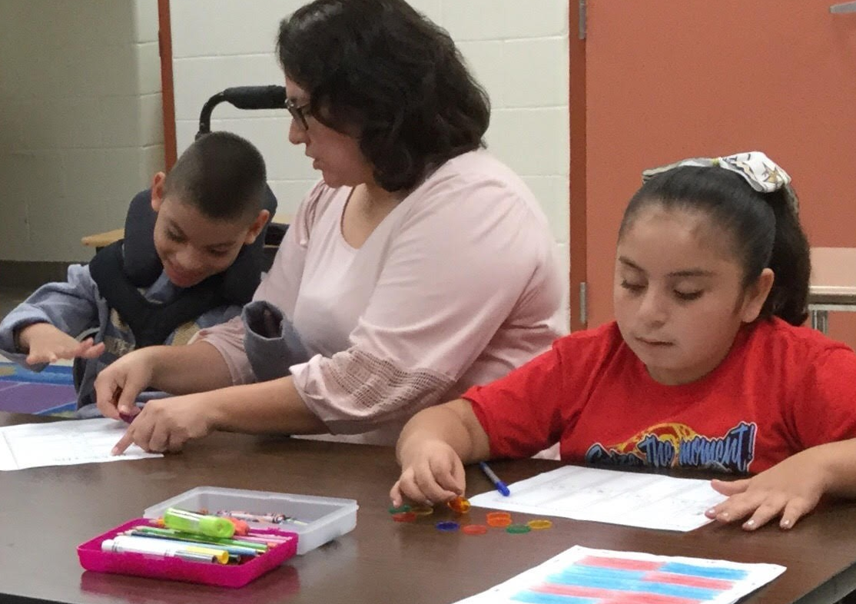
Who Takes TELPAS Alternate?
Students Eligible for TELPAS Alternate
Are EB students in grades 2–12 who have the most significant cognitive disabilities and who are in the process of acquiring English proficiency in listening, speaking, reading, and writing.
Have one or more disabilities that significantly limit their intellectual functioning, as shown by their ability to plan, comprehend, and reason, and their adaptive behavior, as shown by their ability to apply social and practical skills.
Please note: Unlike TELPAS, there are no domain-specific exemptions for TELPAS Alternate. Students must be assessed in all 4 language domains.

Slide 83
Who Is Assessed with TELPAS Alternate?
Grades K–1 | No TELPAS Alternate for K–1. All EB students, including students receiving special education services, will take TELPAS K–1 holistically rated assessment for all four language domains.
Grade 2 | Participation requirements are available on TEA’s TELPAS Alternate Resources webpage. ARD committees, in conjunction with the LPAC, are required to review the participation requirements and determine and document student eligibility for TELPAS Alternate.
Grades 3–12 | Participation requirements are available on TEA’s TELPAS Alternate Resources webpage. ARD committees, in conjunction with the LPAC, are required to determine and document student eligibility for TELPAS Alternate. If the student is EB/EL and is eligible for STAAR Alternate 2, he or she will take TELPAS Alternate.

Slide 84
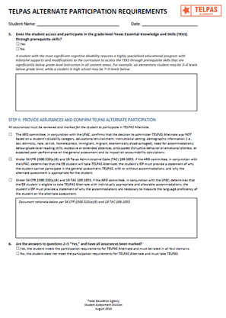
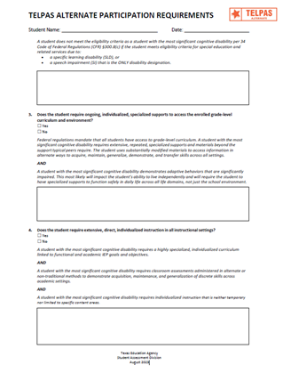
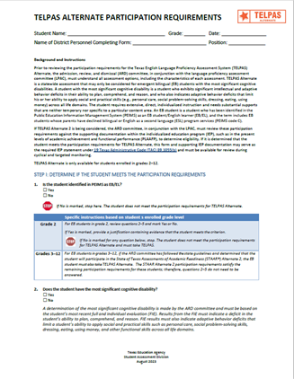
Updated TELPAS Alternate Participation Requirements
The TELPAS Alternate Participation Requirements (for grades 2–12 have been updated and are available on TEA’s TELPAS Alternate Resources webpage.
Participation requirements are intended to guide the ARD committee, in conjunction with the LPAC, when determining the appropriate English language proficiency assessment to administer to EB students.
Documentation of eligibility is different for students in grade 2 compared to students in grades 3–12.
For student in grades 3–12, the LPAC will answer question 1: “Is the student identified in PEIMS as EB/EL?”, initial the assurances in Step II, and answer "Yes" in question 6.

Slide 85
TELPAS Alternate Participation Requirements: Question 6 for Grades 3-12
For grades 3-12, if the student has met the updated STAAR Alternate 2 participation requirements,
all the assurances should be marked, and
the response should be “Yes” to Question #6.

Slide 86
Alternate Proficiency Level Descriptors (PLDs)
The Alternate PLDs are domain-specific and define how well EB students at the five proficiency levels are able to understand and use English in social and academic settings.
The descriptors show the progression of second language acquisition from one proficiency level to the next and serve as a road map to help teachers tailor instruction to the linguistic needs of EB students.

Slide 87
What Are Observable Behaviors?
The “questions” are called Observable Behaviors. Each Observable Behavior describes characteristics that students learning English demonstrate as they gain proficiency.
Test administrators, based on their knowledge of a student’s English language skills over a period of time, will make holistic judgments across all four domains of English language proficiency (listening, speaking, reading, writing) using alternate ELPS-aligned observable behaviors.

Slide 88
Observable Behaviors: Notes Version
Starting in the 2023-2024 school year, the “notes version” of the Observable Behaviors will no longer be available on the TELPAS Alternate Resources web page.

Slide 89
TELPAS Alternate Observable Behaviors (Electronic Version)
The electronic version of the TELPAS Alternate Observable Behaviors will no longer be available.

Slide 90
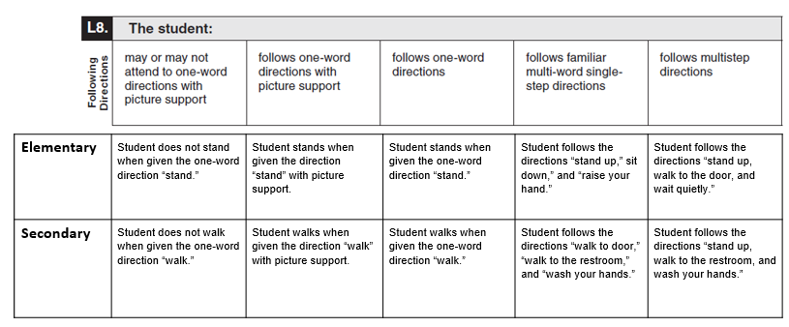
Observable Behaviors with Classroom Examples
Texas teachers developed classroom examples to help test administrators better understand the descriptions of student performance for each Observable Behavior.
Elementary and secondary examples describe one way that students could demonstrate each skill across the five levels of proficiency.
An accessible version of the Observable Behaviors and classroom examples can be found on TEA’s TELPAS Alternate Resources webpage.

Slide 91
Using the Classroom Examples
The purpose of each example is to illustrate how a student could demonstrate the skill at each proficiency level.
There are many other classroom activities that could be used as examples for the Observable Behaviors.
These examples are not intended to be used as test questions or performance tasks for teachers to replicate, although using them for this purpose is acceptable if needed.
Teachers are encouraged to use their own activities in the regular classroom setting when determining a student’s ability to understand and use English.

Slide 92
TELPAS Alternate Administration Training
As with TELPAS administration training, testing personnel are required to receive training at least once in test security and administration procedures and are responsible for complying with state assessment requirements.
In addition, testing personnel must receive training at least once in testing policies and procedures specific to each administration and, if applicable, training related to security protocols for authorized viewing of state assessments.

Slide 93
TELPAS Alternate Training
There are two training options.
OPTION 1:
TELPAS Alternate Training Courses in LMS
Part 1 includes 4 modules (one per language domain)
Part 2 includes 4 modules (Introduction, Eligibility, Accessibility, and Test Administration)
Educators will get CPE hours once both parts are completed.
OPTION 2:
A series of training PowerPoints is also available on TEA’s TELPAS Alternate Resources webpage.
There are domain-specific PPTs, eligibility requirements, and test administration info.
Each PPT can be reviewed by in about 10–15 minutes.
However, CPE hours are not earned for reviewing PPTs.
While training is not required, TEA highly recommends that test administrators rating students, especially if there are new test administrators or have never administered TELPAS Alternate. There is no calibration for TELPAS Alternate test administrators.

Slide 94
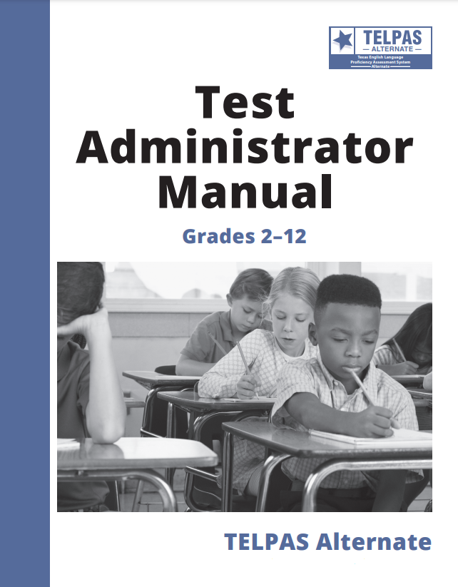
TELPAS Alternate Test Administrator Manual
Manuals
available online only
not shipped to districts
Observable Behaviors shipped to districts
Based on registration counts + 10% overage
Observable Behaviors will be packed in 3’s
Districts are not able to place additional order
Observable Behaviors PDF available online for printing

Slide 95
TELPAS Alternate Ratings in DEI
TELPAS Alternate ratings are processed in DEI by 3/29, 11:59 p.m. (CT).
If a student’s test is not available in DEI to enter ratings, verify that Emergent Bilingual Indicator has been marked with “1” and the Alternate Student Flag for TELPAS Alternate has been marked with “Yes” for the student.
Ratings for all 40 Observable Behaviors (10 per each language domain) must be entered in DEI in order for the ratings to be submitted.

Slide 96
TELPAS Alternate Score Codes in TIDE
Score Codes for TELPAS Alternate
E | Extenuating Circumstances | An eligible student cannot be rated in all 40 Observable Behaviors due to extenuating circumstances. | Due to the 6-week testing window, this score code should be rarely used as teachers must provide multiple opportunities throughout the assessment window for students to demonstrate their ELP.
M | Medical Exception (ME) | The ARD Committee, in conjunction with the LPAC, has determined that the student has met eligibility criteria for ME or for NAAR and will not participate in TELPAS Alternate. | These decisions should have been made prior to attempting to administer the assessment and requires documentation in the student’s individualized education program.
N | No Authentic Academic Response (NAAR) | Examples for this score code include a student did not complete test due to illness or a test administration irregularity.
The deadline for entering score codes and student demographic information in TIDE is 3/29, 11:59 p.m. (CT).

Slide 97
TELPAS Alternate Resources
Resource | Purpose | Audience
TELPAS and TELPAS Alternate Educator Guide | Provides an overview of TELPAS and TELPAS Alternate and serves to support effective implementation of the ELPS. (A standalone TELPAS Alternate Educator Guide is coming soon.) | Administrators, Coordinators, Teachers
Updated Participation Requirements | Used by ARD committees, in conjunction with the LPAC, to make eligibility/participation decisions about TELPAS Alternate participation. The participation requirements have been updated for the 2023-2024 school year. | Members of ARD committees and LPACs
Observable Behaviors (Classroom Examples) | Provide elementary and secondary classroom examples to help test administrators better understand the descriptions of student performance for each Observable Behavior. | Educators

Slide 98
TELPAS Alternate Resources (cont.)
Resource | Purpose | Audience
Test Administration Manual | Contains instructions covering the responsibilities of test administrators and the observable behaviors used to assess students Required to be read carefully and followed as written Will include a fillable version of the TELPAS Alternate Observable Behaviors | Administrators, Coordinators, Teachers serving as test administrators
TELPAS Alternate Training Modules | Provides training on a variety of topics, including authentic classroom activities for each domain that explain how to rate students with the observable behaviors Includes two parts; both parts must be completed in order to receive continuing professional education (CPE) hours | Administrators, Coordinators, Teachers serving as test administrators
Training PowerPoints | Provides training on a variety of topics, including authentic classroom activities for each domain that explain how to rate students with the observable behaviors Are optional though highly recommended | Administrators, Coordinators, Teachers serving as test administrators
Parent Brochure | Communicates (English and Spanish) basic information about TELPAS Alternate. This information is now on Texas Assessment webpage. | Parents

Slide 99
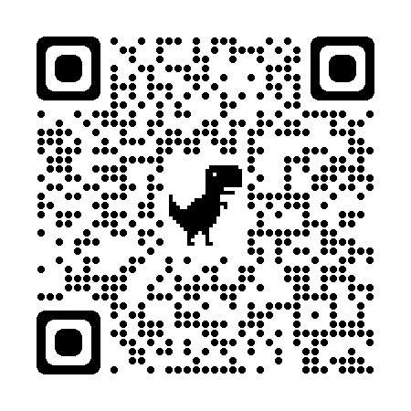
Please register for one of our committees on the Texas Assessment Learning Management System!
Classroom teachers, instructional coaches, campus and district content specialists, and campus administrators can serve in a variety of ways:
Educator item review – each potential question for a state test is reviewed and approved by a committee of Texas educators
Constructed response range-finding – educators are convened to set the scoring boundaries for student essays based on the rubric
Subject-area advisory groups – groups of educators are convened to provide feedback on subject-area-specific topics
Standard-setting – groups of educators are convened to establish cut scores that define the performance levels
Use the QR code or visit the Texas Educator Committees page to register for committee.

Slide 100
Contact Information
Help Desk: Helpdesk.tea.texas.gov
Student Assessment Division: (512) 463-9536
Information on State Assessments for Special Populations: Assessments for Special Populations webpage

Slide 101
Disclaimer
These slides have been prepared by the Student Assessment Division of the Texas Education Agency. You are welcome to use them for local training.
If any of the slides are changed for local use, please remove any TEA logos, headers, or footers. (You may need to edit the Master slide.)
This training is not intended to replace any materials or additional information on the TEA website.

Slide 102
Questions

