Slide 1
2023-2024 Accessibility TASI

Slide 2
Accommodation Policy

Slide 3
2023-2024 Accommodations Agenda
Accommodation Updates and Reminders
Accommodations Overview
Online and Paper Practice
Accommodation Request Forms
Roll Call and Questions
TDS Enhancements

Slide 4
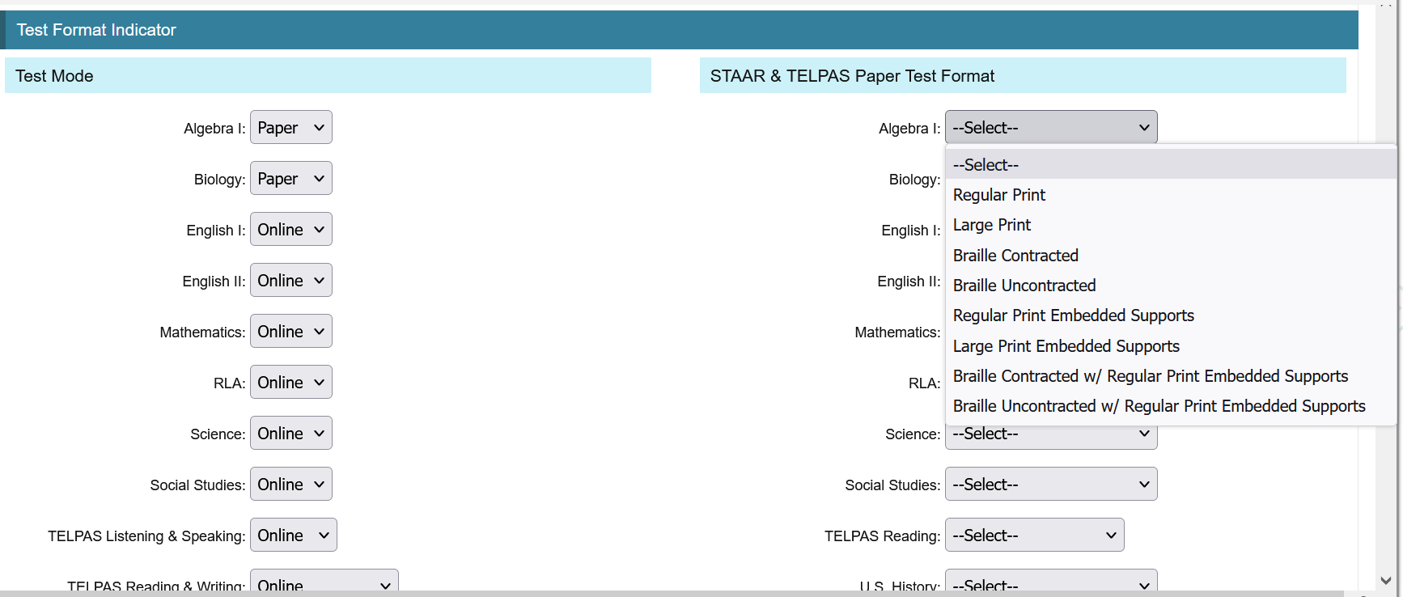
2023–2024 Accommodation Updates
NEW
Ordering Braille Materials in TIDE

Slide 5
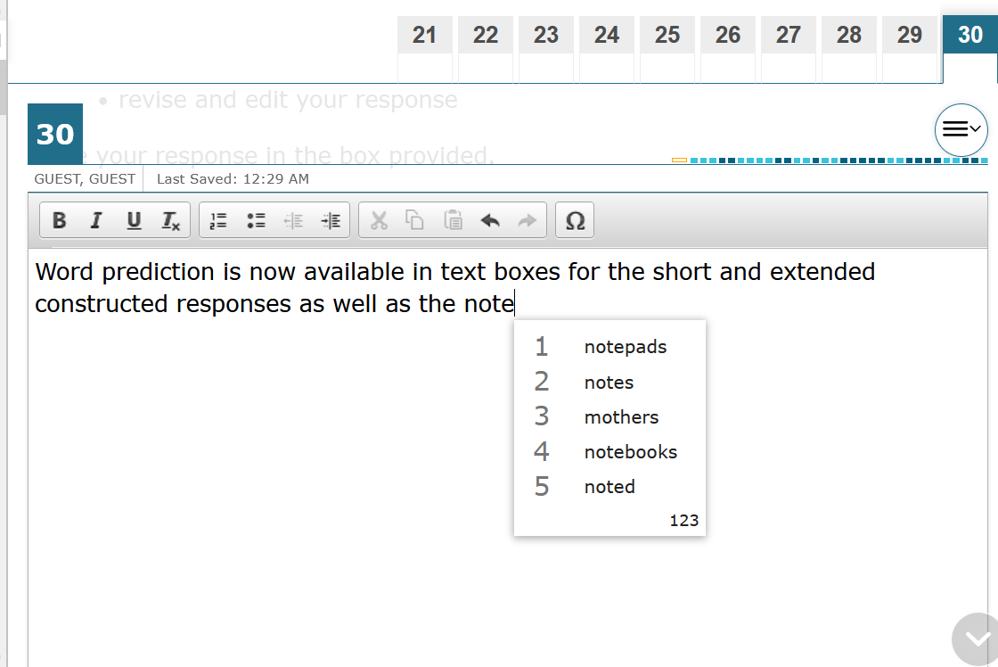
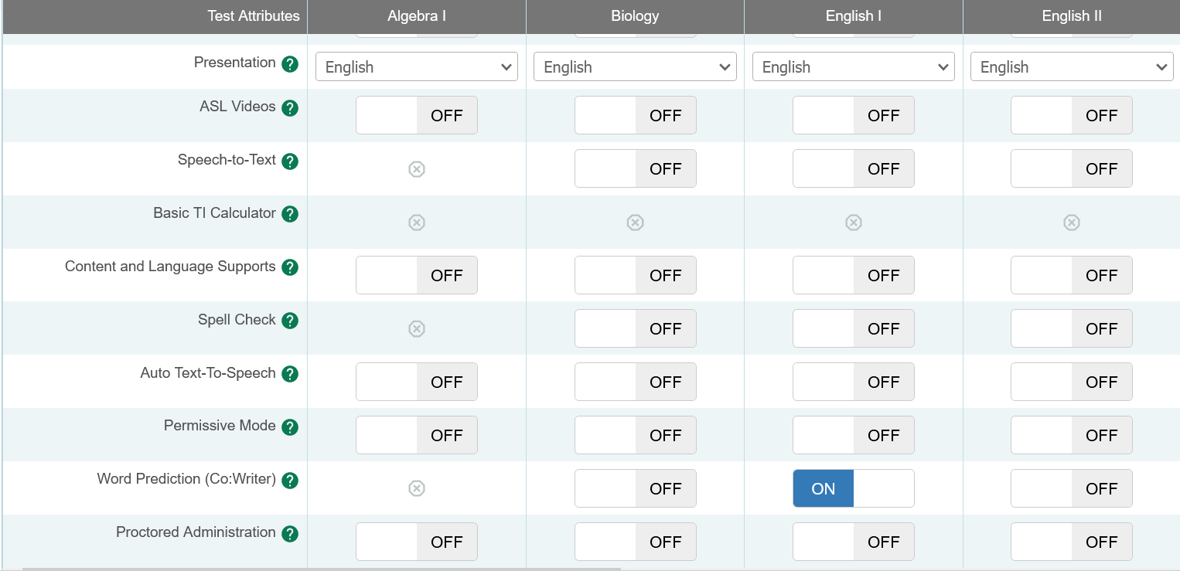
2023–2024 Accommodation Update
NEW
Word Prediction (Co:Writer) now an embedded tool in TDS
For students eligible for word prediction under Spelling Assistance policy
Students may still use a separate device or permissive mode to access word prediction software instead if that is what they are most comfortable with. (Technology guidelines must be followed.)

Slide 6
2023–2024 Accommodation Update
NEW
DCCR Accessibility Table Updates
Layout for Readability
Additional Non-Examples
Language specifying trained administrators required

Slide 7
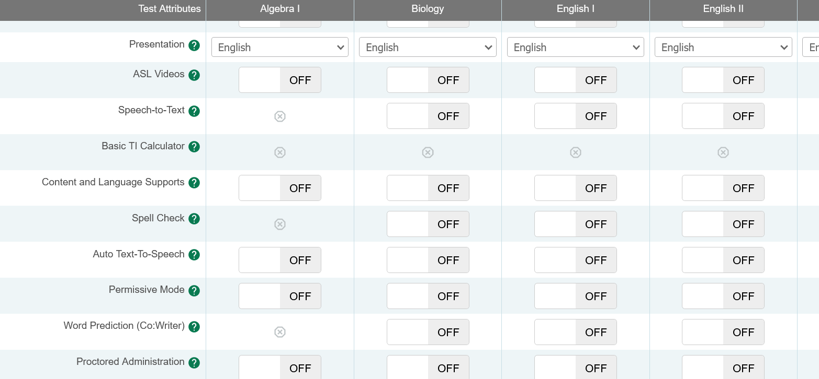
2023–2024 Accommodation Update
NEW
In TIDE, Spell Check is now specifically listed.

Slide 8
House Bill 1225: Paper by Request
NEW
House Bill (HB) 1225 allows districts to provide paper administrations of STAAR to any student whose parent, guardian, or teacher requests it.
Students' responses for all paper administrations must be processed in DEI by 11:59 p.m. (CT) on the last day of each testing window.
The 3% paper by request numbers do not include the students who meet the criteria for a special paper administration.
There are no changes to the special administration of an online assessment request process from last year.

Slide 9
2023–2024 Accommodation Update
NEW
Starting this spring, blank graphic organizers (paper versions only) will be allowed for both online TELPAS tests (listening and speaking and reading and writing).
A student will have to meet the eligibility criteria and the appropriate committee must make the decision, as noted on the Supplemental Aids policy document.

Slide 10
2023–2024 Accommodation Reminder
Reading Assistance for STAAR Grade 3 Math
Students who require reading assistance for the STAAR grade 3 online math administration must have Text-to-Speech (TTS) enabled to receive this support.
Test administrators should NOT be providing this support by reading test content from the screen.
Prior to the administration, campuses should identify students who regularly request this support during classroom instruction, so TTS can be enabled in advance of testing and the student can become familiar with using this support online.
If a student requests this support during testing, the test will need to paused, TTS enabled, and then the student may resume testing. TTS can stay enabled for the remainder of the test.
Note: For students participating in a STAAR paper administration, the test administrator trained
in oral administration will provide this support.

Slide 11
2023–2024 Accommodation Reminder
Reading Assistance for STAAR Grade 3 Math, cont.
Question: How can the TA support students who have TTS enabled the day of or during the test?
Answer: The TA may use the chart provided in the appendix A of the STAAR test administrator manual. If a student is having trouble locating the tool, the TA may point to the proper icon in the ICON column below. If a student asks how a tool or button functions, the test administrator may read aloud the information in the TEXT column. The information in this column may be read verbatim, paraphrased, or clarified as needed. No additional prompting, demonstration, or explanation may be provided.

Slide 12
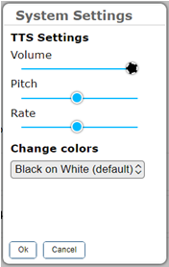
TDS Enhancements—Color Choice Update
NEW
Color Choice has moved to inside the student interface
Students can control color without having to pause and log out.

Slide 13
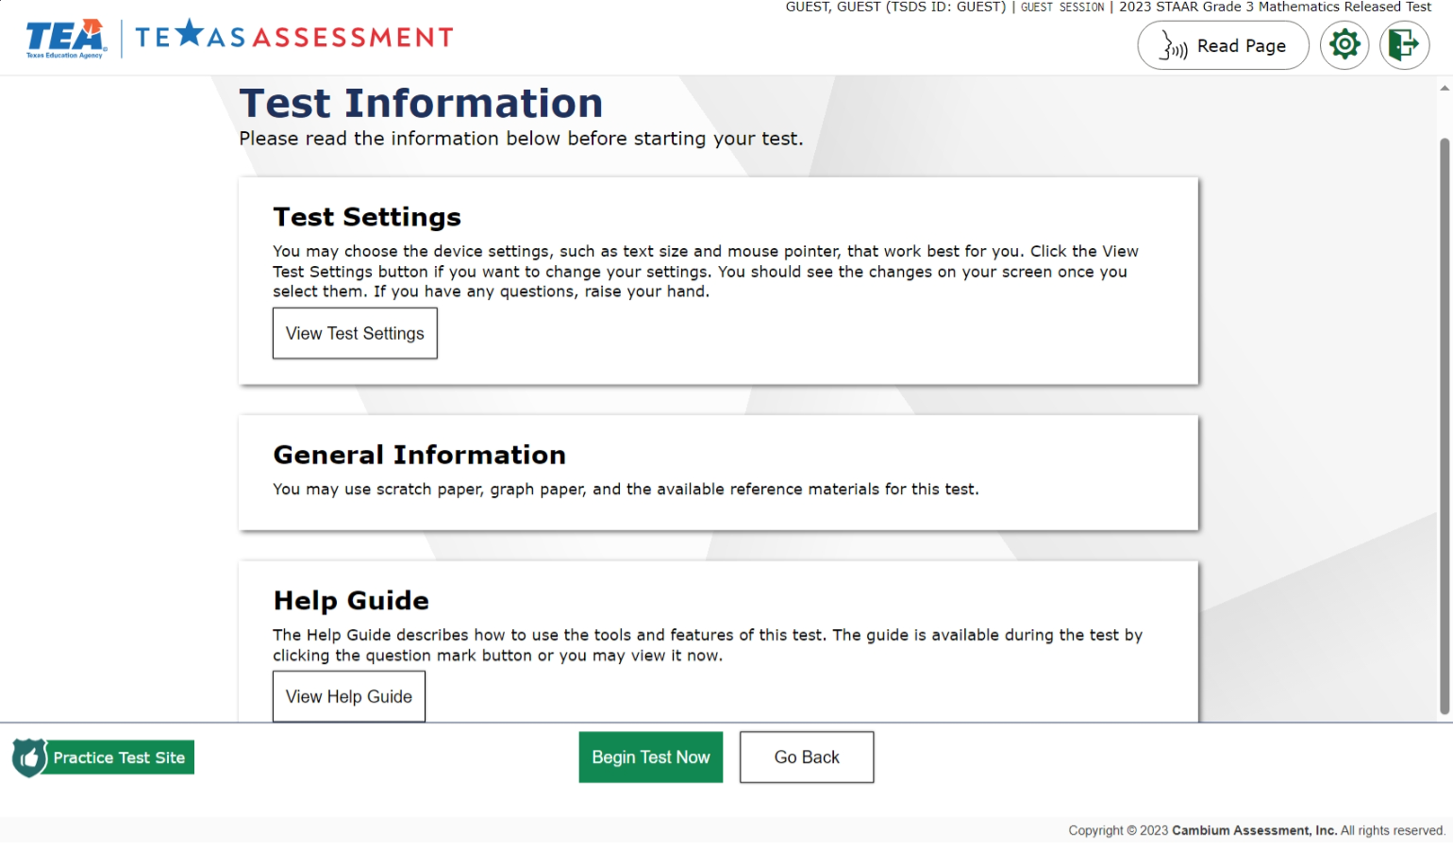
TDS Enhancements—Text-to-Speech: Update
NEW
Pre-test instruction pages can now be read to students who have TTS.

Slide 14
What Are “Accommodations” in Assessment?
Accommodations ensure that each student can interact appropriately with the content, presentation, and response mode of the test.
Assessments should allow ALL test takers to demonstrate their knowledge of the content being tested without the format of the assessment, non-tested language, or the type of response needed to answer the questions serving as barriers to their success.
Accommodations Policy
STAAR
TELPAS
STAAR (Spanish)

Slide 15
Who Do Accommodation Considerations Help?
Accommodation considerations may benefit any student who:
routinely and effectively uses the support during classroom instruction and testing
is served by a 504 committee
is served by an ARD committee
requires the use of an accessibility feature or designated support in an unexpected or emergency situation
is served by an LPAC committee

Slide 16
What Do “Accommodations” Look Like in Assessments?
Accessibility features: available for any student that needs it, no documentation required
Locally-Approved Designated supports: available only to students who meet specific eligibility criteria. The decision should be aimed at addressing a student’s consistent academic struggle in a specific area even after intensive instruction and remediation.
Designated supports that require TEA approval: Complex Transcribing, Extra Day, Math Scribe, and Other
Designated Support | Program
 | STAAR | STAAR Spanish | TELPAS
Basic Transcribing | X | X | X
Braille /Refreshable Braille | X
Calculation Aids | X | X
Content and Language Supports | X | X
Individualized Structured Reminders | X | X | X
Large Print | X | X | X
Manipulating Test Materials | X | X | X
Mathematics Manipulatives | X | X
Oral/Signed Administration | X | X
Spelling Assistance | X | X
Supplemental Aids | X | X | X
Complex Transcribing | X | X | X
Extra Day | X | X | X
Mathematics Scribe | X | X
Other | X | X | X

Slide 17
Student Eligibility Criteria At-A-Glance
ALL designated supports require that students routinely and effectively use them during instruction and classroom assessments.
Some designated supports have additional eligibility requirements that must be met. Policy documents outline what these circumstances are and who at the local level has the authority to approve the accommodation.
 | Routinely and effectively uses the support in classroom instruction and testing | Requires additional eligibility criteria (see policy document)
Basic Transcribing | X | X
Braille/Refreshable Braille | X
Calculation Aids | X | X
Content and Language Supports | X | X
Individualized Structured Reminders | X
Large Print | X | X
Manipulating Test Materials | X
Mathematics Manipulatives | X
Oral/Signed Administration | X | X
Spelling Assistance | X | X
Supplemental Aids | X

Slide 18
Available Accommodations by Academic Committee
RTI, Student Assistance Team, or other related support (struggling learners)
Basic Transcribing Braille Individualized Structured Reminders Manipulating Test Materials Mathematics Manipulatives Oral/Signed Administration Supplemental Aids
Section 504 Committee (students with other health impairments, dyslexia)
Basic Transcribing Braille Calculation Aids Content and Language Supports Individualized Structured Reminders Large Print Manipulating Test Materials Mathematics Manipulatives Oral/Signed Administration Spelling Assistance Supplemental Aids
Admission, Review, and Dismissal (ARD) Committee (special education students)
Basic Transcribing Braille Calculation Aids Content and Language Supports Individualized Structured Reminders Large Print Manipulating Test Materials Mathematics Manipulatives Oral/Signed Administration Spelling Assistance Supplemental Aids
Language Proficiency Assessment Committee (LPAC) (EB students)
Content and Language Supports Oral/Signed Administration

Slide 19
2023–2024 Accommodations
Assessments eligible for special paper or holistic administration of an online assessment:
Test Format | Paper Administration | Holistic Administration
STAAR grades 3-8 and EOC regular print and large print | X
STAAR Spanish grades 3-5 regular print and large print | X
STAAR with Embedded Supports grades 3-8 and EOC regular print, large print, and braille (contracted and uncontracted) | X
STAAR grades 3-8 and EOC braille (contracted and uncontracted) | X
TELPAS reading grades 2-12 regular print and large print | X
TELPAS reading grades 2-12 braille (contracted and uncontracted) | X
TELPAS writing grades 2-12 |  | X
TELPAS listening and speaking |  | X

Slide 20
2023–2024 Accommodations
Paper orders for online assessment: Unique Scenarios
Juvenile Justice Alternative Education
Homebound Student Without Internet
Emergency Medical Situations
Contact:
Texas Testing Support at 833-601-8821

Slide 21
Requirements for Local Decision-Making Authorities
Annual Review and Dismissal (ARD) Committee
The responsibilities of the ARD committee do not change simply because the state assessment accommodation policy has changed. The purpose of an IEP is to document current and correct information. Any part of that document that is no longer true and valid should be updated.
The ARD committee does not have to meet again regarding state assessment accommodations if decisions made at the annual meeting still apply to the current school year.
The ARD committee would need to meet again regarding state assessment accommodations if decisions made at the annual meeting do not apply to the current school year.

Slide 22
Requirements for Local Decision-Making Authorities
Section 504
Committee
Section 504 committee should ensure that a student's accommodation plan is current for the school year.
If the documented designated supports in place for the student are still valid, there is no reason to meet again.
If the documented designated supports in place for the student are not valid, this should be corrected.

Slide 23
Requirements for Local Decision-Making Authorities
Response to Intervention (RtI) and Similar Student Support Teams
Depending on local policies for these committees (i.e., what time of year they meet):
If the documented designated supports in place for the student are still valid, there is no reason to meet again.
If the documented designated supports in place for the student are not valid, this should be corrected.

Slide 24
Requirements for Local Decision-Making Authorities
Language Proficiency Assessment Committee (LPAC)
Designated supports decisions should be made as close as possible to the assessment to account for students' progress in acquiring the English language.
Making a determination for a student the previous year may not take into account this progress and must be revisited.
For students testing in English, the LPAC has sole authority for decisions related to Oral Administration and Content and Language Supports.
For students testing in Spanish, the LPAC has restricted authority for decisions limited to Oral Administration and Content and Language Supports. Decisions must be made in conjunction with another committee.

Slide 25
The Categories of Accommodations
Accessibility Features
Locally Approved Designated Supports
Designated Supports Requiring TEA Approval

Slide 26
Accessibility Features
Accessibility Features Overview
Documents can be found in the District and Campus Coordinator Resources and the Accommodations Resources webpage.
Are available to any student who regularly benefits from the use of these procedures or materials during instruction.
No need to document use of accessibility features in student paperwork, a test booklet, or TIDE.

Slide 27
Accessibility Features
Accessibility Features Overview
A student using certain accessibility features may need to complete the test in a separate setting in order to eliminate distractions to other students and to ensure that the security and confidentiality of the test is maintained.
A student cannot be required to use them during testing.
Coordinators are responsible for ensuring that test administrators
understand the proper implementation of these procedures
and use of these materials.

Slide 28
Accessibility Features
Amplification Devices
Bilingual Dictionary
Color Overlay or Color Setting for Online Test
on STAAR mathematics, science, and social studies assessments (word-to-word translations; no definitions or examples; no applications on tablets or other devices)
e.g., speakers, frequency-modulated [FM] systems
General Reminders to Stay on Task

Slide 29
Accessibility Features
Highlighter (including online tool), Colored Pencils
Individual Administration
any other tool that can be used to focus attention on text
Zoom Tool for Online Assessments and Magnifying Devices

Slide 30
Accessibility Features
Minimize Distractions
Photocopying or Enlarging Non-Secure Test Materials
Place Marker (Blank)
Projection Devices
e.g., stress ball, headphones, instrumental music
e.g., test administration directions, state-supplied graph paper, state-supplied reference materials
e.g., closed-circuit televisions [CCTVs] or liquid crystal display [LCD] projectors for online tests

Slide 31
Accessibility Features
Read Test Aloud to Self
Reading Assistance
Scratch Paper/Notes Tool/Sticky Notes
e.g., PVC pipe, recording device
Grade 3 math via TTS
various types of scratch paper, dry erase boards, or any other medium that can be erased, deleted, or destroyed

Slide 32
Accessibility Features
Signing or Providing Oral Interpretation (e.g., lip reading) Test Directions for a Student Who is Deaf or Hard of Hearing
Small Group
Translating Test Directions Into the Native Language of an English Learner
number of students in small group is determined at local level based on the needs of each student and should mirror, as much as possible, the same small- group size in classroom testing situations

Slide 33
Locally- Approved Designated Supports
Designated Supports Overview
These include eleven supports that may be made available to students who meet eligibility criteria.
Eligibility decisions are made locally by the appropriate team of people at the campus level based on the eligibility criteria and are documented in the appropriate paperwork.
Policy documents located on the DCCR and Accommodation Resources Webpage

Slide 34
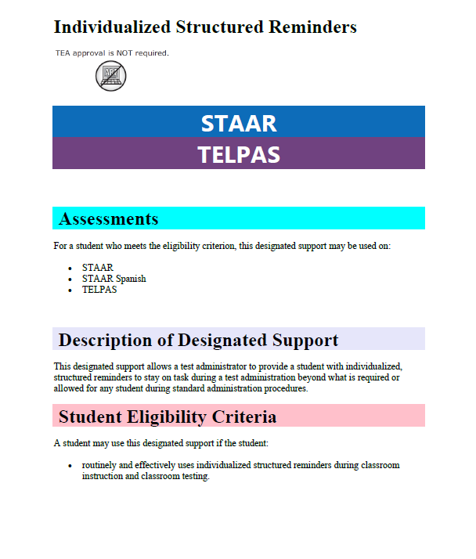
Designated Supports
Designated Supports Overview
Each policy document is organized the same way:
Assessments
Description of Accommodation
Student Eligibility Criteria
Authority for Decision and Required Documentation
Examples/Types
Special Instructions/Considerations
Supporting Resources

Slide 35
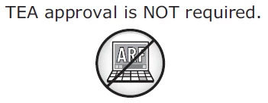
Designated Supports (Locally Approved)
Basic Transcribing allows a test administrator to transfer student responses into TDS when a student is unable to accomplish this task independently. A student may receive this support if served by an ARD committee, Section 504 committee, RtI committee, or student assistance team.
If the student is not receiving special education or Section 504 services, the decision should be based on consistent academic struggles in the specific area even after intensive instruction and remediation.
Eligibility includes routine (i.e., is familiar with the tool and its presentation) and effective (some evidence of previous success) use of the support in classroom instruction and testing.
If the student uses speech-to-text technology to indicate responses for the constructed response questions, please refer to our Technology Use Guidelines document.
The student may dictate or sign information to be recorded in the margins of the test booklet or in the notes tool for online tests. (Does NOT apply to math calculations or responses to the written composition.)

Slide 36
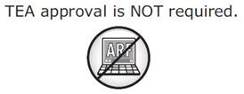
Designated Supports (Locally Approved)
Basic Transcribing (continued):
The student must be given the full time allotted to complete the entire test. It is allowable for the student to review the transcription and make any edits within the time constraints of the assessment. This means that the student can change his or her response ONLY within the seven hour time limit of the test.
The student may dictate or sign information to be recorded in the margins of the test booklet or in the notes tool for online tests. (Does NOT apply to math calculations or responses to the written composition.)

Slide 37
Designated Supports (Locally Approved)
Braille/Refreshable Braille provides brailled test materials or screen reader support for refreshable braille (STAAR only) displays to a student with a Visual Impairment (VI) who is unable to access printed test materials.
A student may receive this support if it is routinely and effectively used in classroom instruction and testing, and if the support is determined appropriate by the student’s ARD committee, Section 504 committee, RtI committee, or student assistance team.
served by an ARD committee, Section 504 committee, RTI committee, or student assistance team
For braille administrations, there is no need to submit an Accommodation Request Form to request "Extra Day". (Included in "General Instructions for Administering Braille State Assessments".)
The state will provide both contracted and uncontracted braille test materials in UEB ONLY.
Accommodations specific to braille test takers will be provided in the “STAAR with Embedded Supports Paper Test Administration Information” accommodation tables and identified for the test administrator as “Braille Instructions ONLY.”
Online screen reader support for refreshable braille displays will be available in reading/language arts and social studies assessments.

Slide 38
Designated Supports (Locally Approved)
Braille/Refreshable Braille (continued):
If the qualifying student is an EB student with a disability, the decision is made by the ARD committee in conjunction with the student’s LPAC.
Districts can order contracted or uncontracted embedded supports versions of the braille test in TIDE.
If a student is testing online with refreshable braille plus
embedded supports, a paper copy
must be ordered as well.

Slide 39
Designated Supports (Locally Approved)
Calculation Aids provide an alternate method of computation for a student who is unable to effectively use paper-and-pencil methods. A student may receive this support if the student is served by an ARD or Section 504 committee.
If a student is an EB with a disability,
the decision is made by the ARD committee
in conjunction with the student’s LPAC.
For questions about the functions allowed available on a “basic” calculator, refer to the calculator tool
in the online STAAR practice tests.
Grade-specific eligibility must be met for a student who receives Section 504 or special education services and routinely and effectively uses the support in classroom instruction and testing.
The four-function calculator will remain available for students that meet eligibility in grades 3–7 to use a calculation device.​

Slide 40
Designated Supports (Locally Approved)
Calculation Aids (continued):
Allowable Examples/Types
Basic (i.e., four-function) handheld calculator or calculator application, including large-key or speech-output
Basic calculator available as an online embedded support on STAAR
Abacus or Cranmer modified abacus
0–9 addition grid without special number (e.g., even numbers) indicated
Grade-appropriate multiplication grid without special numbers (e.g., perfect squares) indicated

Slide 41
Designated Supports (Locally Approved)
Content and Language Supports allow for various types of assistance (e.g., scaffolded directions, assistance with tracking, graphic organizers, simplified language, graphic representations of vocabulary and concepts) to support a student’s understanding of selections, test questions, and answer choices. A student may receive this support if served by an ARD committee, Section 504 committee, or LPAC committee (for an English test).
NOTE: Students for whom the LPAC recommends content and language supports for any English reading or English EOC assessment may not be reclassified at the end of the school year.
EB students taking STAAR Spanish may be eligible for content and language supports if the Section 504 or ARD committee determines the student is eligible.
Supports are provided in the form of pop-ups, rollovers, prereading text, and supplementary materials, and are available on STAAR and STAAR Spanish online tests only.

Slide 42
Designated Supports (Locally Approved)
Content and Language Supports (continued):
NOTE: Although STAAR Spanish uses the same guidelines for Content and Language Supports as the English version of STAAR, some of the accommodations in the pop-ups and rollovers may not be identical due to linguistic differences.
STAAR and STAAR Spanish with embedded supports paper version available through the Special Paper Administration Process.
Writing, including Eng. I and II, will ONLY have prereads prior to the editing passages.
Reading selections, including Eng. I and II, will have prereads prior to the selections.

Slide 43
Designated Supports (Locally Approved)
Individual Structured Reminders allow a test administrator to provide a student individualized structured reminders to stay on task during state testing beyond what is required or allowed for any student during the standard administration procedures. A student may use this designated support if that student routinely and effectively uses it during classroom instruction and classroom testing.
This designated support includes but is not limited to:
paperclips or adhesive notes used to divide the test into sections
more-frequent or less-frequent reminders of time left to test than required in the standard administration procedures
structured reminders that are part of a behavior plan
personal timer or clock set to remind a student to move on to the next question, page, or section or to remind a student to stop at pre-established times during the test
index cards that have handwritten or color-coded reminders to continue working

Slide 44
Designated Supports (Locally Approved)
Individual Structured Reminders (continued):
Any type of administration in which the test administrator has to view a secure state assessment requires that the test administrator sign a security oath. Responding to test questions, making notes about test questions, and discussing the content of the test at any time are prohibited.
For TELPAS grades 2–12, these supports only apply to the online reading and writing test, paper reading test and the online listening and speaking test. They do not apply to any holistically-rated domain, since those are assessed during authentic classroom activities and the same accommodations routinely used during classroom instruction are acceptable.
Some students might need assistance with certain reminders (e.g., inserting paperclips, setting the timer). This is allowable; however, it is preferable that the student, rather than the test administrator, direct or control the use of the reminder when possible.
A student who uses this designated support may complete the test in a separate setting to eliminate distractions to other students and to ensure the confidentiality of the test.

Slide 45
Designated Supports (Locally Approved)
Large Print provides a student with enlarged test materials when he or she is unable to effectively access test materials in standard print size.
Students who are eligible for
this support
routinely and effectively use large-print materials, including textbooks, worksheets, etc., during classroom instruction and classroom testing,
2) and meet at least one of the following:
The student has an impairment in vision (e.g., uncorrected vision, nystagmus, qualifies for special education services with a Visual Impairment [VI]).
The student is not able to accurately track letter to letter, word to word, or line to line.
The student has a physical disability which necessitates the use of large-print materials.

Slide 46
Designated Supports (Locally Approved)
Large Print (continued):
There is no preview window for large print tests.
Specific information about large-print test materials, including the policy for students needing a test booklet in a larger print size than produced by the state, is available in the General Instructions for Administering Large-Print State Assessments document, located on TEA’s Accommodation Resources webpage.
Student responses on large-print tests must be transcribed into DEI according to the procedures outlined in the Basic Transcribing and Complex Transcribing policies. If this is not done, the student’s test cannot be scored.
The ordering of large-print materials will be closely monitored to ensure districts are ordering only for those students who meet the eligibility criteria. In most cases, large-print test materials should be ordered only for a student with an impairment in vision.

Slide 47
Designated Supports (Locally Approved)
Manipulating Test Materials allows the test administrator to physically manipulate test materials, online tools, and equipment for a student who is unable to do so independently. A student may receive this support if served by an ARD committee, Section 504 committee, RtI committee, or student assistance team.
The student must give specific directions about how the test administrator should manipulate test materials, online tools, and equipment. The test administrator may not provide feedback regarding the correctness of the student’s directions.
Eligibility includes routinely and effectively uses the support in classroom instruction and testing.
If a student is an EB student with a disability, the decision is made by the ARD committee in conjunction with the student’s LPAC.
If the student is not receiving special education or Section 504 services, the decision should be based on consistent academic struggles in the specific area even after intensive instruction and remediation.

Slide 48
Designated Supports (Locally Approved)
Manipulating Test Materials (continued):
This designated support includes but is not limited to
turning test booklet pages per student directions
positioning the ruler per student directions
operating technology per student directions, such as using the mouse to navigate the pages and operate the tools in an online administration
highlighting per student directions
positioning mathematic manipulatives per student directions

Slide 49
Designated Supports (Locally Approved)
Mathematics Manipulatives supports are concrete objects or pictures of concrete objects for a student to move and touch in order to visualize abstract concepts.
Using mathematics manipulatives as an accommodation during classroom instruction and classroom testing should not replace the teaching of subject-specific skills as outlined in the TEKS. The student must be able to understand the information that the mathematics manipulatives provide and simply need assistance recalling or visualizing the concepts.
For a student who meets the eligibility criteria, this designated support may be used on STAAR grades 3–8 mathematics, Algebra I, and STAAR Spanish grades 3–5 mathematics.

Slide 50
Designated Supports (Locally Approved)
Mathematics Manipulatives (continued):
This designated support may include only
Real or play money (both heads and tails)
Clocks with or without numbers shown on clock face; the clock should NOT have gears
Various types of counters (e.g., two-sided chips, blocks, numerals with printed or raised dots)
Algebra tiles; the tiles should NOT contain words, labels, pictures, acronyms, mnemonics, numbers, symbols, or variables
Fraction pieces (e.g., fraction bars, fraction circles); the fraction pieces should NOT contain labels (e.g., labels that show individual fractions, equivalencies, or cumulative sequence)
Geometric figures that are grade- or course-appropriate; the figures may be provided in either three-dimensional form or two-dimensional form, but NOT in both forms; the figures should NOT contain words, labels, colors used as labels, pictures, acronyms, mnemonics, numbers, symbols, or variables. Providing a pictorial model of a geometric figure in another form (e.g., three-dimensional solid) is NOT allowed.

Slide 51
Designated Supports (Locally Approved)
Oral/Signed Administration support allows test material to be read aloud or signed to a student. All references to reading support during an oral administration also apply to oral interpretation (e.g., lip reading) and signing during a signed administration. An online oral/signed administration is administered via text-to-speech (TTS) or American Sign Language (ASL) videos.
TTS is offered as an online option for oral administration. The TTS tool allows a student to independently select and change his or her level of reading support during the test administration. Students can also be registered for “automatic TTS” which will ensure all eligible parts of the test are read aloud.
Several types of oral administration are available. All guidelines for providing an oral administration apply to paper tests, braille tests, and online tests.
Test administrators must be trained in the procedures specific to an oral administration. Guidelines can be found in the STAAR Oral and Signed Administrations Educator Guide document located on the Accommodation Resources webpage.
Oral administration can include different levels of reading support for each eligible student. The test administrator may read parts of the test questions and answer choices at student request or read all test questions and answer choices throughout the test.

Slide 52
Designated Supports (Locally Approved)
Oral/Signed Administration (continued):
For a student who is not receiving special education or Section 504 services, the decision should be based on consistent academic struggles in the specific area even after intensive instruction and remediation.
EBs taking STAAR Spanish may be eligible for an oral administration IF they are identified with dyslexia or related disorder OR have documented evidence of reading difficulties.
For a student who is an EB with a disability, the decision is made by the ARD committee in conjunction with the student’s LPAC.
NOTE: Students for whom the LPAC recommends oral administration for any English reading or English EOC assessment may not be reclassified at the end of the school year.
For a student who is an EB, the decision is made by the LPAC based on the eligibility criteria and is documented in the student’s file.

Slide 53
Designated Supports (Locally Approved)
Oral/Signed Administration (continued):
Students identified with dyslexia or a related disorder per TEC, §38.003 may be eligible for this support if it is routinely and effectively used during classroom instruction and classroom testing.
Students with documented evidence of reading difficulties may be eligible for this support if it is routinely and effectively used during classroom instruction and classroom testing. Evidence of reading difficulties can be caused by various reasons including, but not limited to:
learning disability in reading
ADD/ADHD
behavioral or emotional problem
processing or memory issue

Slide 54
Designated Supports (Locally Approved)
Oral/Signed Administration (continued):
Oral/Signed Administration Policy Highlights
ASL videos—online option for STAAR (English language versions only)
STAAR Spanish online—TTS is offered as a tool for oral reading support
Revising passages, test questions, and answer choices can be read aloud for STAAR and STAAR Spanish PAPER writing selections. A titled cover page and footers above the page numbers of the test booklet will identify revising section
STAAR online with a screen reader support for refreshable braille displays is available for students taking a braille test
2023-2024 STAAR Oral and Signed Administrations Educator Guide available in DCCR and the Accommodation Resources webpage

Slide 55
Designated Supports (Locally Approved)
Oral/Signed Administration (continued):
Oral/Signed Administration Policy Highlights
Oral administration can include different levels of reading support for a student.
Read all parts of the test question and answer choices at student request
Read all test questions and answer choices throughout
Text-to-speech (TTS) tool is an online option for oral administration and allows a student to independently select and change his or her level of reading support. Students may also be registered for “Auto TTS” prior to the test
NOTE: A student can request a change in the level of reading support during testing IF this option is documented. Changes involving removal or addition of Auto TTS will require pausing the student’s test.

Slide 56
Designated Supports (Locally Approved)
Updated
Oral/Signed Administration (continued):
Constructed Response Questions
Students participating in a STAAR online administration who need test questions, including short and extended constructed response questions, to be read aloud must have Text-to-Speech (TTS) turned on to receive this support.
Students must meet eligibility requirements for oral administration prior to the administration of the test.
Test administrators should not be providing this support by reading the secure test content from the screen.
Note: For students participating in a STAAR paper administration, the test administrator trained
in oral administration will provide this support.

Slide 57
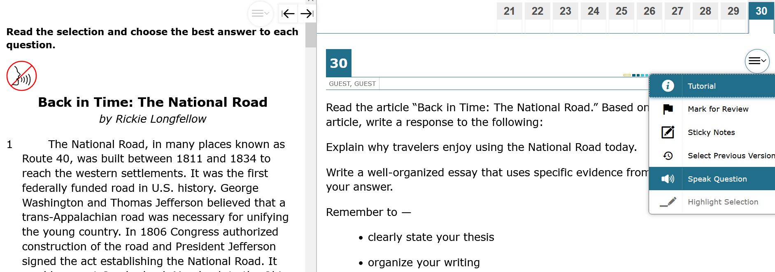
Designated Supports (Locally Approved)
Oral/Signed Administration (continued):
Example of a Constructed Response Question

Slide 58
Designated Supports (Locally Approved)
Oral/Signed Administration (continued):
Oral/Signed Administration For Students who are Deaf or Hard of Hearing
For students who are deaf or hard-of-hearing who are eligible for Content and Language Supports, AND Oral/Signed Administration:
Signing of allowable test content is allowed.
ASL videos are available as an embedded support; however, these are not available for Content and Language Supports. A test administrator will need to provide this support for the student.
If a student needs signing or oral interpretation support, an interpreter or teacher of the deaf in the room may provide assistance.
Required training: Oral/Signed Administration Guidelines and the specific guidelines for signing test content are included in the General Instructions for Administering State Assessments to Students Who are Deaf or Hard of Hearing.

Slide 59
Designated Supports (Locally Approved)
Oral/Signed Administration (continued):
Oral/Signed Administration For Students who are Deaf or Hard of Hearing
Signed administrations can be provided via a test administrator viewing a secondary mirrored monitor
-The proctor will see the student’s exact screen and can provide signed support or oral interpretation
-Screen mirroring requires connection via an HDMI cable
-Appropriate for individual administration
. Districts may request a proctor code from Cambium in order to access a proctor version of the test online if the access to an online test is needed for group administrations.
Interpreters or teachers of the deaf who provide signed or oral assistance to students may preview test material eligible for an oral/signed administration the day of the assessment to prepare an accurate interpretation. Districts may request a proctor code from Cambium in order to access a proctor version of the test online.

Slide 60
Designated Supports (Locally Approved)
Oral/Signed Administration (continued):
American Sign Language (ASL) Videos
Available on STAAR online for students eligible for Oral/Signed Administration
Questions and answer choices signed in ASL for all subjects (not available for Content and Language Supports)
Closed-Captioning
There is no indicator on the student’s screen that they are in an “ASL” version of the test. The student will need to be familiar enough with the online accommodation to know there should be embedded videos.

Slide 61
Designated Supports (Locally Approved)
Spelling Assistance provides various types of spelling assistance for a student with a disability. A student may receive this support if served by an ARD committee or Section 504 committee.
Available as an online embedded support on STAAR writing (composition) if a student routinely uses a similar tool during class instruction. For example, if a student uses a frequently misspelled word list or speech-to-text, then do NOT activate the online spelling assistance support in TIDE. The student will use what he or she routinely uses in class.
A student should be capable of organizing and developing ideas and understands the basic function and use of written language conventions (e.g., sentence structures, irregular verbs) BUT has a disability that is so severe that he or she cannot apply basic spelling rules or word patterns (e.g., silent letters, base words with affixes) to written responses
If a student is an EB with a disability, the decision is made by the ARD committee in conjunction with the student’s LPAC.

Slide 62
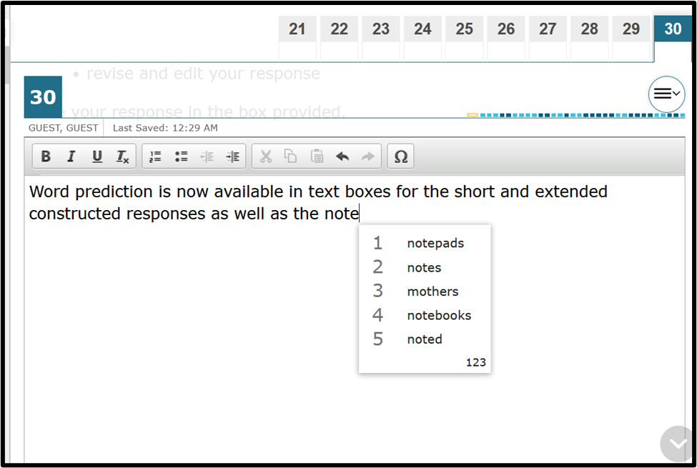
Designated Supports (Locally Approved)
Spelling Assistance (continued):
Note: Spell check does not identify grammatical or usage errors.

Slide 63
Designated Supports (Locally Approved)
Supplemental Aids allow a student to use paper-based resources that assist in recalling information. A student may use this designated support if that student routinely, independently, and effectively uses it during classroom instruction and classroom testing.
If a student writes on the supplemental aid while taking the state assessment, the supplemental aid must be destroyed after testing.
Supplemental aids should be individualized for each student. Students have different strengths and needs, so it is not appropriate to provide all students the exact same set of supplemental aids.
It is not necessary to conceal or remove instructional or reference materials in the testing area, the classroom, or hallways unless they could assist a student with answering questions on the subject-area assessment being administered.
Supplemental aids can be provided in the language that is most appropriate for the student.

Slide 64
Designated Supports (Locally Approved)
Supplemental Aids (continued):
Only the paper-based supplemental aids listed below are allowed on the state assessment.
NOTE: TEA cannot make decisions on specific supplemental aids used for an individual student.
Examples of allowable and non-allowable supplemental aids are available in the Accommodations Allowable Supplemental Aids training presentation on TEA’s Accommodation Resources webpage.
All Subjects
Mnemonic Devices
Blank Graphic Organizers
Mathematics
Math Charts
Graphics
Written Composition
Grammar and Mechanics Rules
Science
Graphics
Social Studies
Graphics

Slide 65
Requirements for Local Decision-Making Authorities
Supplemental Aids (continued):
REMEMBER: Multiplication and addition charts are considered calculation aids NOT supplemental aids.

Slide 66
Designated Supports Requiring TEA Approval
Overview of Designated Supports Requiring TEA Approval
Supports that may be made available to students who have a TEA-approved accommodation request
Eligibility decisions are made by the appropriate team of people at the campus level based on the eligibility criteria, and then an Accommodation Request is submitted in TIDE for TEA to review
Other determinations should be made in conjunction with the testing coordinator prior to submitting to ensure appropriateness
Policy documents located on the DCCR and Accommodation Resources Website

Slide 67
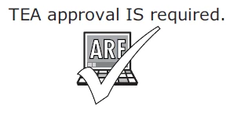
Designated Supports Requiring TEA Approval
Complex Transcribing
This designated support allows a test administrator to record into TDS or from paper into DEI a student’s dictated or signed responses to the constructed response items when a student is unable to accomplish this task independently.
Intended for an extremely small group of students with disabilities
TEA will provide, with any approved submitted accommodation request, specific guidelines about how to transcribe the student’s responses to the writing prompts, including how to indicate the student’s spelling, punctuation, and capitalization

Slide 68
Designated Supports Requiring TEA Approval
Mathematics Scribe
This designated support allows a test administrator to record a student’s dictated mathematics scratch work and computations when a disabling condition prevents the student from accomplishing this task independently.
The role of the mathematics scribe is to record the student’s dictated scratch work and computations exactly as the student indicates.
The test administrator may write the student’s dictated scratch work and computations onto scratch paper, a chalkboard, white board, or the space in the student’s test booklet.

Slide 69
Designated Supports Requiring TEA Approval
Extra Day
This designated support allows a student with a disability an extra day to complete a state assessment.
NOTE: For TELPAS grades 2–12, Extra Day only applies to the online reading and writing test, the paper reading test and the online listening and speaking test. It does not apply to any holistically-rated domain, since those are assessed during authentic classroom activities and the same accommodations routinely used during classroom instruction are acceptable.
Intended for an extremely small group of students with disabilities
Students only permitted to test over two regularly scheduled, consecutive school days
Each day of testing must not extend beyond seven hours

Slide 70
Designated Supports Requiring TEA Approval
Other
Designated supports that fall into this category are only for students who have unique needs that are not specifically addressed with any accessibility features or designated supports located on TEA’s Accommodation Resources webpage. These designated supports are not intended to provide additional supplemental aids not listed as allowable, or for students who fail to meet established eligibility criteria for designated supports.
Example: If a student requires double-sided test materials photocopied into single-sided sheets because they have a physical disability or have a disability that necessitates test materials be presented in a printed format other than a test booklet in order to prevent severe behaviors that could interfere with completion of the test, an ARF for Other should be submitted to TEA. These cases should be rare.
TEA may provide additional procedures specific to the requested designated support if approved.

Slide 71
Accommodation Request Process
Online Accommodation Requests
should only be submitted for designated supports requiring TEA approval:
The request is submitted in TIDE.
Opens: October 2023
Expiration date of approved requests is the day the last test is administered for the academic year or by June 30, 2024.
Each district is assigned an “Accommodations Task Force Member” who will process requests.

Slide 72
Accommodation Request Process
Accommodation Requests must be submitted to the Texas Education Agency (TEA) in a timely manner to allow committee members the ability to process and review requests, as well as communicate to districts the appropriate procedures for administering a TEA-Approved Designated Support.
Requests should be submitted no later than one week prior to the individual student’s test administration window. For circumstances that require an accommodation request but occur after this time (e.g., newly enrolled student, medical emergency, updated admission, review, and dismissal (ARD) committee decision) the district testing coordinator should contact TEA’s Student Assessment Division at 512-463-9536 and ask to speak to their assigned member of the Accommodation Task Force for further instructions.

Slide 73
Accommodation Request Process
Accommodation requests must be approved by the TEA before a student can use the accommodation on a state assessment.
Documentation in the appropriate paperwork should state “pending TEA approval.”
Do NOT include confidential student information in the rationale. The request will be deleted, and you will be asked to resubmit.
Example: student’s first and last name, language from an IEP, medical documents

Slide 74
Accommodations in Unexpected or Emergency Situations
When an unexpected or emergency situation (e.g., broken arm, lost eyeglasses) occurs just prior to or on the day of the state assessment, it may or may not be necessary to contact TEA. After testing, document the accommodation used in TIDE.
Step 1: No need to contact TEA
Make available Accessibility Features which are allowed for any student.
Step 2: No need to contact TEA
Make available locally-approved Designated Supports. Consideration should be given to accommodations that the student can independently use.
Step 3: Contact TEA
If the student’s needs cannot be met with Step 1 or 2, contact a member of the Accommodations Task Force at TEA. The district testing coordinator may need to submit an Accommodation Request.

Slide 75
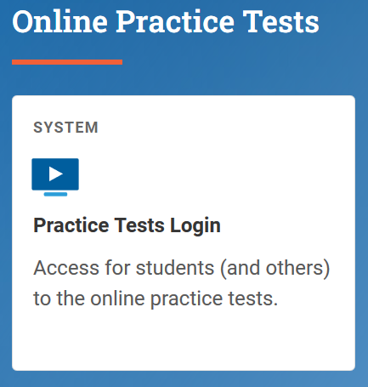
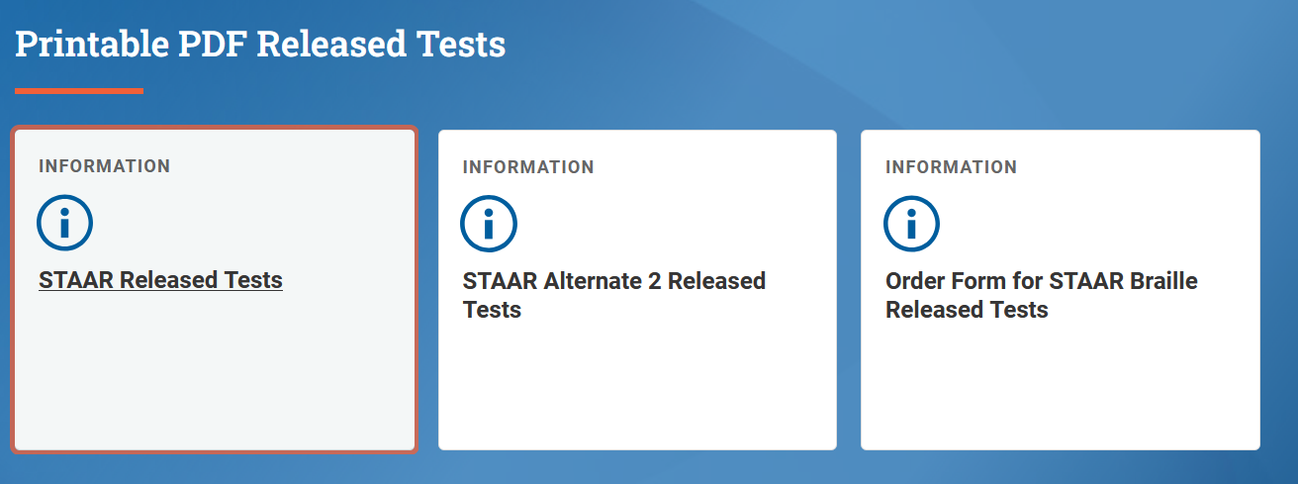
Online Practice and Released Tests
https://www.texasassessment.gov/
Online released and practice tests should be used to familiarize students with the tools that will be available in a live testing situation.

Slide 76
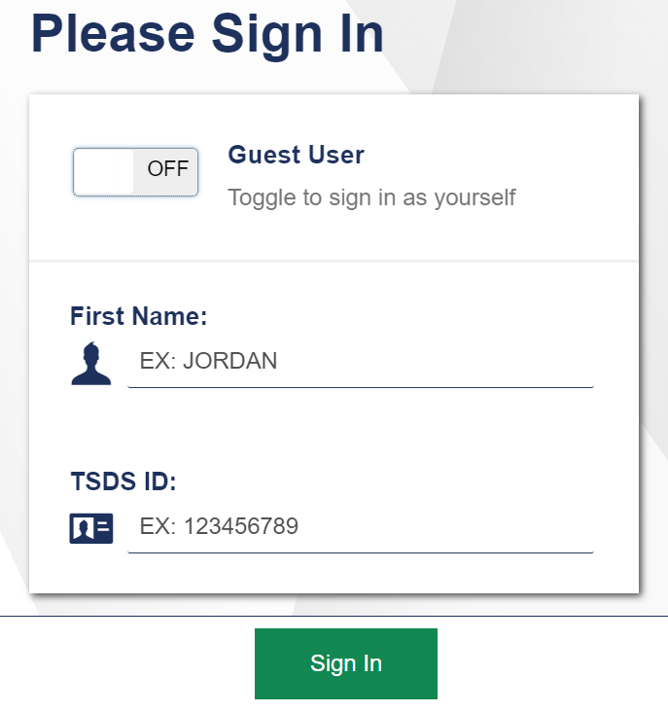
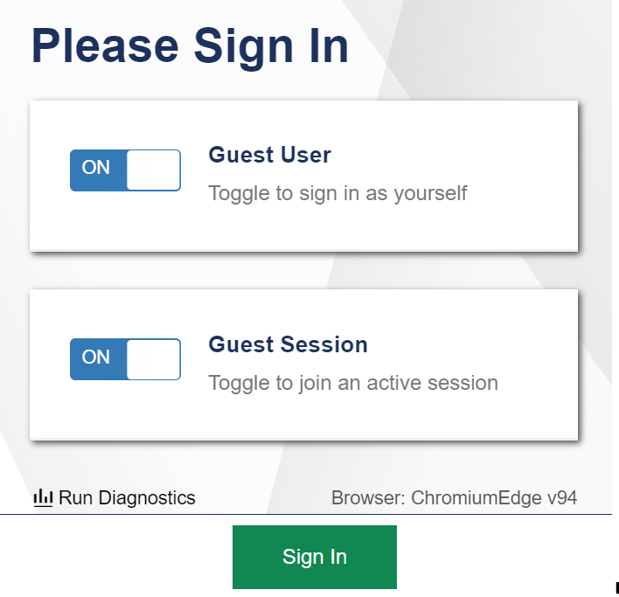
STAAR Online Practice
Both login options shown here:

Slide 77
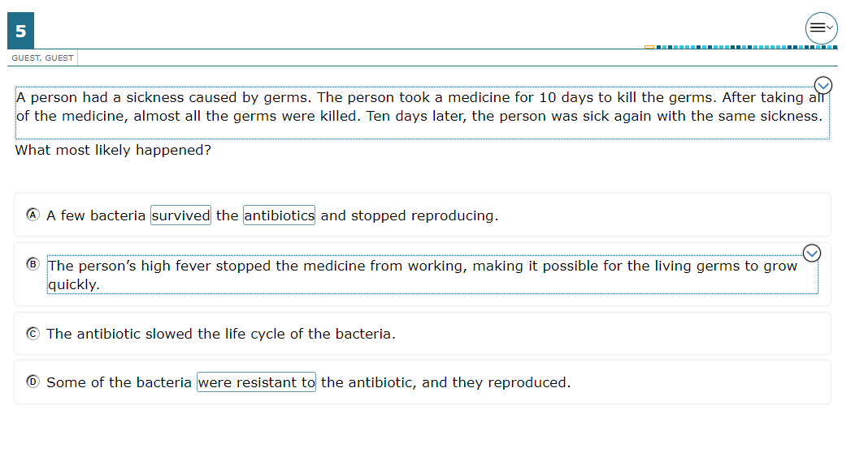
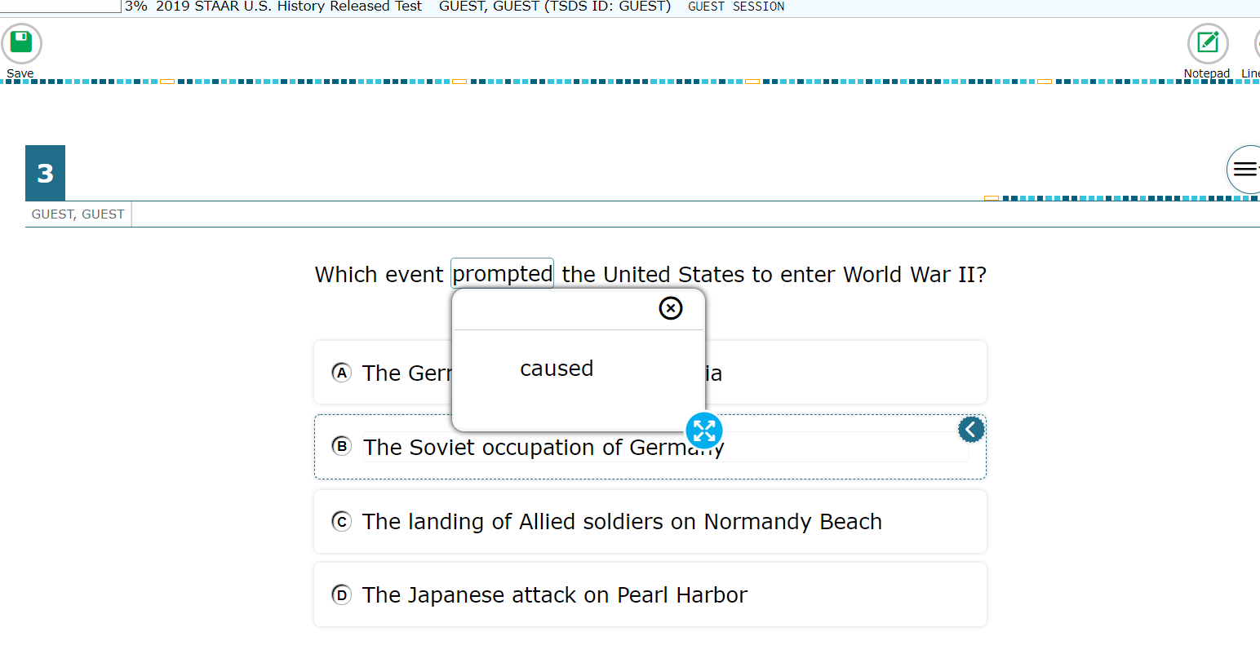
STAAR Online Practice
ROLLOVERS
POP-UPS

Slide 78
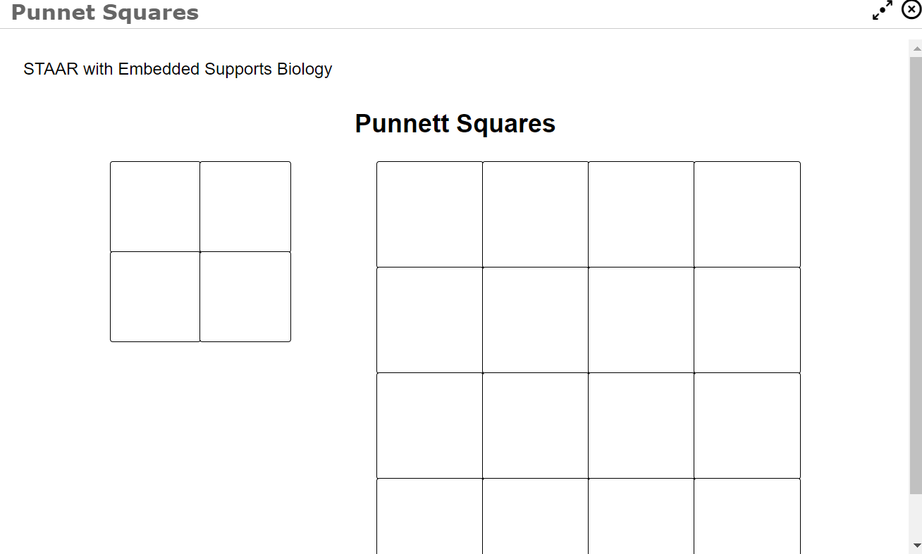
STAAR Online Practice
PUNNETT SQUARES
SPELLING ASSISTANCE (spell check & word prediction)

Slide 79
STAAR Online Practice
PREREADING TEXT

Slide 80
Training Reminders
Potential Designated Supports Topics
Understanding accessibility policies, including eligibility criteria
Ensuring that testing personnel have a current list of each student’s allowed or approved accessibility features and designated supports
Ensuring that test administrators giving an oral administration are thoroughly trained in oral administration procedures
Collecting materials and preparing designated supports for eligible students
Preparing testing locations for students who need certain designated supports or accessibility features (e.g., oral administration, individual or small-group administration)
Basic and Complex Transcribing policies and how to enter student responses into DEI

Slide 81
Accommodation Resources
Allowable Supplemental Aids
Technology Guidelines
Technology Use Guidelines Presentation Accommodations in Unexpected or Emergency Situations
TEA-Approved Accommodations Procedure documents:
Math Scribe
Extra Day
Complex Transcribing STAAR
Complex Transcribing TELPAS
General Instructions for Administering Large-Print State Assessments
General Instructions for Administering State Assessments to Students Who are Deaf or Hard of Hearing
General Instructions for Administering Braille State Assessments
Oral and Signed Administrations: Guidelines for Reading Aloud Various Types of Test Questions
Font and Point Size Matrices for STAAR, STAAR Spanish, and TELPAS
Parent Resource: Designated Supports Available for STAAR, STAAR Spanish, and TELPAS

Slide 82
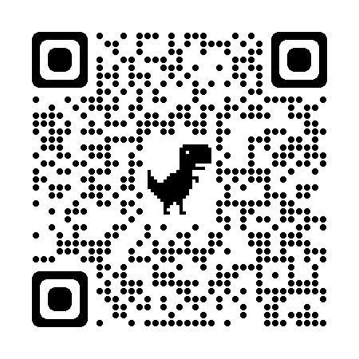
Texas Educator Assessment Committees
Classroom teachers, instructional coaches, campus and district content specialists, and campus administrators can serve in a variety of ways:
Educator passage review – each potential passage for the RLA test is reviewed and approved by a committee of Texas educators
Educator item review – each potential question for a state test is reviewed and approved by a committee of Texas educators
Constructed response range-finding – educators are convened to set the scoring boundaries for student essays based on the rubric
Subject-area advisory groups – groups of educators are convened to provide feedback on subject-area-specific topics

Slide 83
TEA Contact Information
For inquiries related to development and
administration of state assessments, reporting activities,
or data corrections, please contact:
Student Assessment Help Desk
(512) 463-9536
https://tea.Texas.gov/student.assessment/

