Slide 1
2019–2020 Testing Coordinator Training
Student Assessment division
Texas education Agency
October 3, 2019

Slide 2
Welcome and Introductions

Slide 3
Agenda
Welcome and Introductions
  Student Assessment Updates
    Test Administration Updates
    Policy Updates
    Accessibility
    TELPAS and TELPAS Alternate
    STAAR Alternate 2
  Test Administration Call Drivers and FAQs (part 1)
Lunch
  Test Administration Call Drivers and FAQs (part 2)
  3. Online Testing Procedures and End-to-End Testing Process
  4. ETS and Pearson Systems Functionality Changes and Updates

Slide 4
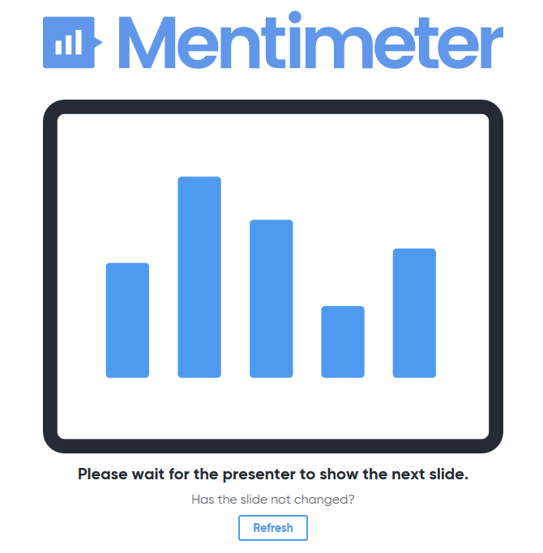

Join Our Interactive Q/A
  Using your mobile device, please join us at:
  www.menti.com
  Enter code: XXXXXX
  Make sure to participate every time you see the following icon:

Slide 5
Key Enhancements for 2019–2020
NEW
Improved participation counts process based of initial registration
Form number included on all general STAAR test booklets
No more substitute bubble on answer documents
Testing calendar updates
New process to request alternate test dates for writing tests
New Student Assessment Help Desk
Improved District and Campus Coordinator Resources
New Technology Systems and Requirements webinar

Slide 6
Key Enhancements for 2019–2020
NEW
LPAC authority for decision for accommodations changes
TELPAS Training Center upgrades
TELPAS manuals upgrades
TELPAS writing samples new rater option
STAAR Alternate 2 materials distribution process
Braille preview period
Braille and STAAR paper with Embedded Supports materials ordering process
Updated test security oaths

Slide 7

Test Administration Updates

Slide 8
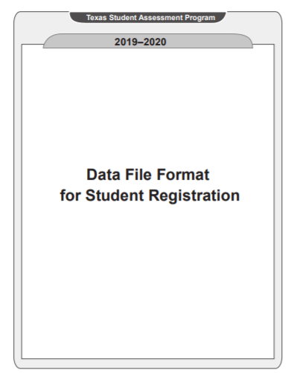
Improved Participation Counts Process
Materials orders will be based on initial registrations.
Districts no longer need a separate participation counts submission.

Slide 9
Form # Included In All General STAAR Test Booklets
All general STAAR test booklets will now have a form number on the cover.
All answer documents will have a FORM # field.
Does not apply to Braille or STAAR paper with Embedded Supports since these assessments have their own separate answer document.

Slide 10
No more substitute bubble in answer documents
  Substitute assessment bubble has been removed from all STAAR EOC assessment answer documents and in the online testing attributes.

Slide 11
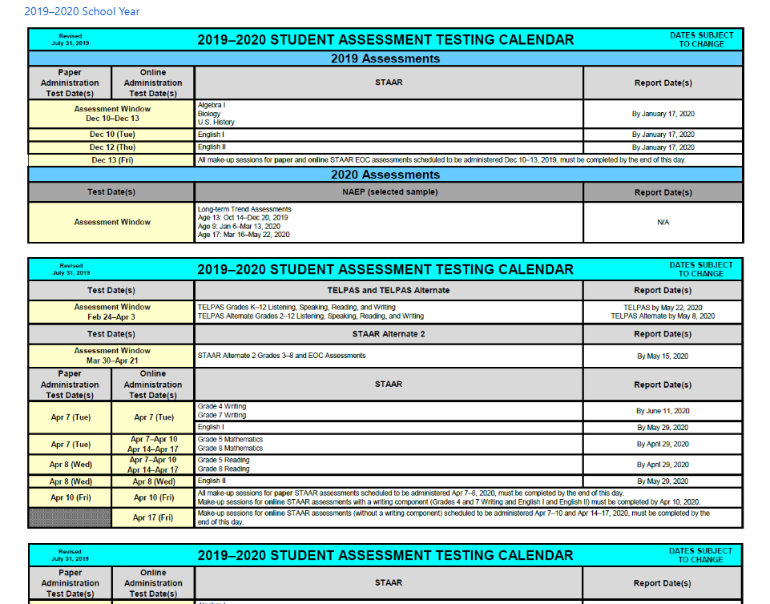
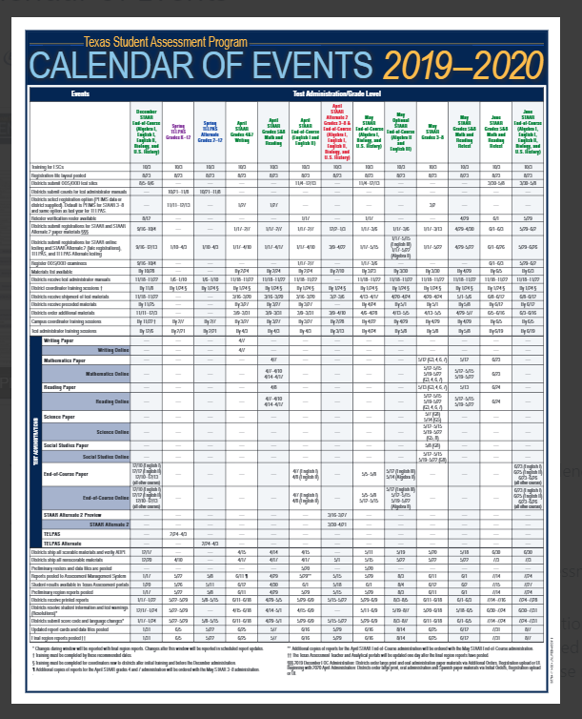
Calendar Updates
Calendar no longer allows test administrations to be scheduled on Mondays during the regular school year
Recently updated to allow for grade 8 science and social studies online testing window to align with paper administration
Districts that are no longer in session on Monday, June 22, may use that day to schedule test administrations
New downloadable Calendar of Events (CoE) with improved functionality
*For tests with a composition only, an alternate test date request must be submitted to TEA if districts need to reschedule the administration (available from the DCCR here).

Slide 12
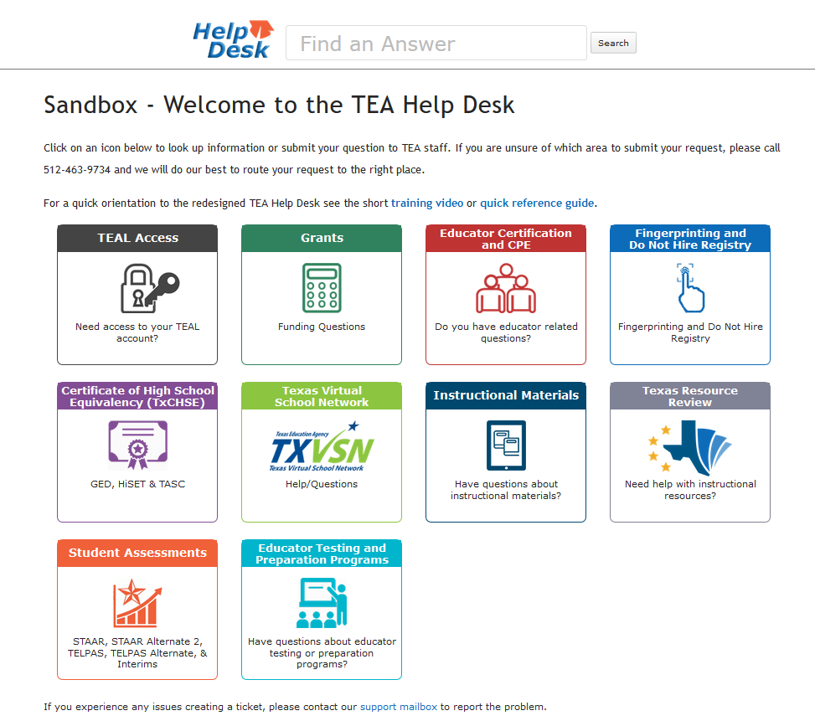
New Student Assessment Help Desk
New Help Desk system and searchable FAQs coming soon to provide additional assistance and alternative response methods.

Slide 13
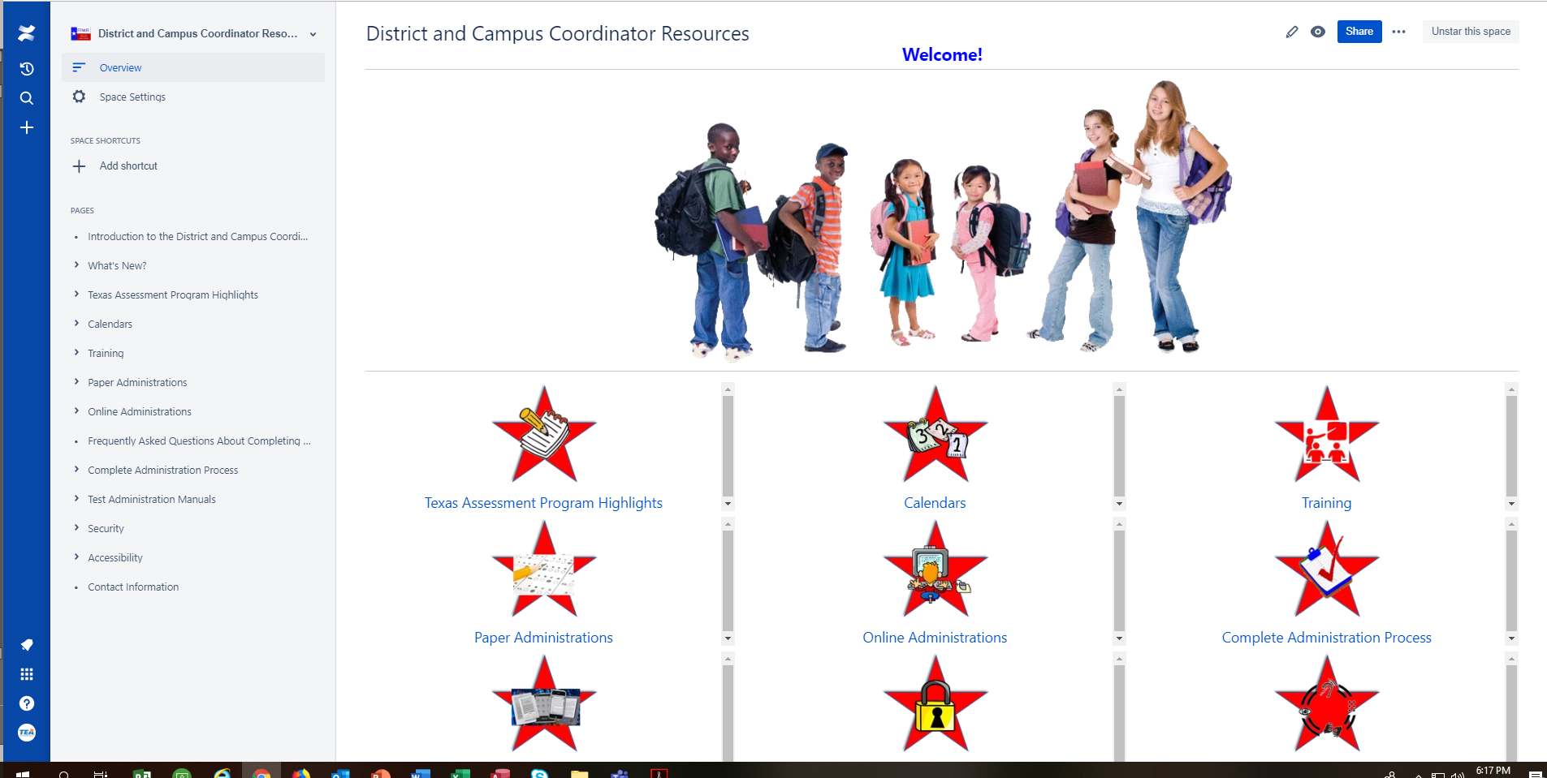
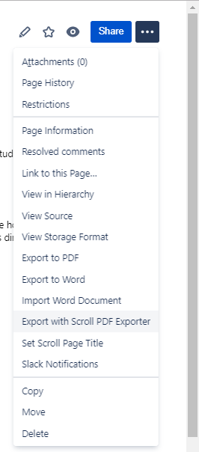
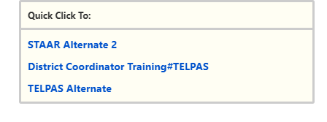
Improved Coordinator Resources (DCCR 2.0)
New introduction section with all new functionality “how-to” descriptions
Improved search features
Provides option to convert ALL resources to one PDF for easy printing on demand
New “Quick Click” Navigation
Color coded!
New test security oaths

Slide 14
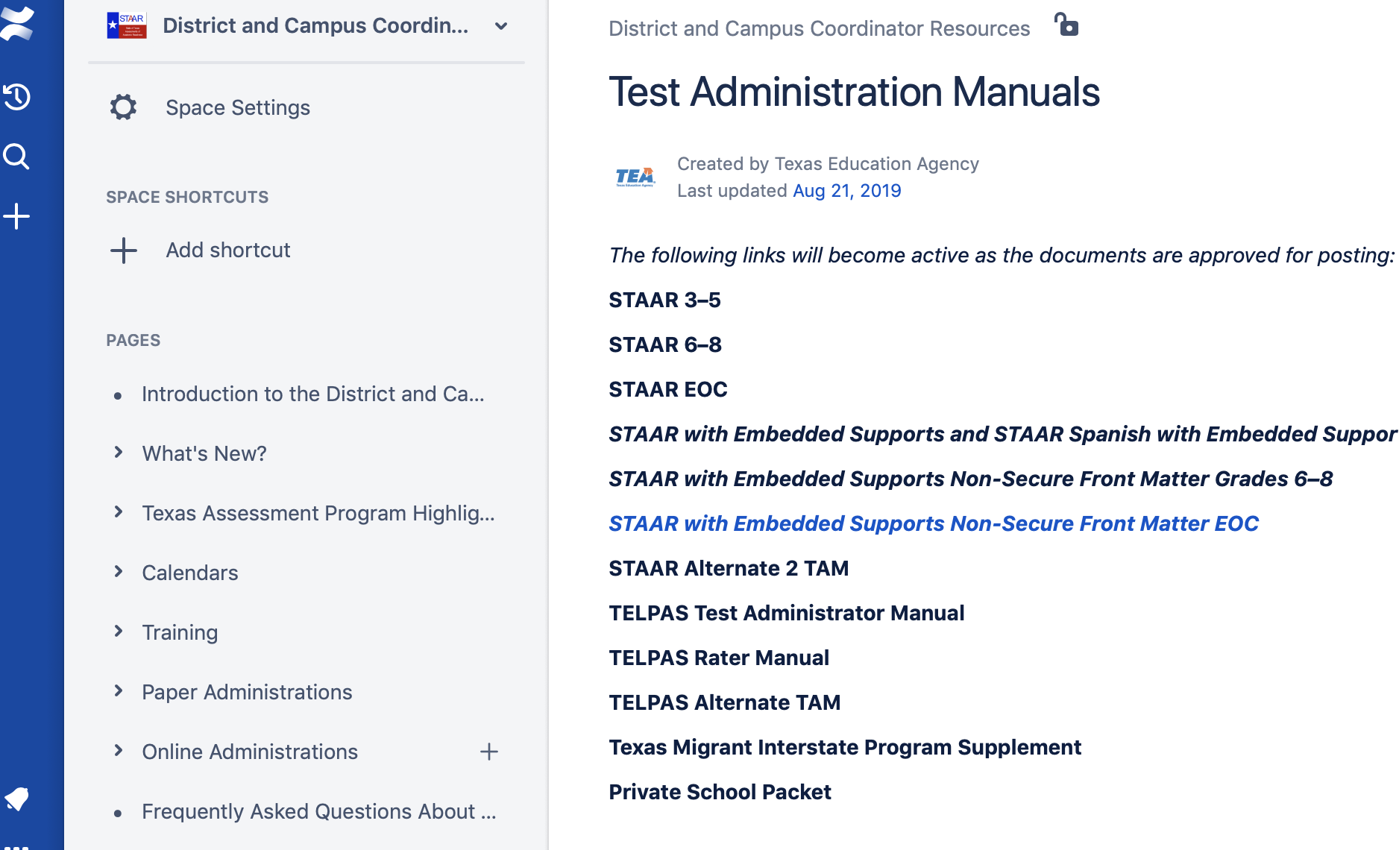
Test Administration Manuals
  STAAR 3–5, 6–8, and EOC test administrator manuals (TAM) will be shipped together according to the date on the calendar of events (CoE).
  New TELPAS Manual for Raters will be online only, and New TELPAS Manual for Test Administrators will be printed.
  As they become available, all manuals will be posted in the Coordinator Resources.

Slide 15
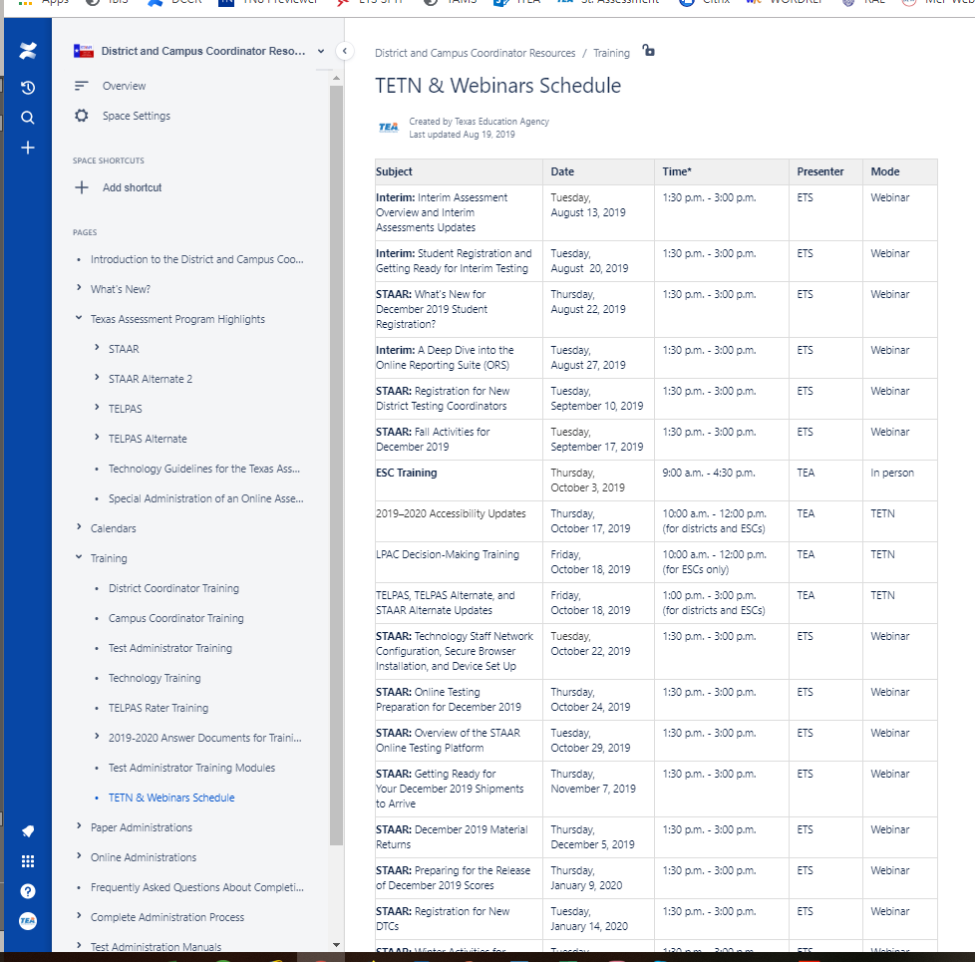
Administration Processes and Procedures Updates
New training opportunities (i.e., New Technology Staff Network Configuration)
All updates to current policy & procedures to be covered in depth during TETNs and Webinars
Please visit the Coordinator Resources for schedule

Slide 16
Check for Understanding

Slide 17

Test Security Updates

Slide 18
Revised Security Section in DCCR
The security section has been reorganized to include the following pages.
Overview
Testing irregularities
Penalties for violating security and confidentiality of assessments
Investigating and reporting testing irregularities
Things to consider before, during, and after an administration
Security forms

Slide 19

Testing Irregularities Section
Includes:
Serious
Procedural
Incidents involving student cheating
Incidents that are not necessarily testing irregularities
How to avoid testing irregularities

Slide 20

Penalties for Test Violations
Penalties include:
Invalidating student test results
Referring to SBEC for potential sanctions
  Restriction
  Reprimand
  Suspension
  Revocation
Class C misdemeanor
Lowering accreditation status or accountability rating
Charter sanction or revocation

Slide 21
Online Incident Report Form
The form is being updated to reflect the updates in the DCCR.
The form will ask if the irregularity is procedural or serious.
  If procedural, you will need to select one of the five procedural categories.
  If serious, you will need to select tampering, assistance, or other.
For all incidents, you need to submit an online incident report form and include an investigative summary and plan of action.
For serious violations, you also need to submit witness statements.
You may also need to submit other requested documentation (e.g., seating charts, oaths, etc.).

Slide 22
Revised Security Oaths
Based on feedback from the field, TEA has revised the security oaths.
There are now three separate oaths with links to each on the security forms page.
  Superintendent and Chief Administrative Officer
  District Testing Coordinator
  General (for CTC, TA, technology staff, proctors, raters, etc.)
The Superintendent and DTC oaths are online forms with checkboxes. They can be printed and submitted online.
The General oath is a fillable PDF that can be printed and saved electronically.

Slide 23
Check for Understanding

Slide 24

Policy Updates

Slide 25
Updates Based on
New Legislation

Slide 26

House Bill 3—General Information
TEA staff are working to provide information to the field regarding HB 3 and its implications.
Information and resources are available at: http://tea.texas.gov/About_TEA/Government_Relations_and_Legal/Government_Relations/House_Bill_3
  Budgeting Resources
  Topics of Interest
  HB 3 in 30 Video Series
  Guidance and Correspondence
If you have HB 3 related questions, please send them to HB3info@tea.texas.gov.

Slide 27
House Bill 3—STAAR Study
TEA is required to contract with a public institution of higher education to conduct a study on the alignment and readability of STAAR.
TEA has signed a memorandum of understanding with the University of Texas at Austin to conduct the study and prepare a report.
The study includes STAAR grades 3–8 assessments administered in spring 2019 and those to be administered in spring 2020.

Slide 28
House Bill 1244—U.S. History Assessment
STAAR U.S. history assessment must include 10 questions randomly selected from the civics test administered by the U.S. Citizenship and Immigration Services as part of the naturalization process.
TEA must
ensure that the questions included align with the Texas Essential Knowledge and Skills for the high school U.S. history course; and
annually issue a report that:
  provides the included questions and answers
  details student performance on the questions, both statewide and disaggregated by district and campus

Slide 29
House Bill 1244—U.S. History Assessment
Due to the amount of time necessary to implement this legislation, TEA is planning for this change to the STAAR U.S. History assessment to occur during the 2020–2021 school year.
There are NO changes to the STAAR U.S. History assessed curriculum or blueprint as a result of this legislation for the 2019–2020 school year.

Slide 30
Senate Bill 213—Graduation Provisions
This bill extends the current expiration date for certain provisions from September 1, 2019, to September 1, 2023, effective immediately. This includes:
using the TSI assessment as a substitute assessment,
graduation based on the determination of an Individual Graduation Committee for students who have STAAR as a graduation requirement but have not met assessment graduation requirements, and
alternate graduation requirements for students who entered ninth grade before the 2011–2012 school year but who have not met assessment graduation requirements.

Slide 31
Senate Bill 213—TAC §101.4002
Texas Administrative Code (TAC) §101.4002, STAAR Substitute Assessments
Being amended to update the date for students who have STAAR as a graduation requirement to use the TSI assessment as a substitute assessment for Algebra I and English II under paragraph (d)(2).
Extended expiration date to September 1, 2023.
Scheduled to be posted for public comment October 11–November 12, 2019.
Proposed effective date is January 26, 2020.

Slide 32
Senate Bill 213—TAC §101.3022
Texas Administrative Code (TAC) §101.3022, STAAR Graduation Requirements
Amended to update the date for students who have STAAR as a graduation requirement to graduate based on the determination an Individual Graduation Committee.
Extended expiration date to September 1, 2023.
Posted for public comment July 26–August 26, 2019.
No changes were made to the rule since published as proposed.
Effective October 15, 2019.

Slide 33
Senate Bill 213—TAC §101.3024
Texas Administrative Code (TAC) §101.3024, TAKS Graduation Requirements
Amended to update the date for students who have TAKS (or TAAS or TEAMS) as a graduation requirement to graduate based alternate graduation requirements.
Extended expiration date to September 1, 2023.
Posted for public comment July 26–August 26, 2019.
No changes were made to the rule since published as proposed.
Effective October 15, 2019.

Slide 34

House Bill 3906—Educator Advisory Committee
TEA is required to establish a new assessment advisory committee.
The purpose of the new committee is to advise TEA on the development of academically appropriate state assessment instruments.
The committee is expected to advise TEA on the design and implementation of potential changes to the state’s assessment program.

Slide 35
House Bill 3906—Educator Advisory Committee
The new committee:
  Must include experts in curriculum and instruction.
  Will include content experts and individuals with experience supporting special populations.
  May include K–12 educators, K–12 administrators, and higher education representatives.
Nominations for the new committee were requested and submitted in August 2019.
The commissioner’s appointments to this new committee are pending.

Slide 36

House Bill 3906—First Instructional Day of the Week
The SBOE shall ensure that STAAR assessments are not administered on the first instructional day of the week (i.e., Monday).
This applies to STAAR grades 3–8 and EOC assessments.
This does not apply to STAAR Alternate 2, TELPAS, or TELPAS Alternate.
MONDAY

Slide 37
House Bill 3906—First Instructional Day of the Week
The 2019–2020 testing calendar was updated to reflect this new law.
All STAAR assessments were adjusted to avoid testing on Monday.
If a district is no longer in session during the June STAAR administration, the district may adjust the testing schedule to test on Monday.

Slide 38
TAC 101.5001—Statewide Testing Calendar
Texas Administrative Code (TAC) §101.5001, Statewide Testing Calendar
Being amended to provide clarification indicating that for the purpose of scheduling STAAR, the first instructional day of a week is Monday.
Posted for public comment August 30–September 30, 2019.
Proposed effective date is December 2, 2019.

Slide 39
House Bill 3906—Multi-Part Assessments
STAAR assessments may be administered in multiple parts over more than one day.
A STAAR assessment may not have more than three parts.
A part of a STAAR assessment must be designed so that:
  if administered to students in grades 3 and 4, 85% of students will be able to complete that part within 60 minutes; and
  if administered to students in grades 5–8, 85% of students will be able to complete that part within 75 minutes.

Slide 40
House Bill 3906—Multi-Part Assessments
The goal of multi-part assessments is to increase scheduling flexibility for districts.
During the 2019–2020 school year, TEA will work with stakeholders to design options to best support districts and campuses while ensuring continued test security and validity.
The multi-part assessment option will be available to districts during the 2020–2021 school year.

Slide 41
House Bill 3906—Multi-Part Assessments
The SBOE by rule may designate sections of a STAAR mathematics assessment that:
  may be completed with the aid of technology and
  must be completed without the aid of technology.
During the 2019–2020 school year, TEA will work with math educators and other stakeholders to design options to best support districts and campuses while ensuring strong alignment to the math TEKS.
The rulemaking process for the SBOE typically takes 7 or more months; therefore, the implementation of calculator sections will be a few years away.

Slide 42
House Bill 3906—Multiple-Choice Questions
Beginning with the 2022–2023 school year, STAAR assessments may not include more than 75% of the questions in a multiple-choice format.
TEA began soliciting input from educators during summer 2019 to help identify non-multiple-choice formats that would best assess the TEKS.
During the next few years, TEA will work with educators and other stakeholders to develop non-multiple-choice test questions for STAAR.

Slide 43
House Bill 3906—Stand-Alone Writing Tests
Eliminates stand-alone writing tests for grades 4 and 7 beginning with the 2021–2022 school year.
Writing skills will be assessed with reading skills in the future.
There are NO changes to the STAAR grades 4 and 7 writing assessments for the 2019–2020 and 2020–2021 school years.

Slide 44

House Bill 3906—Electronic Administrations
TEA, in consultation with the SBOE, shall develop a transition plan to administer assessments electronically beginning not later than the 2022–2023 school year.
Not later than December 1, 2020, TEA shall submit to the legislature a report on the transition plan.

Slide 45
House Bill 3906—Interim Assessments
STAAR Interim Assessments have been incorporated into the Texas Education Code, TEC §39.023(o).
Interim assessments are:
  are optional,
  must be administered electronically,
  must be predictive, and
  may not be used for accountability purposes
More information is available on the State-Developed STAAR Interim Assessments webpage.

Slide 46
House Bill 3906—Integrated Formative Assessments
TEA must establish a pilot program in which participating school districts administer to students integrated formative assessment instruments.
During the next few years, TEA will work with educators and other stakeholders to develop an integrated formative assessment pilot program.
Not later than December 1 of each even-numbered year, TEA shall submit to the legislature a report on the pilot program.

Slide 47
Updates Based on
Federal Requirements

Slide 48
STAAR Substitute Assessments and Accountability
Under ESEA, a state is required to administer the same academic assessments to measure the achievement of all public-school students and include these assessment results in the accountability system.
Therefore, TEA is no longer able to use substitute assessments for purposes of accountability as indicated in a communication to districts dated June 20, 2019.
Beginning with the December 2019 administration, substitute assessments will not be included in state or federal accountability calculations.
If you have accountability questions, please contact the Performance Reporting Division at (512) 463-9704 or performance.reporting@tea.texas.gov.

Slide 49
New Policy for STAAR Substitute Assessments
To meet federal testing and accountability requirements, students will need to take STAAR EOC assessments at least once.
For accountability purposes, taking a STAAR EOC assessment means receiving a score (i.e., score code “S”).
If after taking the STAAR EOC assessment at least once and not meeting the passing requirement for graduation, a student may retake the EOC assessment or, if eligible, use a substitute assessment to satisfy the graduation requirement.

Slide 50
TAC 101.4002—STAAR Substitute Assessments
Texas Administrative Code (TAC) §101.4002, STAAR Substitute Assessments
Being amended to require a student to take an EOC assessment at least once for the purpose of federal accountability.
No recommended changes to the substitute assessments allowed or the required scores in the chart.
Scheduled to be posted for public comment October 11–November 12, 2019.
Proposed effective date is January 26, 2020.

Slide 51

New Policy for STAAR Substitute Assessments
The recommended policy for the 2019–2020 school year is that a student takes an STAAR EOC assessment at least once prior to using a substitute assessment to fulfill testing graduation requirements.
However, this new policy is not officially in effect until amendments to TAC §101.4002 are adopted.

Slide 52
Testing Requirements for Accelerated Students
As indicated in a communication to districts dated August 22, 2019, there will be NO policy changes to the testing requirements for accelerated students for the 2019–2020 school year.
Districts should continue to follow existing policies and guidance concerning testing accelerated students.
  Students in grades 3–8 take their enrolled grade-level assessment unless they are receiving instruction above-grade-level and taking an assessment that corresponds to that instruction.
  Students take EOC assessments as they are completing a high school course.
  No double-testing is required.

Slide 53
Testing Requirements for Accelerated Students
TEA is working to implement new funding for SAT/ACT established under HB 3.
This new funding will facilitate the implementation of federal testing requirements for students who have taken high school assessments prior to high school (i.e., accelerated students).
TEA is also working with USDE to ensure the state’s testing policies meet all the requirements of ESEA.

Slide 54
Check for Understanding

Slide 55

Questions?

Slide 56
Accessibility Updates

Slide 57

Accessibility
What is accessibility?
Ensuring that each student can interact appropriately with the content, presentation, and response mode of the test.
Assessments should allow all test takers to demonstrate their knowledge of the content being tested without the format of the assessment, non-tested language, or the type of response needed to answer the questions being barriers.
In order to meet this goal, various features and supports are made available on paper and online tests to students who use the same or similar supports during classroom instruction.

Slide 58
2019–2020 Accessibility Updates
NEW
  Accessibility Features:
  Guidance on small group size
  Content and Language Supports:
  Beginning in spring 2020 pre-reads will only be provided prior to reading selections and editing passages
  Authority for Decision and Required Documentation:
  An LPAC can make a decision for a student to use the following designated supports WITHOUT an ARD or Section 504 committee, if eligible for:
    Extra Time
    Content and Language Supports
    Oral/Signed Administration

Slide 59
2019–2020 Accessibility Updates
NEW
  Braille/Refreshable Braille:
  A submission of an Accommodation Request Form is NOT needed for braille students who need the STAAR with Embedded Supports paper test.
  For students taking STAAR braille, including students using a refreshable braille display, who are also eligible to receive content and language supports, districts should contact the Texas Assessment Support Center to order STAAR with Embedded Supports materials.
  A preview window during testing week for districts administering the following:
    Braille assessment with the STAAR large-print test booklet
    Braille assessment in conjunction with the STAAR with Embedded Supports paper test

Slide 60
Accessibility Features
  Can be found in the District and Campus Coordinator Resources and the Accommodations Resources webpage.
  Are available to any student who regularly benefits from the use of these procedures or materials during instruction.
  No need to document use of accessibility features in student paperwork, the answer document, or in the Texas Assessment Management System.
  A student using certain accessibility features may need to complete the test in a separate setting in order to eliminate distractions to other students and to ensure that the security and confidentiality of the test is maintained.
  A student cannot be required to use them during testing.
  Coordinators are responsible for ensuring that test administrators understand the proper implementation of these procedures and use of these materials.

Slide 61
Accessibility Features
  Signing test administration directions
  Translating test administration directions
  Bilingual dictionary (word-to-word translations; no definitions or examples) for mathematics, science, and social studies assessments
    Bilingual dictionary applications on a tablet, laptop, or desktop are not allowable as an Accessibility Feature
  Reading test aloud to self (e.g., PVC pipe, recording device)
  Reading aloud or signing the expository or persuasive writing prompt
  Reading assistance on the grade 3 mathematics test
  Scratch paper (or any medium that can be erased or destroyed)
  Tools to minimize distractions or to help maintain focus (e.g., stress ball, headphones, instrumental music)

Slide 62
Accessibility Features
    Highlighters (including online tool), colored pencils, or crayons
    Reminding students to stay on task
    Color overlays or online color setting
    Blank place markers or online guideline tool
    Magnifying devices or online zoom feature
    Online sticky notes tool
    Use of amplification devices (e.g., speakers, frequency-modulated [FM] systems)
    Use of projection devices (e.g., closed-circuit televisions [CCTVs] or liquid crystal display [LCD] projectors for online tests)
    Typing a student’s response to the writing prompt into the online test for any grade 4 student who is taking STAAR writing online and cannot type proficiently

Slide 63
Accessibility Features
    Photocopying or enlarging non-secure test materials such as:
      Test administration directions
      Blank answer documents
      State-supplied graph paper
      State-supplied reference materials
    Individual or small-group administrations:
      Number of students in small group is determined at local level based on the needs of each student
      Number of students in a small group should mirror, as much as possible, the same group size classroom testing situations
NEW

Slide 64
Accessibility Features—STAAR Online Grade 4 Writing
Reminder
  Typing a student’s response to the writing prompt into the online test for any grade 4 student who is taking STAAR writing online and cannot type proficiently:
  Eligibility for Basic Transcribing does NOT need to be determined; however, the procedures for Basic Transcribing MUST be adhered to. The Basic Transcribing policy document can be found on TEA’s Accommodation Resources webpage.
  Students taking the grade 7 writing test, English I, English II, or English III must meet the eligibility requirements for Basic Transcribing if this type of support is needed.

Slide 65
Locally Approved Designated Supports
  These include twelve supports that may be made available to students who meet eligibility criteria.
  Eligibility decisions are made by the appropriate team of people at the campus level based on the eligibility criteria and are documented in the appropriate paperwork.
  Each policy document is organized the same way
    Description of Accommodation
    Assessments
    Student Eligibility Criteria
    Authority for Decision and Required Documentation
    Examples/Types
    Special Instructions/Considerations

Slide 66

Locally Approved Designated Supports
  Basic Transcribing
  Braille/Refreshable Braille
  Calculation Aids
  Content and Language Supports
  Extra Time
  Individual Structured Reminders
  Supplemental Aids
  Large Print
  Manipulating Test Materials
  Mathematics Manipulatives
  Oral/Signed Administration
  Spelling Assistance
Policy documents located on the DCCR and Accommodation Resources website

Slide 67
Basic Transcribing
  A student may receive this support if served by an ARD committee, Section 504 committee, RTI committee, or student assistance team.
    If the student is not receiving special education or Section 504 services, the decision should be based on consistent academic struggles in the specific area even after intensive instruction and remediation.
    Eligibility includes routinely and effectively uses the support in classroom instruction and testing.
    If the student uses speech-to-text technology to indicate responses for multiple-choice questions, griddable questions, or the writing prompt, please refer to our Technology Use Guidelines document.
    Added in 2019, the student may dictate or sign information to be recorded in the margins of the test booklet or in the notes tool for online tests. (Does NOT apply to math calculations or responses to the written composition.)

Slide 68
Basic Transcribing—Special Instructions/Considerations
  The student must be given the full time allotted to complete the entire test. It is allowable for the student to review the transcription and make any edits within the time constraints of the assessment.
    This means that the student can change his or her response ONLY within the time limit of the test (i.e., 4 hours, 5 hours, or extra time).
  If the test administrator transfers the student’s final responses onto the answer document/online testing platform after the testing period has ended, the student may not edit his or her response.
  It is recommended that the test administrator ensure that he or she can read and understand the student’s intended response prior to the student leaving the testing room.

Slide 69
Manipulating Test Materials
A student may receive this support if served by an ARD committee, Section 504 committee, RTI committee, or student assistance team.
  If the student is not receiving special education or Section 504 services, the decision should be based on consistent academic struggles in the specific area even after intensive instruction and remediation.
  If a student is an EL with a disability, the decision is made by the ARD committee in conjunction with the student’s LPAC.
  Eligibility includes routinely and effectively uses the support in classroom instruction and testing.

Slide 70
Calculation Aids
A student may receive this support if:
  The student is served by an ARD or Section 504 committee.
  If a student is an EL with a disability, the decision is made by the ARD committee in conjunction with the student’s LPAC.
  Grade-specific eligibility must be met for a student who receives Section 504 or special education services and routinely and effectively uses the support in classroom instruction and testing.
  For math and science STAAR and STAAR Spanish, the basic calculator (i.e., four-function) will be offered as an embedded PNP support on the STAAR online assessment for students who meet the eligibility in grades 3–7. For questions about the functions allowed on a basic calculator, refer to the calculator tool in the online 2018 STAAR released tests and technology guidelines training PPT.

Slide 71
Calculation Aids—Examples/Types
  Allowable Examples/Types
    Basic (i.e., four-function) handheld calculator or calculator application, including large-key or speech-output
    Basic calculator available as an online embedded support on STAAR
    Abacus or Cranmer modified abacus
    0–9 addition grid without special number (e.g., even numbers) indicated
    Grade-appropriate multiplication grid without special numbers (e.g., perfect squares) indicated

Slide 72
Braille/Refreshable Braille
Updated
  A student may receive this support if:
    routinely and effectively using the support in classroom instruction and testing, and
    served by an ARD committee, Section 504 committee, RTI committee, or student assistance team.
      If a student is an EL with a disability, the decision is made by the ARD committee in conjunction with the student’s LPAC.
    For students taking STAAR braille, including students using a refreshable braille display, who are also eligible to receive content and language supports, districts should contact the Texas Assessment Support Center to order STAAR with Embedded Supports materials. Districts do NOT need to submit a request for TEA to approve for the STAAR with Embedded Supports.
    Specific information about administering braille tests is available in the General Instructions for Administering Braille State Assessments document, located on the TEA’s Accommodation Resources webpage.
    The state will provide both contracted and uncontracted braille test materials in UEB ONLY.
NEW

Slide 73
Braille/Refreshable Braille
NEW
INFORMATION
  Online screen reader support for refreshable braille displays will be available in reading/language arts and social studies assessments.
  For braille administrations, there is no need submit an Accommodation Request Form to request "Extra Day". (Included in "General Instructions for Administering Braille State Assessments".)
  Accommodations specific to braille test takers will be provided in the STAAR with Embedded Supports Paper Administration Guide accommodation tables and identified for the test administrator as “Braille Instructions ONLY.” Samples of how these accommodations will appear will be provided in the non-secure front matter of the STAAR with Embedded Supports Paper Administration Guide.
  UPDATE
  The contents of a braille assessment and the STAAR large-print test booklet may be previewed by the test administrator during the district-determined preview window. The preview may take place on any school day prior to the subject-area test, during the testing week. Districts and campuses are responsible for keeping testing materials secure. If a student receives the STAAR with Embedded Supports test in conjunction with the braille assessment, this preview window is also allowable.
NEW

Slide 74
Check for Understanding

Slide 75
Content and Language Supports
A student may receive this support if:
  Served by an ARD committee, Section 504 committee, or LPAC committee (for an English test)
    If a student is an EL with a disability, the decision is made by the ARD committee in conjunction with the student’s LPAC.
    ELs taking STAAR Spanish may be eligible for content and language supports if the Section 504 or ARD committee determines the student is eligible.
  The ARD, Section 504, or LPAC committee determines he/she uses the support routinely and effectively in classroom instruction and testing.
  NOTE: Students for whom the LPAC recommends the use of these supports for any reading or writing assessment may not be considered for reclassification at the end of the school year.

Slide 76
Content and Language Supports
NEW
INFORMATION
  STAAR and STAAR Spanish online tests only (not available for Algebra II or English III).
    NOTE: Although STAAR Spanish uses the same guidelines for Content and Language Supports as the English version of STAAR, some of the accommodations in the pop-ups and rollovers may not be identical due to linguistic differences.
  Content and Language Supports include
    Pop-ups
    Rollovers
    Supplementary Materials
    Prereads
      NEW: Writing—beginning in spring 2020 all writing tests, including Eng. I and II, will ONLY have prereads prior to the editing passages.
      Reading—all reading selections, including Eng. I and II, will have prereads prior to the selection.
  STAAR and STAAR Spanish with embedded supports paper version available through the Special Paper Administration Process.
NEW

Slide 77
Oral/Signed Administration
Updated
A student may receive this support if:
  Served by an ARD committee, Section 504 committee, LPAC, RTI committee, or student assistance team and a determination is made that the student meets eligibility criteria.
  For a student that is not receiving special education or Section 504 services, the decision should be based on consistent academic struggles in the specific area even after intensive instruction and remediation.
  For a student who is an EL, the decision is made by the LPAC based on the eligibility criteria and is documented in the student’s file.
  For a student that is an EL with a disability, the decision is made by the ARD committee in conjunction with the student’s LPAC.
    NOTE: Students for whom the LPAC recommends the use of these supports for any reading or writing assessment, may not be considered for reclassification at the end of the school year.

Slide 78
Oral/Signed Administration
Eligibility
    routinely and effectively uses in class
    meets at least one of the following: EL and takes English test; dyslexia or related disorder; documented evidence of reading difficulties
      NOTE: ELs taking STAAR Spanish may be eligible for an oral administration IF they are identified with dyslexia or related disorder OR have documented evidence of reading difficulties.
Evidence of reading difficulties can be caused by various reasons including, but not limited to,
    learning disability in reading
    ADD/ADHD
    behavioral or emotional problem
    processing or memory issue

Slide 79
Oral/Signed Administration
Policy Highlights:
  ASL videos—online PNP option for STAAR
  STAAR Spanish online—TTS is offered as a tool for oral reading support
  Revising passages, test questions, and answer choices can be read aloud on STAAR and STAAR Spanish PAPER writing assessments. Title page on test booklet will identify revising section.
  STAAR online with a screen reader support for refreshable braille displays is available for students taking a braille test.
  2019–2020 Oral/Signed Administration Guidelines available in DCCR and the Accommodation Resources webpage
    Guidelines for writing oral/signed administration added with examples

Slide 80
Oral/Signed Administration
  Policy Highlights:
    Oral administration can include different levels of reading support for a student.
      Read all parts of the test question and answer choices at student request.
      Read all test questions and answer choices throughout.
      Text-to-speech (TTS) tool is an online option for oral administration and allows a student to independently select and change his or her level of reading support.
        NOTE: A student can request a change in the level of reading support during testing IF this option is documented.
    It is recommended that students use the STAAR online tutorial and practice released tests prior to test administrations.

Slide 81
Oral/Signed Administration-
For Students who are Deaf or Hard of Hearing
For students who are deaf or hard-of-hearing who are eligible for Content and Language Supports, AND Oral/Signed Administration
    Signing of allowable test content is allowed.
    ASL videos are available as an embedded PNP support; however, these are not available for Content and Language Supports. A test administrator will need to sign this information for the student.
    If a student does not use ASL or needs signing support, test administrator may sign.
    Required training: Oral/Signed Administration Guidelines and the specific guidelines for signing test content are included in the General Instructions for Administering State Assessments to Students Who are Deaf or Hard of Hearing.
    Proctor codes are available to district testing coordinators and assistants in the STAAR Assessment Management System to download and distribute to test administrators providing a signed administration of an online STAAR test.

Slide 82
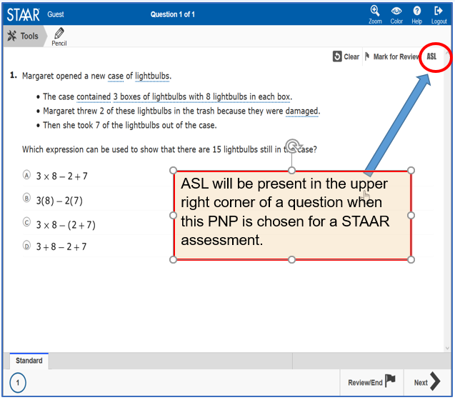
American Sign Language (ASL) Videos
Available on STAAR online as a PNP for students eligible for Oral/Signed Administration
PNP made available in spring 2019
Questions and answer choices signed in ASL for all subjects (not available for Content and Language Supports)
Closed-Captioning
Mini practice test with a few samples to practice using functionality is available

Slide 83
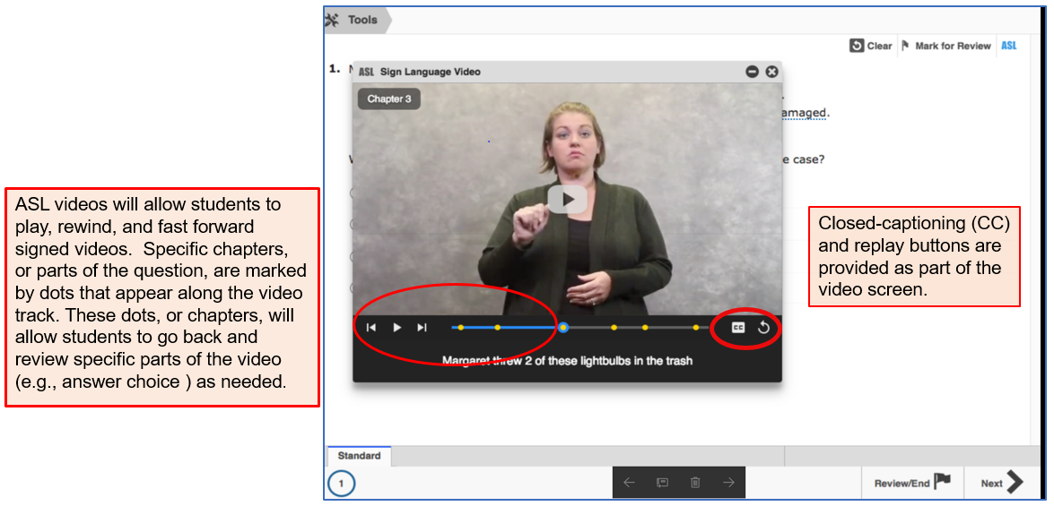
American Sign Language (ASL)

Slide 84
Spelling Assistance
A student may receive this support if served by an ARD committee or Section 504 committee.
  If a student is an EL with a disability, the decision is made by the ARD committee in conjunction with the student’s LPAC.
  Eligibility must be met for a student who receives Section 504 or special education services and routinely and effectively uses the support in classroom instruction and testing.
  A student should be capable of organizing and developing ideas and understands the basic function and use of written language conventions (e.g., sentence structures, irregular verbs) BUT has a disability that is so severe that he or she cannot apply basic spelling rules or word patterns (e.g., silent letters, base words with affixes) to written responses.

Slide 85
Spelling Assistance
  Available as an online embedded PNP support on STAAR writing (composition) if a student routinely uses a similar tool during class instruction.
    For example, if a student uses a frequently misspelled word list or speech-to-text, then do NOT activate the online spelling assistance PNP. The student will use what he or she routinely uses in class.
  Available on the STAAR Spanish online as an embedded PNP support for grade 4 writing.

Slide 86
Designated Supports Requiring TEA Approval
  These include supports that may be made available to students who have a TEA-approved accommodation request form.
  Eligibility decisions are made by the appropriate team of people at the campus level based on the eligibility criteria, and then an Accommodation Request Form is sent to TEA for determination.
  Other determinations should be made in conjunction with the testing coordinator prior to submitting to ensure appropriateness.
Complex Transcribing | Mathematics Scribe
Extra Day | Other

Slide 87
Accommodation Request Process
Online Accommodation Request Forms should only be submitted for designated supports requiring TEA approval (i.e., complex transcribing, math scribe, extra day, or other).
Open: October 2019
Link to form and training document: Accommodation Resources webpage
Expiration date of approved requests: The day the last test is administered for the academic year or by June 30, 2020.

Slide 88
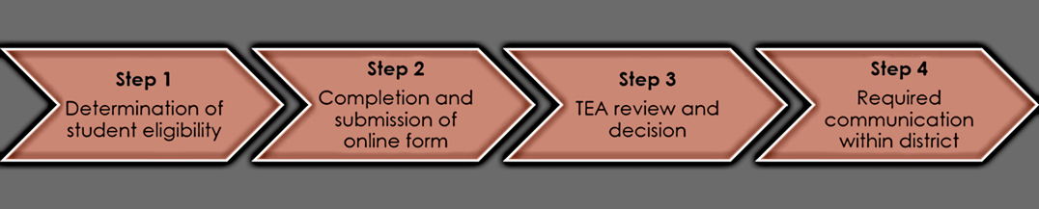
Accommodation Request Process
Accommodation requests must be approved before a student can use the accommodation on a state assessment. Documentation in the appropriate paperwork should state "Pending TEA approval.“
Accommodation Request Forms must be received by TEA at least one week prior to testing. Late requests will NOT be processed unless circumstances involving the student change after the deadline. Refer to the submission deadlines document
Do NOT include confidential student information (e.g., student’s first and last name, Social Security numbers, pages from an IEP, medical documents). Request will be deleted, and you will be asked to resubmit.

Slide 89
Special Administration Requests
Because English and Spanish Content and Language Supports are embedded PNP accommodations presented in an online format, replicating these features in a paper version is not always possible.
Technology-based supports enable most students to test online; however, in instances in which the use of an accommodation is not feasible or appropriate, or if the administration of an online test is inappropriate due to a student’s particular disability, a special request may be made to TEA for approval to administer a paper test booklet.
    This process also applies to TELPAS reading.
    For students taking TELPAS Listening and Speaking, a special request may be made to TEA for approval to assess holistically.

Slide 90
Special Administration Requests
Example situations when a request for a special administration of STAAR with Embedded Supports paper test is appropriate:
    Student has seizures or migraines from looking at computer screen and frequent breaks do not work.
    After multiple attempts throughout the year to acclimate the student to online testing, student becomes agitated or violent when beginning any practice test due to his or her disability.
    No access to technology because student is homebound with no internet connection available or student is in a juvenile detention facility and county does not allow online test application to be downloaded onto computers.

Slide 91
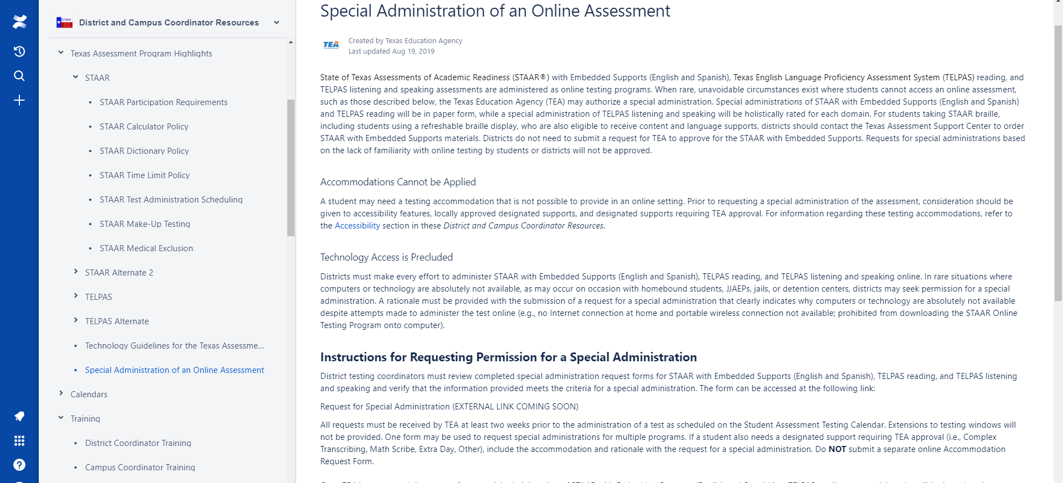
Special Administration Requests
NEW
INFORMATION
Form will be in the District and Campus Coordinator Resources under the link of Special Administration of an Online Assessment.
Special Administration Request Form will be open for submissions in October 2019.
NEW: Students taking braille who are also eligible for content and language supports will NOT need to have a special administration request form for the paper STAAR with Embedded Supports submitted.

Slide 92
LPAC Decision-Making Requirements
Designated supports decisions should be made as close as possible to the assessment to account for students' progress in acquiring the English language.
Making a determination for a student the previous year may not take into account this progress and must be revisited.
LPAC alone has authority for decision restricted to Oral Administration, Content and language supports, and Extra time.
NEW

Slide 93
RTI (and similar) Committee
Decision-Making Requirements
Depending on local policies for these committees (i.e., what time of year they meet):
  If the documented designated supports in place for the student are still valid, there is no reason to meet again.
  If the documented designated supports in place for the student are not valid, this should be corrected.

Slide 94
Section 504 Committee
Decision-Making Requirements
Section 504 committee should ensure that a student's accommodation plan is current for the school year.
    If the documented designated supports in place for the student are still valid, there is no reason to meet again.
    If the documented designated supports in place for the student are not valid, this should be corrected.

Slide 95
ARD Committee
Decision-Making Requirements
The responsibilities of the ARD committee do not change simply because the state assessment accommodation policy has changed. The purpose of an IEP is to document current and correct information. Any part of that document that is no longer true and valid should be updated.
    The ARD committee does not have to meet again regarding state assessment accommodations if decisions made at the annual meeting still apply to the current school year.
    The ARD committee would need to meet again regarding state assessment accommodations if decisions made at the annual meeting do not apply to the current school year.

Slide 96
Check for Understanding

Slide 97
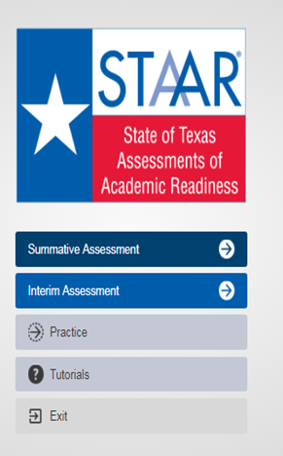
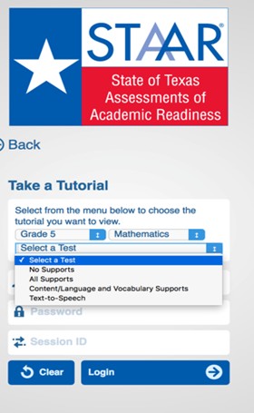
STAAR Online Tutorials
  When you open the STAAR Online Testing Platform (SOTP), you will see a menu of options, including “Tutorials.”
  Once you select “Tutorials,” you will be taken to a screen with several drop-down menus.
  Choose the grade, subject, and test (i.e., available supports) you want to view.

Slide 98
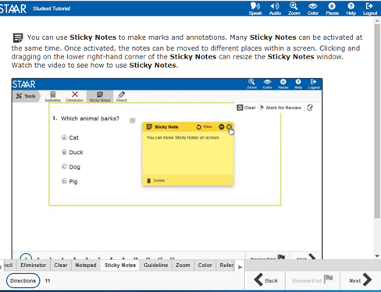
STAAR Online Tutorials
  Tabs at the bottom of the screen act as a table of contents. Each tab contains a page that explains the online feature/tool and provides a short video.
  Videos do not have sound except for the Speak and Audio videos, which only read aloud the text on the screen.
  The second page of each tab has a question that can be used to practice with the feature/tool you just learned about.
  The questions do NOT contain tested content but are only intended to practice using the feature/tool.

Slide 99

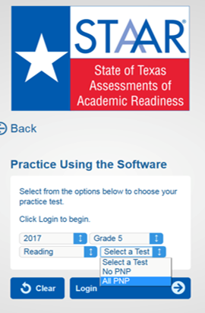
STAAR Online Practice
  When you open the STAAR Online Testing Platform (SOTP), you will see a menu of options, including “Practice.”
  Here you will find released tests for 2017 and 2018.
  All PNP will include the following supports:
    Text-to-Speech (when available)
    Spelling Assistance (writing compositions only)
    Content and Language Supports

Slide 100


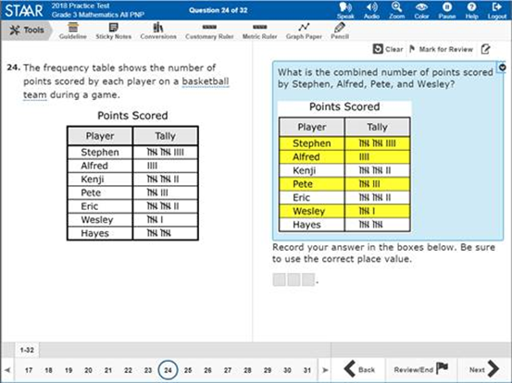
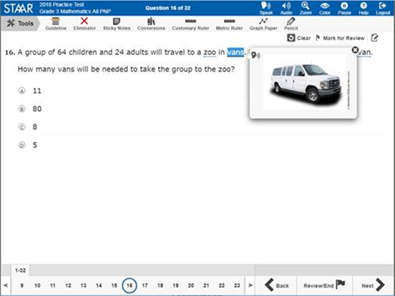
STAAR Online Practice

Slide 101


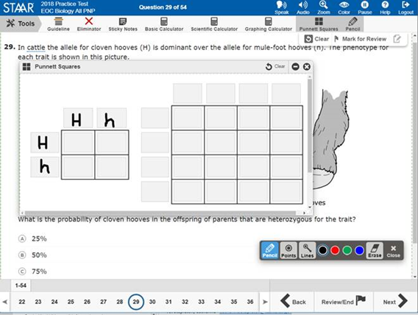
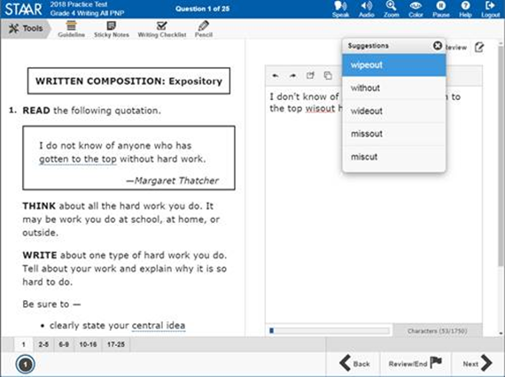
STAAR Online Practice

Slide 102


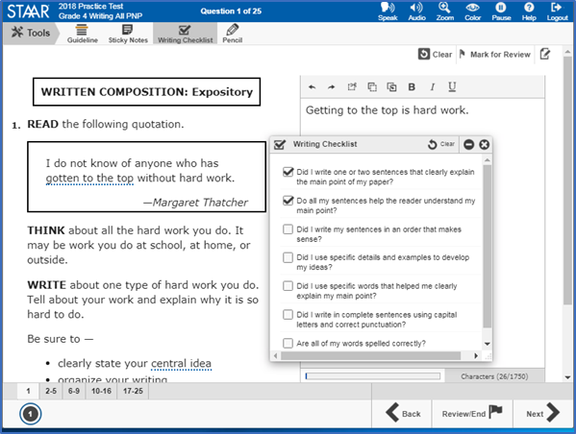
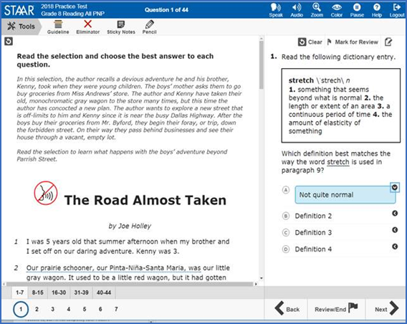
STAAR Online Practice

Slide 103
Questions?

Slide 104
TELPAS & TELPAS ALTERNATE Updates

Slide 105
TELPAS Updates for 2019-2020
TELPAS Manuals
TELPAS Centralized Raters

Slide 106
TELPAS Overview
TELPAS annually assesses the progress that English learners (ELs) make in learning the English language.
All K-12 students classified as LEP/EL in the Public Education Information Management System (PEIMS) are required to participate in TELPAS, including those who have parents who have declined bilingual/English as a Second Language (ESL) program services.

Slide 107
TELPAS Components
Grades K-1 | Grades 2-12
Holistically-rated assessments in listening, speaking, reading, and writing Classroom observations and student interactions | Online test for reading, listening, and speaking Holistically-rated student writing collection

Slide 108
Exceptions
  There are exceptions to an EL being assessed in one or more language domain.
An EL receiving special education services
  Decision must be made by ARD committee in conjunction with the LPAC.
  Participation must be considered on a domain-by-domain basis.
  Reason for not assessing student must be well-supported and documented.
An EL from another Texas school district, state, or country who enrolls on or after the first day of the TELPAS testing window
  Will not be assessed by receiving district in the holistically-rated domains.
  Is required to take the TELPAS reading test and the listening and speaking test

Slide 109
Special Administration of TELPAS
In rare circumstances that prevent a student from testing online, TEA may grant approval for a special administration of a TELPAS online test (reading or listening and speaking) for grades 2–12.
  Accommodations cannot be applied
  Technology access is precluded
The decision to recommend a special administration of TELPAS must be determined by the appropriate team of people at the campus level (e.g., RTI team, student assistance team, 504 team).
TELPAS reading requests are for paper versions, while TELPAS listening and speaking requests are for holistic assessments that require training and calibration to administer.

Slide 110
TELPAS Manuals: Raters and Test Administrators
NEW
  Based on feedback from the field and advisory groups, the TELPAS manuals organization will be updated in the 2019-2020 school year.
  TELPAS Rater Manual will only be online and not shipped to districts.
  TELPAS Test Administrator Manual will be online as well as printed and shipped to districts.
  Both manuals will be posted on the TELPAS Resources webpage and in the District and Campus Coordinator Resources (DCCR).

Slide 111
TELPAS Rater Resources – Training Purposes
 | K-1 Raters | 2-12 Raters
For training purposes: | K-12 Listening PLDs K-12 Speaking PLDs K-1 Reading PLDs K-1 Writing PLDs | 2-12 Writing PLDs If approved for a special administration of listening and speaking test, 2-12 raters will also need: K-12 Listening PLDs K-12 Speaking PLDs
For easier access, the PLDs will be in an appendix of the TELPAS Rater Manual.

Slide 112
TELPAS Rater Resources – Rater Purposes
 | K-1 Raters | 2-12 Raters
For rating purposes: | K-12 Listening PLDs K-12 Speaking PLDs K-1 Reading PLDs K-1 Writing PLDs TELPAS Student Rating Roster | 2-12 Writing PLDs TELPAS Student Rating Roster Writing Collection Cover Sheet Writing Collection Verification Checklist If approved for a special administration of listening and speaking test, 2-12 raters will also need: K-12 Listening PLDs K-12 Speaking PLDs
For easier access, the PLDs will be in an appendix of the TELPAS Rater Manual.

Slide 113
TELPAS Writing Collections: Centralized Raters
NEW
Districts will have the option to designate one or more centralized raters to rate TELPAS grades 2-12 writing collections district wide or only at a campus(es) or grade level.
  The centralized raters will still have to meet the TELPAS rater requirements (training and calibration).
  Exception: This does not apply to raters of students that have been approved for a special administration of the TELPAS listening and speaking assessment.

Slide 114
TELPAS Writing Collections: Centralized Raters
NEW
The implementation of centralized raters is not a requirement. It is solely an option to provide districts some flexibility in the TELPAS assessment of grades 2-12 student writing collections.
  As noted before, the centralized raters will still have to meet the TELPAS rater requirements. However, districts, at their own discretion, may require additional training for those raters designated as centralized raters.

Slide 115
TELPAS Writing Collections: Centralized Raters
NEW
Teachers of ELs in 2-12 are still required to assemble an EL’s writing collection to be rated.
Districts using centralized raters will need to develop their own process to gather the writing collections district wide, campus wide or by grade level.
Teachers assembling the writing collection(s) are required to receive TELPAS administration procedures training in order to ensure that writing collections are assembled appropriately.

Slide 116
K-1 Rater Credentials
A teacher (including a substitute teacher) selected to rate an EL must
  have the student in class at the time of the spring assessment window
  be knowledgeable about the student’s ability to use English in instructional and informal settings
  hold valid Texas education credentials, such as a teacher certificate or permit
  be appropriately trained in the holistic rating process
  rate the student in all eligible domains
Raters may include bilingual teachers, ESL teachers, general education teachers, gifted and talented teachers, and teachers of enrichment subjects. Paraprofessionals may not serve as raters.

Slide 117
2-12 Rater Credentials (writing only)
NEW
Starting in 2019-2020, a rater does not need to have the student in class at the time of the spring assessment.
The rater (including a substitute teacher) selected to rate an EL must
  hold valid Texas education credentials, such as a teacher certificate or permit
  be appropriately trained in the holistic rating process*
It is important to note that teachers are still required to assemble writing collections.
Districts that designate centralized raters (district wide, campus wide, or by grade levels) will need to develop their own process to gather and verify the writing collections.
Paraprofessionals may not serve as raters.
*Please note that districts, at their discretion, can implement additional requirements for grades 2-12 raters of writing collections.

Slide 118
2-12 Rater Credentials
(listening, speaking, and writing)
In rare circumstances, an EL may be approved for a special administration for the listening and speaking domains. In this situation, the teacher must rate the student in all the eligible domains.
A teacher (including a substitute teacher) selected to rate an EL must
  have the student in class at the time of the spring assessment window
  be knowledgeable about the student’s ability to use English in instructional and informal settings
  hold valid Texas education credentials, such as a teacher certificate or permit
  be appropriately trained in the holistic rating process
  rate the student in all eligible domains
Raters may include bilingual teachers, ESL teachers, general education teachers, gifted and talented teachers, and teachers of enrichment subjects. Paraprofessionals may not serve as raters.

Slide 119
Centralized Raters: Teachers of ELs in 2-12
NEW
Teachers of grades 2-12 ELs are still required to assemble student writing collections.
As noted before, the centralized raters will still have to meet the TELPAS rater requirements. However, districts, at their own discretion, may require additional training for those raters designated as centralized raters.

Slide 120
Check for Understanding

Slide 121
TELPAS Resources
Resource | Purpose | Audience
Educator Guide to TELPAS and TELPAS Alternate | Provides an overview of TELPAS and TELPAS Alternate and serves to support effective implementation of the ELPS and PLDs to guide instruction | Administrators, Coordinators, Teachers
TELPAS Training PowerPoints | Provide introductory training resources for educators and raters that administrators/coordinators to build foundational knowledge of TELPAS | Administrators, Coordinators, Teachers
TELPAS Reading, Listening, and Speaking Blueprints | Provide districts with the test blueprints (reading, listening, and speaking) and TELPAS speaking rubrics | Administrators, Coordinators, Teachers

Slide 122
TELPAS Resources
Resource | Purpose | Audience
TELPAS Speaking Rubrics | Were derived from the TELPAS proficiency level descriptors (PLDs) and demonstrate the number of score points that a student can achieve based on their performance on each speaking test item | Administrators, Coordinators, Teachers
TELPAS Reading Released Tests | Are available in the online interface and can be used to administer to students for diagnostic purposes | Administrators, Coordinators, Teachers
TELPAS Tutorial | Assists students to become familiar with online TELPAS tests (navigating through tests, online tools, and interaction with listening and speaking test items) | Administrators, Coordinators, Teachers, Students

Slide 123
TELPAS Resources (continued)
Resource | Purpose | Audience
TELPAS Listening and Speaking Practice Sets | Created to help students become familiar with online listening and speaking test items and to practice recording speaking responses | Administrators, Coordinators, Teachers, Students
TELPAS Microphone and Headset Check | Available in the TestNav app under the “Practice Tests” link for districts to test connection, recording, and audio playback of their headsets prior to utilizing listening and speaking practice sets and definitely before testing | Administrators, Coordinators, Teachers
TELPAS Parent Resources | Provide parent resources that include TELPAS FAQs and TELPAS parent tips for all language domains | Administrators, Coordinators, Teachers

Slide 124

TELPAS Alternate
There are no significant changes to TELPAS Alternate.
We are in the process of developing additional resources.

Slide 125

What is TELPAS Alternate?
  A holistic inventory that assesses the language domains of listening, speaking, reading, and writing for students with significant cognitive disabilities in grades 2-12
  Aligned to the Texas English Language Proficiency Standards (ELPS)
  Based on alternate Proficiency Level Descriptors (PLDs) created to address the specific access needs of this population

Slide 126
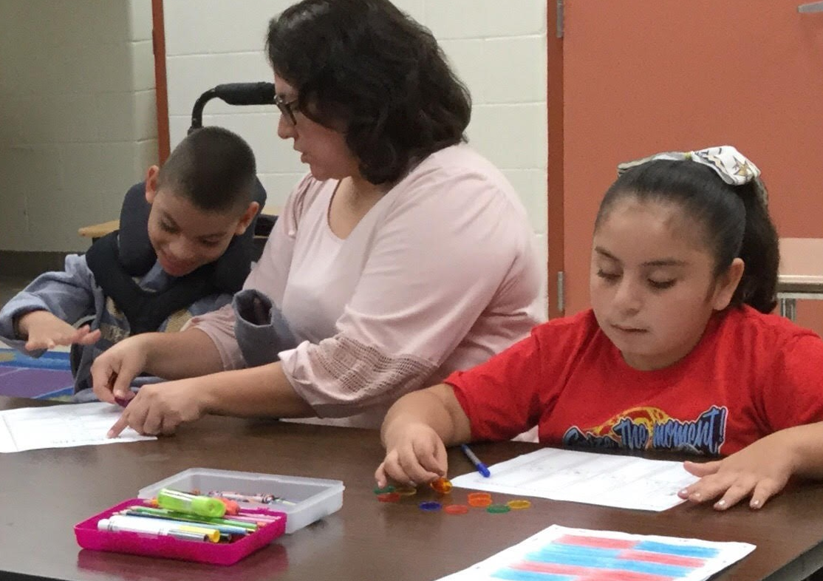
Who takes TELPAS Alternate?
  Students taking TELPAS Alternate are English learners in grades 2-12 who have significant cognitive disabilities and who are in the process of acquiring English proficiency in listening, speaking, reading, and writing.
  These students have one or more disabilities that significantly limit their intellectual functioning, as shown by their ability to plan, comprehend, and reason, and their adaptive behavior, as shown by their ability to apply social and practical skills.

Slide 127
Who is assessed with TELPAS Alternate?
Grades K – 1 | No TELPAS Alternate for K-1 at this time. All ELs, including students receiving special education services, will take TELPAS K-1 holistically rated assessment for all four language domains.
Grade 2 | Participation requirements are available on TEA’s TELPAS Alternate Resources webpage. ARD committees, in conjunction with the LPAC, are required to review the participation requirements and determine and document student eligibility for TELPAS Alternate.
Grades 3 - 12 | Participation requirements are available on TEA’s TELPAS Alternate Resources webpage. ARD committees, in conjunction with the LPAC, are required to determine and document student eligibility for TELPAS Alternate. If the student is LEP and is eligible for STAAR Alternate 2, he or she will take TELPAS Alternate.

Slide 128
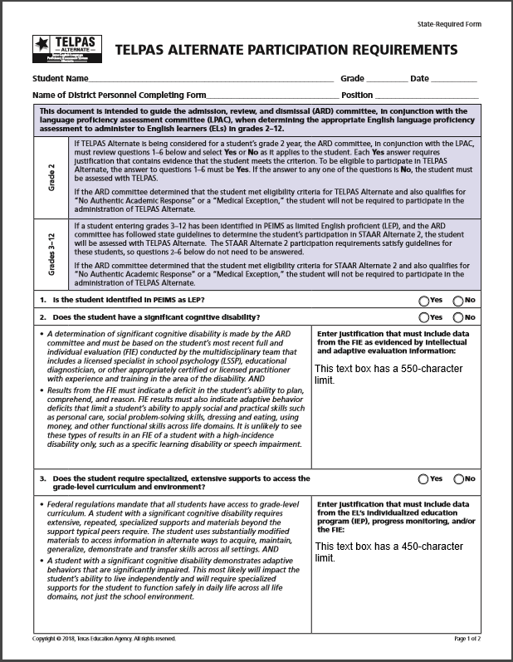
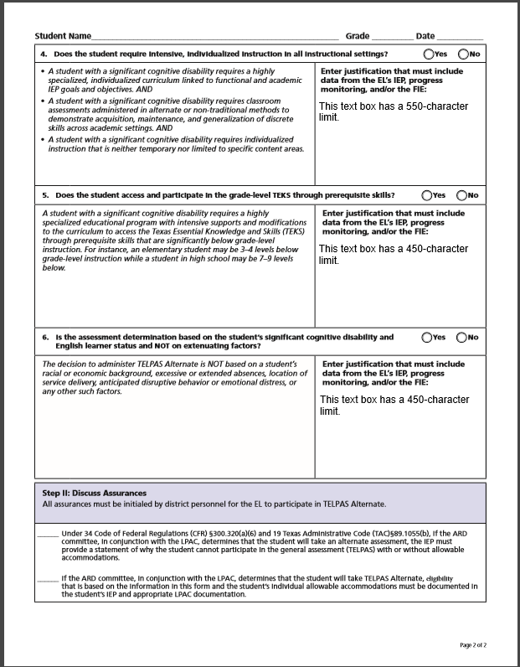
TELPAS Alternate Participation Requirements
Update
  Participation requirements (in English and Spanish) for grades 2-12 are available on TEA’s TELPAS Alternate Resources webpage.
  Participation requirements are intended to guide the ARD committee, in conjunction with the LPAC, when determining the appropriate English language proficiency assessment to administer to ELs.
  Documentation of eligibility is different for students in grade 2 compared to students in grades 3-12.
  UPDATE: For student in grades 3-12, the LPAC will now answer question 1: “Is the student identified in PEIMS as LEP?” and initial the assurances in Step II.

Slide 129
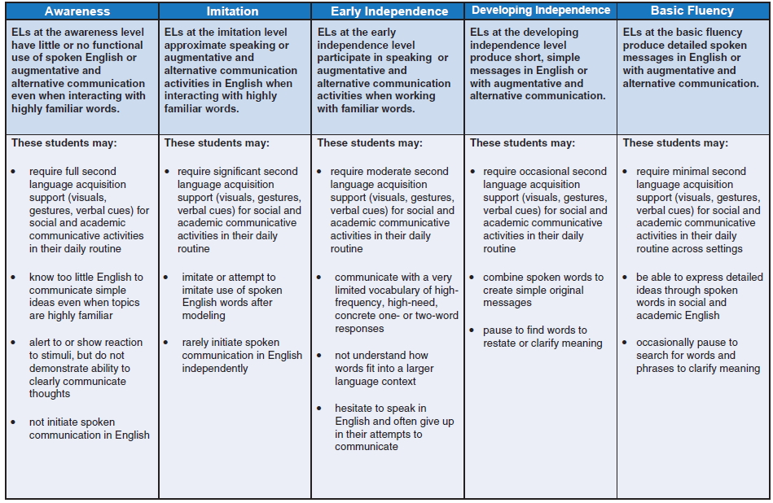
Alternate Proficiency Level Descriptors (PLDs)
  The Alternate PLDs are domain-specific and define how well ELs at the five proficiency levels are able to understand and use English in social and academic settings.
  The descriptors show the progression of second language acquisition from one proficiency level to the next and serve as a road map to help teachers tailor instruction to the linguistic needs of ELs.
  Located on the TELPAS Alternate Resources webpage.

Slide 130
What are Observable Behaviors?
  The “questions” are called Observable Behaviors. Each Observable Behavior describes characteristics that students learning English demonstrate as they gain proficiency.
  Test administrators, based on their knowledge of a student’s English language skills over a period of time, will make holistic judgments across all four domains of English language proficiency (listening, speaking, reading, writing) using alternate ELPS-aligned observable behaviors.

Slide 131
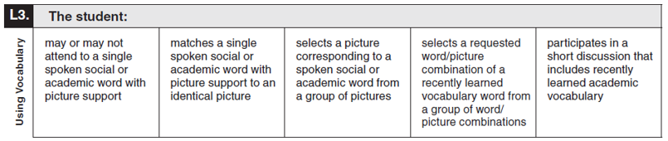
Observable Behaviors: Notes Version
  A “notes version” of the Observable Behaviors can be found on TEA’s TELPAS Alternate Resources web page. It is available so that educators can become familiar with the Observable Behaviors and practice using them during the school year.

Slide 132
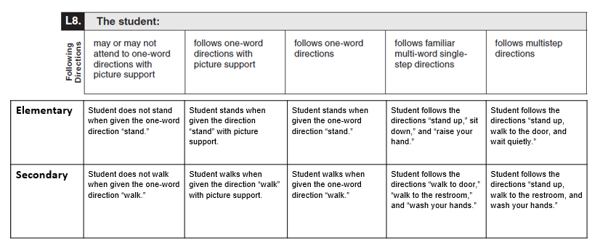
Observable Behaviors with Classroom Examples
  Texas teachers developed classroom examples to help test administrators better understand the descriptions of student performance for each Observable Behavior.
  Elementary and secondary examples describe one way that students could demonstrate each skill across the five levels of proficiency.
An accessible version of the Observable Behaviors and classroom examples can be found at https://tea.texas.gov/student.assessment/telpasalt/#Alt

Slide 133
Using the Classroom Examples
  The purpose of each example is to illustrate how a student could demonstrate the skill at each proficiency level.
  There are many other classroom activities that could be used as examples for the Observable Behaviors.
  These examples are not intended to be used as test questions or performance tasks for teachers to replicate, although using them for this purpose is acceptable if needed.
  Teachers are encouraged to use their own activities in the regular classroom setting when determining a student’s ability to understand and use English.

Slide 134
TELPAS Alternate Training
TELPAS Alternate Test Administrator Manual
A series of training PowerPoints is available on TEA’s TELPAS Alternate Resources webpage. Each PPT can be reviewed by in about 10-15 minutes. Introduction to TELPAS Alternate.
  TELPAS Alternate Student Eligibility (coming soon)
  TELPAS Alternate Accessibility (coming soon)
  TELPAS Alternate Listening Domain
  TELPAS Alternate Speaking Domain
  TELPAS Alternate Reading Domain
  TELPAS Alternate Writing Domain
  TELPAS Test Administration (coming soon)
While the PPTs are not required, TEA highly recommends that test administrators rating students using TELPAS Alternate view these PPTs to become familiar with unique aspects of a TELPAS Alternate administration.

Slide 135
TELPAS Alternate Resources
Resource | Purpose | Audience
Educator Guide to TELPAS and TELPAS Alternate | Provides an overview of TELPAS and TELPAS Alternate and serves to support effective implementation of the ELPS | Administrators, Coordinators, Teachers
Participation Requirements | Used by ARD committees in conjunction with the LPAC to make decisions about TELPAS Alternate | Members of ARD committees and LPACs
Observable Behaviors | Measures the student’s use of English and contain a notes section that can be used to become accustomed to TELPAS Alternate prior to the assessment window | Teachers

Slide 136
TELPAS Alternate Resources (continued)
Resource | Purpose | Audience
Parent Brochure | Communicates (English and Spanish) basic information about TELPAS Alternate | Parents
Test Administration Manual | Contains instructions covering the responsibilities of test administrators and the observable behaviors used to assess students Required to be read carefully and followed as written | Administrators, Coordinators, Teachers serving as test administrators
Training PowerPoints | Provides training on a variety of topics, including authentic classroom activities for each domain that explain how to rate students with the observable behaviors Designed as short PowerPoints that can be viewed in 30 minutes or less Are optional though highly recommended | Administrators, Coordinators, Teachers serving as test administrators

Slide 137
Questions?

Slide 138
STAAR Alternate 2 Updates

Slide 139
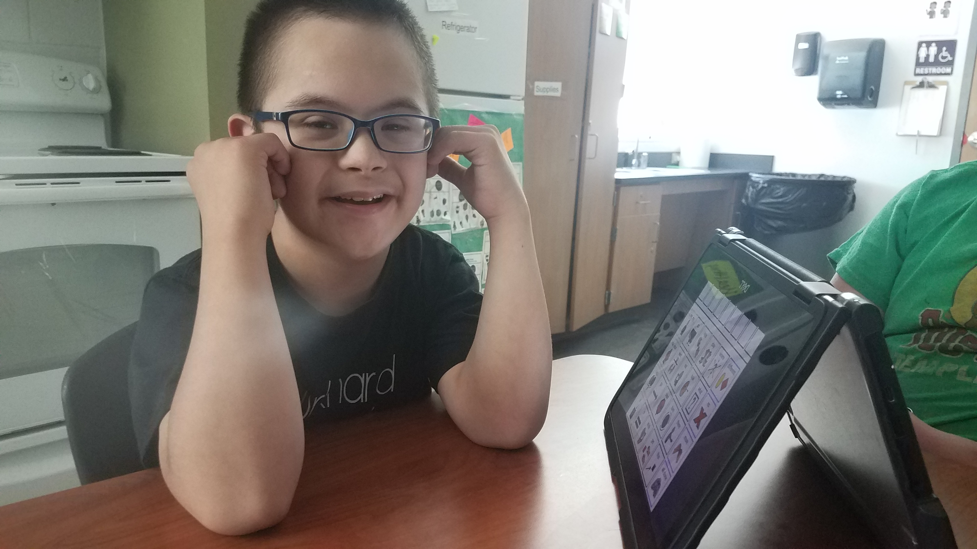
Definition of Significant Cognitive Disability
Texas' definition of a student with a significant cognitive disability:
exhibits significant intellectual and adaptive behavior deficits in their ability to plan, comprehend, and reason, and ALSO indicates adaptive behavior deficits that limit their ability to apply social and practical skills such as personal care, social problem-solving skills, dressing, eating, using money, and other functional skills across life domains;
is NOT identified based on English learner designation or solely on the basis of previous low academic achievement or the need for accommodations; and
requires extensive, direct, individualized instruction, as well as a need for substantial supports that are neither temporary nor specific to a particular content area.

Slide 140
STAAR Alternate 2 Eligibility Decisions
Revised in 2018 to
  clarify the scope of students who are taking STAAR Alternate 2 and
  satisfy the requirements of ESSA, 2015
TETN STAAR Alternate 2 2018-2019 Participation Requirement Training
  https://tea.texas.gov/student.assessment/special-ed/staaralt/

Slide 141
STAAR Alternate 2 Key Dates 2019-2020
12/2-1/3
Submit registrations
3/9-4/21
Late registrations
2/10
Materials list available
3/9-4/10
Additional order window
3/16-3/27
5/1
Preview window
3/30-4/21
Testing window
Ship all nonscorable materials
Additional dates can be found in 2019-2020 Calendar of Events

Slide 142
STAAR Alternate 2 Key Dates
Students who enroll on or after March 30, 2020
  Students who transfer/move to a new district on or after the first day of the STAAR Alternate 2 testing window do not have to be tested.
  Students who transfer within the same district after the first day of the STAAR Alternate 2 testing window still must be tested by the district where the student is enrolled.

Slide 143
Check for Understanding

Slide 144
STAAR Alternate 2 Webpage Updates
  Fall postings
  Updated STAAR Alternate 2 Educator Guide and TAM
  Updated Instructional Terms lists
  Updated Essence Statements
  Updated Social Studies Vertical Alignment and Curriculum Framework documents
  Late Fall postings
  Updated RLA Vertical Alignment and Curriculum Framework documents

Slide 145
STAAR Alternate 2 Test Administrator Training
  Training Topics
  Roles and Responsibilities
  Test Security
  Scheduling Test Administrations
  Preparation for Test Administration (Preview Window)
  Testing with Accommodations
  Monitoring Test Administrations
  Returning Materials to District Coordinator
  Resources
  DCCR STAAR Alternate 2 section
  STAAR Alternate 2 Test Administrator Manual non-secure
  STAAR Alternate 2 Educator Guide

Slide 146
Test Administrator role
Who should administer STAAR Alternate 2?
  Ideally, the student’s teacher for the subject being tested because of a high level of familiarity with the student
    Accommodations can be prepared and delivered appropriately
    The student’s typical response mode can be understood
  Paraprofessionals may serve as test administrators supervised by a certified professional on the same campus throughout the administration.
    Trained in preparation of test materials and test administration procedures
    Signed oath
  See additional options for test administrator in the District and Campus Coordinator Resource

Slide 147
Preview Window Actions
  Practice reading the script and following the presentation instructions for test administration
  Review the Scoring Instructions for test question and plan teacher assistance for items 2 and 3 in each cluster.
  Review the student booklet and image cards to plan and prepare accommodations for any student who may need an accommodation according to the guidelines outlines in “Allowable Accommodations” in the STAAR Alternate 2 Test Administrator Manual
  NOT a preteach period
    Any presentation of materials or introduction of concepts or topics to a student prior to the administration of the test is considered a serious irregularity ad should be reported as such.

Slide 148
Scheduling Test Administrator sessions
  The ARD committee meeting should make assessment decisions as early in the current school year as possible or at the end of the prior year to the applicable school year. The meeting should occur prior to the start of the STAAR Alternate 2 testing window.
  No verification window
    Final day to submit scores online 4/21/20.
  Each district may develop a local schedule for STAAR Alternate 2 assessments during the designated test administration window specified in the Calendar of Events.
  District or campus coordinator should communicate the schedule that test administrators should follow.

Slide 149
Scheduling Individual Test Sessions
STAAR Alternate 2 is an untimed assessment that can be given over multiple sessions.
  Administer the assessment at a time that is most appropriate for a student;
    Allowing breaks, as necessary;
    Administering the test over several days with several sessions per day; or
    Administering the test over several days, one session each day.
  Items are best tested with the entire four-item cluster intact, one cluster at a time. However, frequent breaks within the 4-item cluster may be required and necessary for some students.

Slide 150
Test Administration with Image Cards
Image Cards
  STAAR Alternate 2 must be administered with the student booklet
  Image cards are an optional tool used to
    Support text with images
    Present answer choices one at a time
  A test administrator may use image cards for multiple students;
    Complete clean card
    NO appearance of use whatsoever – no accommodations applied (e.g. highlighting, coloring, cropping, etc.)

Slide 151
Test Administration with Image Cards
Image Cards
  Test administrators should utilize image cards in the same way they previously accommodated the student booklet page.
  EXAMPLES of accommodations that image cards may replace:
    Photocopying and then cutting apart answer choices in order to present answer choices one at a time
    Photocopying and then cutting out an image to pair with text
    Other accommodations that required photocopying and then making a “card” to assist with test administration
  Image cards have a number stamp on the back to correspond with test items.
  On rare occasions, test items do not have an accompanying image card due to nature of the stimulus.

Slide 152
Testing Environment
Test administrators must prepare the environment for the administration of STAAR Alternate 2.
STAAR Alternate 2 is administered to students in a one-on-one setting.
Test sessions
  must be conducted under the best possible conditions with minimal distractions
  and in a setting that is arranged to maintain confidentiality of test material and responses of individual students.
Districts with cameras in self-contained classrooms should use locally-developed policy which includes “penalties for prohibited conduct” in the event that a request is made to view video that was recorded during a test administration session

Slide 153
Entering Responses Online
Students taking the STAAR Alternate 2 administration communicate answers directly to the test administrator.
The test administrator records the student’s response on the STAAR Alternate 2 Scoring Document based on scoring information provided for each item.
The students’ responses are then entered into the Assessment Management System.
The district coordinator, campus coordinator, or other authorized personnel who have completed training and signed oath will enter scoring information into an online system.

Slide 154

ESSA 1% Waiver
TEA’s request for a limited waiver to assess more than 1% of students using an alternate assessment in the 2018-2019 school year in reading/language arts, science and mathematics was approved by the United States Department of Education (USDE) in March, 2019.
Based on state assessment data for Spring 2019, TEA will again be requesting a waiver for the 2019-2020 school year.

Slide 155
% of Districts Exceeding 1% Participation Rate
81%
42%
ESC Regions

Slide 156
% of Districts Exceeding 1% Participation Rate
80%
30%
ESC Regions

Slide 157
Statewide Student Participation Data
 | Spring 2017 |  | Spring 2018 |  | Spring 2019
Math Alternate | 37,980 | 1.4% | 40,646 | 1.4% | 41,836 | 1.5%
All Students Math | 2,807,473 |  | 2,804,047 |  | 2,821,402
Reading/ELA Alternate | 42,398 | 1.2% | 45,392 | 1.3% | 47,136 | 1.3%
All Students Reading ELA | 3,522,895 |  | 3,487,018 |  | 3,584,899
Science Alternate | 15,305 | 1.2% | 16,780 | 1.3% | 16,984 | 1.3%
All Students Science | 1,243,552 |  | 1,271,379 |  | 1,280,714

Slide 158
Subgroup Data for Districts over 1%
Data provided by TEA allows districts over 1% to compare
  Subjects
  Grade level
  Race/Ethnicity/Gender
  Economically Disadvantaged
  English Learners (Els)

Slide 159
Subgroup - Reading Participation Rates

Slide 160

State Disability Data
STAAR Alternate 2 Participation
Spring 2018 to 2019
PRIMARY DISABILITY

Slide 161
State Disability Data
STAAR Alternate 2 Participation Spring 2019
PRIMARY DISABILITY

Slide 162
STAAR Alternate 2
Waiver Request (3rd Year)
  How to submit:
  School districts/charters will receive an email notification indicating that based on 2018-2019 data the LEA assessed more than 1% of its assessed students with STAAR Alternate 2.
    Email will include a PDF attachment of district/charter specific STAAR Alternate 2 participation data
    Email will include a link to complete the waiver form.
  Email notification will be sent to the Superintendent of the school district or the Chief Administrative Official of the charter school AND person submitting the form.
  Districts/charters will receive an email acknowledgement that the district’s waiver information has been received.

Slide 163
ESSA 1% Participation Cap
ESSA reauthorization 2015 placed a state cap on participation in statewide alternate assessment
federally mandated
By 2020 every state should be under 1% cap
# of students assessed with SA2 in SUBJECT
# of ALL students assessed in SUBJECT
2019 PBMAS SPED Indicator #4: SPED STAAR Alternate 2 Participation Rate
Part of TEA’s annual evaluation of school performance and program effectiveness.
Report Only indicator
SPED STAAR Alternate 2 overall participation rate denominator includes STAAR, STAAR Spanish, and STAAR Alternate 2 assessments.
SPED STAAR Alternate 2 overall numerator is for STAAR Alternate 2 grades 3-8 and EOCs.
Students quality for ME or NAAR designation are not included in the calculation of this indicator

Slide 164
Monitoring Plan
Continued training on participation requirements
Collaboration with the Special Education monitoring team
New PBMAS indicator
  Data gathering only
  No staging initial year
  Inform agency regarding support that should be provided to district

Slide 165
Questions?

Slide 166

Call Drivers and Best Practices

Slide 167
ETS Call Drivers and Best Practices – Registration and Precoding

Slide 168

Call Drivers and Best Practices – Registration and Precoding
How can a district testing coordinator (DTC) correct information on a precoded answer document?
  Best Practice: Student identification information and data on precodes must be verified (and, if necessary, corrected) before testing begins.
    A blank answer document must be hand-gridded to make corrections to a student’s first or last name, PEIMS ID, or date of birth; other precoded data that is hand-gridded will override information precoded on the answer documents (ex: LEP indicator).

Slide 169

Call Drivers and Best Practices – Registration and Precoding
Correcting Information on a Precoded Answer Document – Out of Process
  Example: A student’s PEIMS number is incorrect on their precode.
    DTC incorrectly decides to hand-grid the student’s corrected PEIMS ID on the precoded answer document.

Slide 170
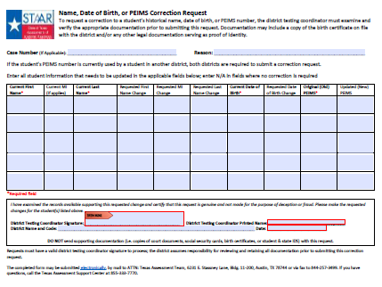
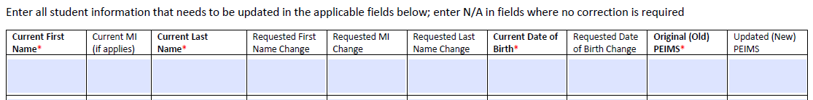
Call Drivers and Best Practices – Registration and Precoding
Correcting Information on a Precoded Answer Document – Out of Process
    Results:
      Scanner does not read the hand-gridded PEIMS ID, and the document is processed using the precoded PEIMS ID.
      Scores are reported using the incorrect PEIMS ID, and it may appear that scores are missing.
        There may be a tangle.
        The student will have a split history in the Student Portal.
        The DTC will need to submit a Name, Date of Birth, PEIMS
        Correction Request Form.

Slide 171

Call Drivers and Best Practices – Registration and Precoding
Correcting Information on a Precoded Answer Document – Following Process
  Example: A student’s PEIMS number is incorrect on their precode.
    DTC correctly decides to void the precode and complete a hand-gridded answer document with the student’s correct PEIMS ID.
    Results:
      The hand-gridded document is processed using the correct PEIMS ID.
      The student’s score are reported using the correct PEIMS ID.
      No additional action is needed by the DTC.

Slide 172
Call Drivers and Best Practices – Registration and Precoding
Check for Understanding

Slide 173

Call Drivers and Best Practices – Registration and Precoding
How can a district ensure precoded answer documents are received for testing?
  Best Practice: DTCs should upload their local data file or register students by the close of the Paper Materials Window on the COE.
    Allow time for investigation and correction of upload warnings and errors.
    Allow time for review of data before the window close to ensure accurate precodes and correct test booklet quantities.
    To avoid late fees and an ensure timely receipt of precodes and test booklets, DTCs should register students as noted on the Calendar of Events (COE).

Slide 174
Call Drivers and Best Practices – Registration and Precoding
Student Registration for Precoded Answer Documents– Out of Process
  Example: A district does not register any students for the December test administration during the window noted on the COE (9/16 – 10/4).
    DTC incorrectly decides to wait and register all students one month prior to testing.

Slide 175
Call Drivers and Best Practices – Registration and Precoding
Student Registration for Precoded Answer Documents– Out of Process
    Results:
      The district will not receive any precodes during “Districts receive precoded materials.”
      The district will not receive any test booklets or other test materials during the “Districts receive shipment of test materials” Window.
        DTC must order test booklets and other testing materials during the “Districts order additional materials” Window (December only).
        Orders placed during this window will be packaged at the district level and will be shipped in the order received.

Slide 176
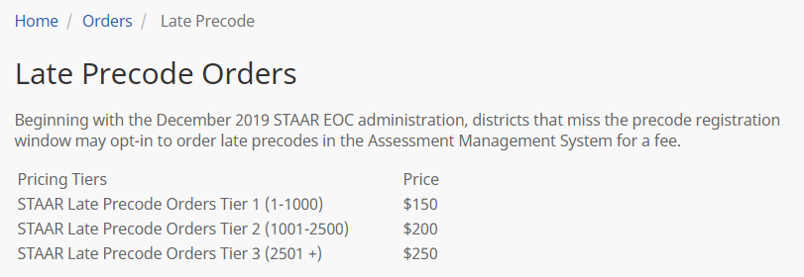
Call Drivers and Best Practices – Registration and Precoding
Student Registration for Precoded Answer Documents– Out of Process
    Results:
      The district may opt in during the Late Precode Window (Orders > Late Precode).
        District must opt in for late precodes and load paper registrations.
        District will incur a late fee based on the quantity of precodes requested.
        Late precodes will not arrive with the district’s initial shipment.
        Late precodes will arrive the Wednesday prior to testing (challenge in distribution to campuses).

Slide 177
Call Drivers and Best Practices – Registration and Precoding
Student Registration for Precoded Answer Documents– Following Process
  Example: DTC registers all students for the December End-of-Course test administration during the window noted on the COE (9/16 – 10/4).
    DTC correctly registers all students and allows time to verify registrations are accurate before the close of the Paper Materials Registration Window.

Slide 178
Call Drivers and Best Practices – Registration and Precoding
Student Registration for Precoded Answer Documents– Following Process
    Results:
      District will receive precodes by the “Districts receive precoded materials” date on the COE.
      District will receive test booklets and other test materials during the “Districts receive shipment of test materials” Window.
      No late fees will be assessed as registrations were submitted as noted on the COE.

Slide 179
Call Drivers and Best Practices – Registration and Precoding
Check for Understanding

Slide 180

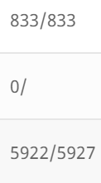
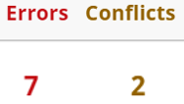
Call Drivers and Best Practices – Registration and Precoding
How can a district testing coordinator ensure their upload file has processed?
  Best Practice: Upload local data files in advance of the paper materials registration deadline to provide adequate time for investigation and correction of upload errors and conflict warnings.
    All records from the upload file have loaded.
    No records from the upload file have loaded.
    Some but not all records from the upload file have loaded.

Slide 181
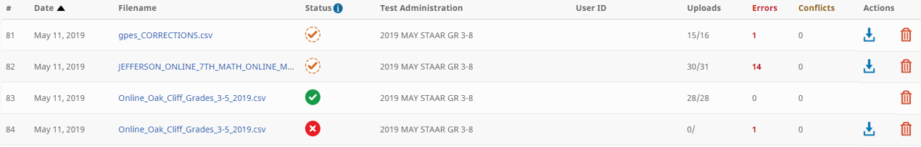

Call Drivers and Best Practices – Registration and Precoding
How can a district testing coordinator ensure their upload file has processed?
  Best Practice: Upload local data files in advance of the paper materials registration deadline to provide time for investigation and correction of upload errors and conflict warnings.

Slide 182
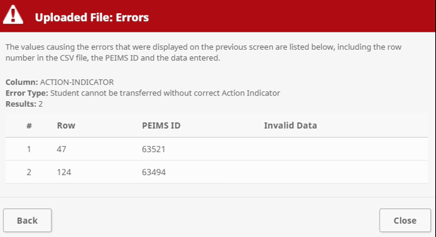
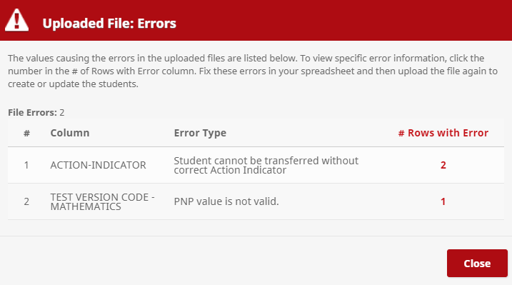
Call Drivers and Best Practices – Registration and Precoding
How can a district testing coordinator ensure their upload file has processed?
    Errors occur when data entered does not conform to data file specifications; errors indicate that data needs to be corrected to specifications.
      Example: using the 18–19 template to load 19–20 data

Slide 183
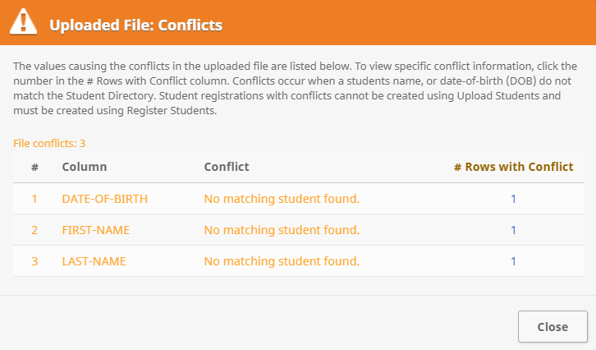
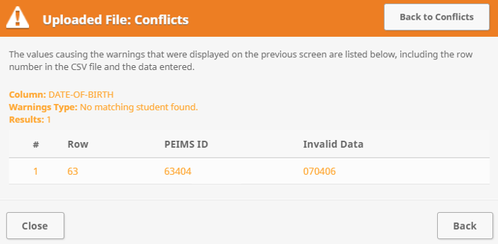
Call Drivers and Best Practices – Registration and Precoding
How can a district testing coordinator ensure their upload file has processed?
    Conflicts occur when there is a mismatch between uploaded student data and Student Directory information; conflicts indicate required research and correction is needed.
      Example: A student’s first name in the upload file is Matt; the Student Directory shows the student’s first name as Matthew

Slide 184
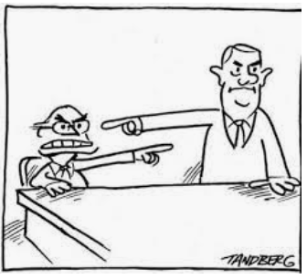
Call Drivers and Best Practices – Registration and Precoding
Student Registration Upload – Out of Process
  Example: DTC has their technology staff load a student registration file.
  Nobody checks the upload file, assuming the other person has, before the registration for paper materials closes. The file has a processing error, and no records have loaded.

Slide 185
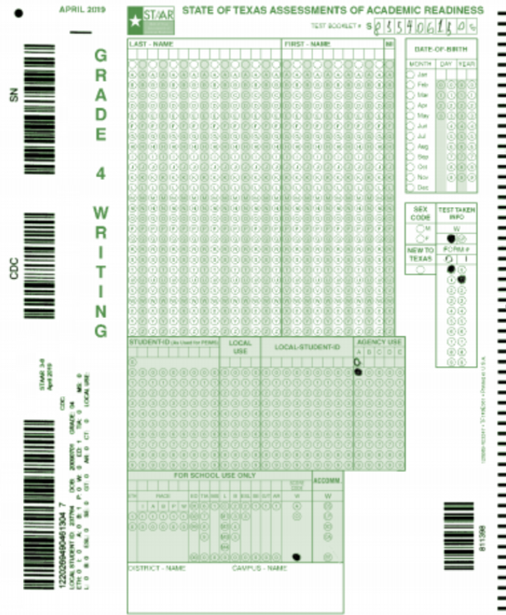
Call Drivers and Best Practices – Registration and Precoding
Student Registration Upload – Out of Process
    Results:
      District will not receive any precodes during “Districts receive precoded materials.”
      District may opt in to order precodes during the Late Precode Window (Orders > Late Precode).
        District must opt in for late precodes and load paper registrations.
        District will incur a late fee based on the quantity of precodes requested.
        Late precodes will not arrive with the district’s initial shipment.
        Late precodes will arrive the Wednesday prior to testing (challenge in distribution to campuses).

Slide 186
Call Drivers and Best Practices – Registration and Precoding
Student Registration Upload – Out of Process
    Results:
      District will not receive any test booklets or other testing materials during the “Districts receive shipment of test materials” Window.
        District must order test booklets and other testing materials during the “Districts order additional materials” Window.
        Orders placed during this window will be packaged at the district level and will be shipped in the order received.

Slide 187
Call Drivers and Best Practices – Registration and Precoding
Student Registration Upload – Following Process
  Example: DTC has their technology staff load a student registration file.
  DTC and the technology staff review the file together before the registration for paper materials closes. File has some errors, but the errors are corrected before the close of the Paper Materials Registration Window.
    Results:
      District will receive precodes during “Districts receive precoded materials.”
      District will receive test booklets and other testing materials during the “Districts receive shipment of test materials” Window.

Slide 188
Call Drivers and Best Practices – Registration and Precoding
Check for Understanding

Slide 189
Pearson Call Drivers and Best Practices – Registration and Precoding

Slide 190
Call Drivers and Best Practices – Registration and Precoding
How is registration tied to STAAR Alternate 2 materials?
  Best Practice: Districts must enter registrations (file upload/user interface) during the submission window.
    These registrations will determine the number of paper test materials, including Large Print, that will be in the initial shipment sent to each campus.
    If a student needs a Large Print test booklet, districts must indicate an “X” in the Test Version Code field for each subject needed (columns AW, BD-BG, and BI).

Slide 191

Call Drivers and Best Practices – Registration and Precoding
Submitting STAAR Alternate 2 Registrations – Out of Process
  Example: The window for entering STAAR Alternate 2 registrations opens.
    If the district does not enter STAAR Alternate 2 registrations during the window.
    Results:
      Districts will not receive initial order of materials.
      Administrators will lose valuable preview time.
      Districts must wait until the late registration window re-opens and enter registrations AND must also submit an additional order for these registrations.
      Additional order materials will be sent to the district and not sorted at the campus level.

Slide 192

Call Drivers and Best Practices – Registration and Precoding
Submitting STAAR Alternate 2 Registrations – Following Process
  Example: The window for entering STAAR Alternate 2 registrations opens.
    DTC enters STAAR Alternate 2 registrations during the window.
    Results:
      Districts receive initial order of materials for each student registered and materials will be packed at district and campus level.
      Administrators will have materials during the preview window.
      Late registrations and additional orders do not have to be submitted.

Slide 193
Call Drivers and Best Practices – Registration and Precoding
Check for Understanding

Slide 194
Pearson Call Drivers and Best Practices – Test Sessions

Slide 195
Call Drivers and Best Practices – Test Sessions
How are TELPAS test sessions created through a file upload?
  TELPAS Session Name
    This field will be used to place student test assignments into named test sessions.
    The session name will be the value that is entered in this field, with a system test code (e.g., “- P04BA”) at the end of the name. If this field is not entered, only the system test code will appear.
      If TELPAS Code A is entered and “TEACHER NAME” is entered in the Session Name field for a grade 4 student, the student will be put into three test sessions and all three session names will be “TEACHER NAME - P04BA”.
      If the TELPAS Code O is entered and “TEACHER NAME” is entered in the Session Name field for a grade 4 student, the student will be put into two test sessions. One session name will be “TEACHER NAME - P04LS” and the other session name will be “TEACHER NAME - P04RE”.
      If the TELPAS Code H is entered and “TEACHER NAME” is entered in the Session Name field for a grade 4 student, the student will be put into one test session. The session name will be “TEACHER NAME - P04WR”.
    If the field is left blank, the student test will not be put into a session. If the field is populated at the time of the import and it is determined that the session should not be auto created, select “Don’t Auto Create Test Sessions” before the student registration import and the session field will be ignored.

Slide 196
Call Drivers and Best Practices – Test Sessions
How is the TELPAS Session Name displayed in PearsonAccess Next?
  This table shows how the Session Name will be displayed based on the TELPAS Code entered in the Student Data File.
If TELPAS Code is set to: | And Session Name field is set to: | Student will be placed into the following session: | For the following test:
A | TEACHER NAME | "TEACHER NAME -P04BA" | Listening & Speaking
(grades 2-12) |  | "TEACHER NAME - P04BA" | Reading
 |  | "TEACHER NAME - P04BA" | Writing
(grades K-1) | TEACHER NAME | "TEACHER NAME - P0KHR" | All Holistic Ratings
O | TEACHER NAME | "TEACHER NAME - P04LS" | Listening & Speaking
 |  | "TEACHER NAME - P04RE" | Reading
H | TEACHER NAME | "TEACHER NAME - P04WR" | Writing

Slide 197
Call Drivers and Best Practices – Test Sessions
Check for Understanding

Slide 198
ETS Call Drivers and Best Practices – Material Returns

Slide 199

Call Drivers and Best Practices – Material Returns
Correct Packing of Scorable and Nonscorable Documents
  Best Practice: DTCs should ensure correct labels are used for returning material.
    Do not put a nonscorable label on a box containing answer documents to be scanned and scored.
    Use the correct administration label for each box paying particular attention to April 5&8 scorable returns.
      Tip: The labels are color coded.
      Scorable return labels are green; nonscorable return labels are color coded by administration.
      End-of-Course administrations are blue.
      5&8 retest administrations are red.
      4&7 and 3-8 administrations are yellow.

Slide 200
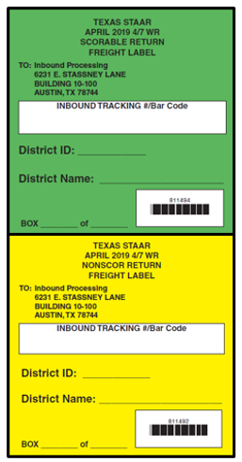
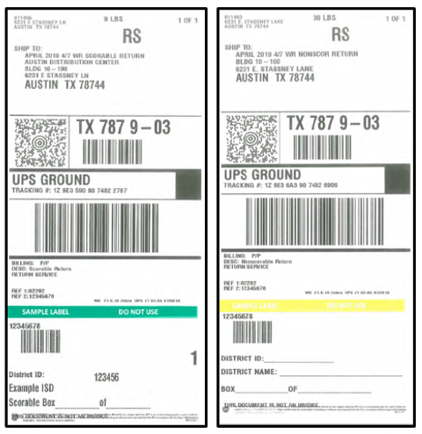



Call Drivers and Best Practices – Material Returns
Correct Packing of Scorable and Nonscorable Documents
Freight Labels
UPS Labels
Scorable labels are always green!
Nonscorable labels are color coded by administration!

Slide 201
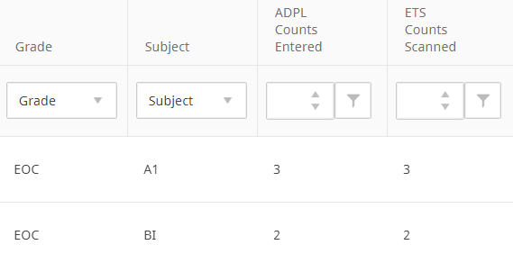
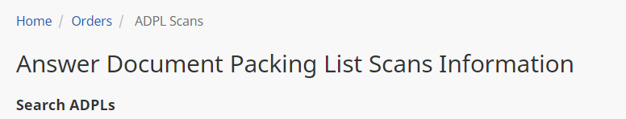
Call Drivers and Best Practices – Material Returns
Packing Scorable Returns – Out of Process
  Example: DTC incorrectly puts 400 answer documents to be scanned and scored into a brown, nonscorable box with a nonscorable return label.
    The coordinator does not realize the mistake until after results are posted to the Assessment Management System.
    Tip: Always check Answer Document Packing List (ADPL) scan counts (Orders > ADPL Scans)!

Slide 202
Call Drivers and Best Practices – Material Returns
Packing Scorable Returns – Out of Process
    Results:
      ETS prioritizes and processes scorable returns first, and those answer documents were not processed in time for scoring.
      Students’ scores are not reported when results are posted to the Assessment Management System.
        The district will not have those results included in their STAAR Report Cards, Confidential Student Labels, Summary Reports, Rosters, or Data File.
        DTC will have to contact ETS regarding the missing scores as they may not know they were placed in the wrong box.

Slide 203
Call Drivers and Best Practices – Material Returns
Packing Scorable Returns – Following Process
  Example: DTC correctly puts 400 answer documents to be scanned and scored into a white, scorable box with a scorable return label.
    DTC viewed their ADPL scans (Orders > ADPL Scans) to confirm that the count of answer documents scanned.
    Results:
      ETS prioritizes and processes scorable returns first, and those answer documents were processed in time for scoring.
      Students’ scores are reported when results are posted to the Assessment Management System.
      No additional action is needed by the DTC.

Slide 204
Call Drivers and Best Practices – Material Returns
Check for Understanding

Slide 205
Call Drivers and Best Practices – Material Returns
Ensuring Results are Attributed to the Correct Campus
  Best Practice: DTCs should ensure that staff check the Campus and Group Identification Sheet to confirm that the correct CDC code is gridded and written.
    Scanner only reads what is gridded as the CDC code; however, the written code can be used as a double check by ETS if there are questions.
    An incomplete or missing campus code will require correction in order to ensure results are reported correctly.

Slide 206
Call Drivers and Best Practices – Material Returns
Ensuring Results are Attributed to the Correct Campus – Out of Process
  Example: DTC writes code 101999001 (District A – Campus One) but incorrectly grids 201999001 (District B – Campus One).
    Scanner is going to read the 201999001 and results will be attributed to District B.
    DTC does not realize the mistake until after results are posted to the Assessment Management System.

Slide 207
Call Drivers and Best Practices – Material Returns
Ensuring Results are Attributed to the Correct Campus – Out of Process
      Tip: Always check your ADPL scan counts (Orders > ADPL Scans)!
      District will not have those results included in their STAAR Report Cards, Confidential Student Labels, Summary Reports, Rosters, or Data File.
    DTC will need to submit a request to change the CDC.

Slide 208
Call Drivers and Best Practices – Material Returns
Ensuring Results are Attributed to the Correct Campus – Following Process
  Example: DTC writes code 101999001 (District A – Campus One) and correctly grids 101999001 (District A – Campus One).
    Scanner is going to read the 101999001 and results will be attributed to District A – Campus One.
    Results will post to the Assessment Management System.
    No additional action is needed by the DTC.

Slide 209
Call Drivers and Best Practices – Material Returns
Check for Understanding

Slide 210
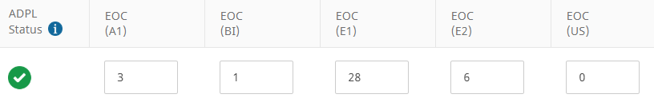
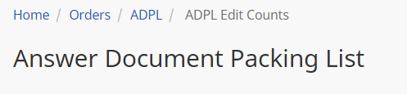
Call Drivers and Best Practices – Material Returns
Account for Scorable Answer Documents Returned
  Best Practice: Complete the online Answer Document Packing List (ADPL) for each administration prior to packing materials.
    Do not include online test taker counts or voided answer document counts in the ADPL.
    ADPL must be completed by 11:59 p.m. (CT) on the “Districts ship scorable materials and verify ADPL” on the COE.

Slide 211
Call Drivers and Best Practices – Material Returns
Account for Scorable Answer Documents Returned – Out of Process
  Example: DTC does not complete their ADPL and forgot to return 100 answer documents to be scanned and scored.
  DTC does not check the ADPL scans.
  DTC does not realize the mistake until after results are posted.
    Results:
      ETS will not conduct an ADPL outreach because there is no discrepancy.
      Tip: Always submit your ADPL and check your ADPL scan counts (Orders > ADPL Scans)!
      District will not have those results included in their STAAR Report Cards, Confidential Student Labels, Summary Reports, Rosters, or Data File.
      DTC will need to reach out to ETS to open an investigation for missing scores.

Slide 212
Call Drivers and Best Practices – Material Returns
Account for Scorable Answer Documents Returned – Following Process
  Example: DTC does complete their ADPL and accounts for all answer documents to be scanned and scored.
    Results:
      District will have those results included in their STAAR Report Cards, Confidential Student Labels, Summary Reports, Rosters, or Data File.
      No additional action is needed by the DTC.

Slide 213
Call Drivers and Best Practices – Material Returns
Check for Understanding

Slide 214
Pearson Call Drivers and Best Practices – Materials

Slide 215
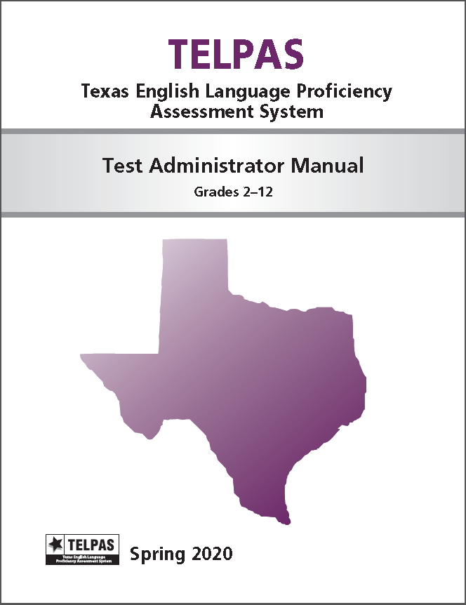

Call Drivers and Best Practices – Materials
How will districts receive TELPAS and TELPAS Alternate Test Administrator Manuals?
  Best Practice: Districts must submit counts for TELPAS and TELPAS Alternate Test Administrator Manuals
    TELPAS Rater Manuals will only be posted online.

Slide 216


Call Drivers and Best Practices – Enter Counts for Manuals
From Setup > Organizations
  Search for and select organization(s). From the task dropdown, select Edit Enrollment Counts and Start.

Slide 217
Call Drivers and Best Practices – Enter Counts for Manuals
Entering counts for TELPAS and TELPAS Alternate Test Administrator Manuals – Out of Process
  Example: The window for entering counts for TELPAS and TELPAS Alternate Test Administrator Manuals opens.
    District does not enter counts during the window.
    Results:
      Districts will receive the same amount of TELPAS and TELPAS Alternate Test Administrator Manuals as the previous year.
      Previous year counts may not be enough for the current year.

Slide 218
Call Drivers and Best Practices – Enter Counts for Manuals
Entering counts for TELPAS and TELPAS Alternate Test Administrator Manuals – Following Process
  Example: The window for entering counts for TELPAS and TELPAS Alternate Test Administrator Manuals opens.
    District enters counts for TELPAS and TELPAS Alternate Test Administrator Manuals.
    Results:
      Districts receive the number of manuals requested, plus overage.

Slide 219
Call Drivers and Best Practices – Materials
Check for Understanding

Slide 220
ETS Call Drivers and Best Practices – Resolutions

Slide 221

Call Drivers and Best Practices – Resolutions
Check Student Resolutions in the Assessment Management System
  Best Practice: DTCs should view and correct student resolutions (Students > Resolutions) during the “Districts resolve student information and test warnings (Resolutions)” window on the COE.
    Changes during this window will be reported with final region reports.
    Changes after this window will be reported in scheduled report updates.

Slide 222
Call Drivers and Best Practices – Resolutions
Check Student Resolutions in the Assessment Management System
    Resolutions are used to identify non-precoded answer documents with conflicts or missing data.
    Resolving these issues ensures that the answer document is matched to the correct student and that the system has the best available, most current, complete, and accurate data.
    Tip: System allows for downloading a report showing a list of all records that require resolution and the specific fields with missing or conflicting data.
    This is especially useful in large districts with a large number of records that need resolution.

Slide 223
Call Drivers and Best Practices – Material Returns
Check Student Resolutions in the Assessment Management System – Out of Process
  Example: DTC does not check and complete their resolutions.
    Results:
      The pdf of the STAAR Report Card is available in Students > Resolutions; however, the results are not accurately reporting to the correct student.
      Students and parents will not receive scores.
      The score information will not be available in the Student Portal.
      District will have incorrect or missing data in their student results.
      DTC will need to resolve the student resolution.

Slide 224
Call Drivers and Best Practices – Material Returns
Check Resolutions in the Assessment Management System – Following Process
  Example: DTC checks and completes their student resolutions by the date noted on the COE.
    Results:
      Results are accurately reported to the correct student when final region reports post.
      Students and parents will receive scores when final region reports post.
      The score information will be available in the Student Portal.

Slide 225
Call Drivers and Best Practices – Resolutions
Check for Understanding

Slide 226
ETS Call Drivers and Best Practices – Retester Verification Roster

Slide 227
Call Drivers and Best Practices – Retester Verification Roster
Check for the Posted Retester Verification Roster
  Best Practice: District testing coordinators should download a copy of their Retester Verification Roster (Reports > Students > Student District Home Campus Report) on the date listed on the Calendar of Events prior to making any updates to student registrations.
    The Retester Verification Roster is not a results file and should be used to edit retester registrations as needed. For student results, look for the Reports Posted to the Assessment Management System listed on the Calendar of Events.
    Tip: Check retesters campus, demographics, and testing mode. Students are registered at the same campus, with the same demographics, and the same testing mode as last tested.
    Tip: Remember to update registrations for braille students. Registrations for braille retesters are rolled over as paper; districts must indicate the needed braille version via Students > View & Edit.

Slide 228
Call Drivers and Best Practices – Retester Verification Roster
Check for the Posted Retester Verification Roster – Out of Process
  Example: A district testing coordinator does not review their retester registrations during the paper registration window.
    Results:
      Student demographics, campus, and test mode may be incorrect and therefore may result in incorrect or missing precoded answer documents.
      The district may need to hand grid student information onto blank answer documents to make corrections to PEIMS, first name, last name, or date of birth.
      The district may need to hand grid student answer documents if test takers were registered for online instead of paper.

Slide 229
Call Drivers and Best Practices – Retester Verification Roster
Check for the Posted Retester Verification Roster – Following Process
  Example: A district testing coordinator reviews their retester registrations during the paper registration window.
    Results:
      Because the coordinator verified student demographics, campus, and test mode during the paper registration window, precoded answer documents will be printed with the current information supplied by the district.
      No additional action is needed by the district testing coordinator.

Slide 230
Call Drivers and Best Practices – Retester Verification Roster
Check for Understanding

Slide 231
ETS Call Drivers and Best Practices – Post Administration

Slide 232




Call Drivers and Best Practices – Post Administration
Check the district data file
  Best Practice: District testing coordinators should download a copy of their district data file (Reports > Results) to ensure results were received for all students as expected.
    Tip: Check the data file for the Record Update Indicator (RUI). Values of 1, 2, or 3 should be reviewed as information is missing, inaccurate, or the student has duplicate scores.
    Tip: Check the data file for missing student portal unique access codes. A missing access code should be reviewed as those results will not be available in the student portal.

Slide 233
Call Drivers and Best Practices – Post Administration
Check the district data file – Out of Process
  Example: A district testing coordinator does not review their district data file to ensure results were received for each student as expected. A student is listed as an RUI 3 and does not have an access code.
    Results:
      The student will have two pdfs of the STAAR Report Card with two different results in their profile in the Assessment Management System.
      Students and parents will not find score information in the Student Portal.
      The district will have duplicate results in their student data file.
      The coordinator will need to contact the Texas Assessment Support Center to have the duplicate scores resolved.

Slide 234
Call Drivers and Best Practices – Post Administration
Check the district data file – Following Process
  Example: A district testing coordinator does review their district data file to ensure results were received for each student as expected. A student is listed as an RUI 3 and does not have an access code.

Slide 235
Call Drivers and Best Practices – Post Administration
Check the district data file – Following Process
    Results:
      The student will have two pdfs of the STAAR Report Card with two different results in their profile in the Assessment Management System.
      Students and parents will not find score information in the Student Portal.
      The district will have duplicate results in their student data file.
      The coordinator will need to contact the Texas Assessment Support Center to have the duplicate scores resolved.
      If the file is checked as soon as initial results are posted, the error may be corrected in time for final region reports to be corrected. Districts will want to resolve these issues before the Consolidated Accountability File (CAF) is generated.

Slide 236
Call Drivers and Best Practices – Post Administration
Check the district data file – Following Process
    Results:
      Tip: If all processes were followed, there would be no Record Update Indicator.
        Do not allow a student to test on another student’s precoded answer document.
        If a test taker logs in to start a test online and switches to the correct paper format, void the test that was started online.
        Do not have students take the same test twice.

Slide 237
Call Drivers and Best Practices – Post Administration
Check for Understanding

Slide 238
Pearson Call Drivers and Best Practices – Reporting

Slide 239

Call Drivers and Best Practices – Reporting
Does the Reporting CDC field have to be entered?
  Best Practice: Districts should only add the Reporting CDC if the student tested at a different district/campus from the one they report to.
  If a Reporting CDC needs to be entered, use the CDC # instead of the name since there are many campuses with the same name.
    Students will be reported to the option selected.

Slide 240
Call Drivers and Best Practices – Reporting
Check for Understanding

Slide 241

Test Administration Technology Systems 101

Slide 242
ETS Technology 101

Slide 243

Technology Page
TexasAssessment.Gov/Administrators/Technology
Resources:
  User’s Guides and Manuals
  Roles and Permissions Matrix
  2019-2020 Data File Format for Student Registration
  Quick Guide to Online Testing
  Unified Minimum Systems Requirements
  Secure Browser Downloads
  Online Readiness Tools

Slide 244
Preparation: Activities and Supporting Resources
Activities to Support Test Delivery | Resource
Verify that the district’s network meets requirements and is properly configured for testing. | STAAR Online Testing Platform Technology Guide
Conduct network diagnostics to estimate district and campus network user capacity and to plan for concurrent testing volumes. | Online Readiness Tools
Determine local caching software needs and complete installation procedures. | STAAR Online Testing Platform Local Caching Software (LCS) District Guide
Verify that all devices used for online testing meet the minimum hardware and software requirements. | Unified Minimum System Requirements
Install the appropriate STAAR Online Testing Platform Secure Browser on all testing devices. | STAAR Online Testing Platform Technology Guide
Confirm successful installation and operation of secure browsers. | STAAR Online Testing Platform Technology Guide
Test the compatibility of computers and gauge technology infrastructure readiness. | STAAR Online Testing Platform student tutorials and practice tests
Prepare all computers for online test delivery. Close all web browser windows, disable any automatically launching applications on all devices, and check for sufficient power sources. | Quick Guide to Online Testing

Slide 245
STAAR Online Testing Timeline
Register Students for Online Testing /Review Resources
(4- 6 weeks prior)
Distribute Test Tickets/Monitor Sessions
(Day of testing)
Verify Online Enrollments
(2 weeks prior)
Prepare Online Testing Environment - Setup and Test Devices
(4 weeks prior)
Print Test Tickets/ Verify Test Language and PNPs
(1 week prior)

Slide 246

STAAR Online Testing Timeline
(Quick Guide To Online Testing)
Register Students for Online Testing
Review Updated Technology Requirements
Prepare the Testing Environment
Verify Online Student Test Registrations
Minimum Systems Requirements
Secure Browser Updates
Perform system readiness tests (Online Readiness Tools)
Update devices and verify installation of the current secure browser versions
Verify student information (demographics) and test registrations (subject/grade level, PNPs, test language.
Verify online testing groups (optional).
Verify online designated supports.
Evaluate System performance using tutorials and practice test or interim testing
Four to Six Weeks Prior
Four Weeks Prior
Two Weeks Prior

Slide 247
STAAR Online Testing Timeline
(Quick Guide To Online Testing)
Download and Print Student Test Tickets and Rosters
Final System Checks
Verify Online Student Test Registrations
Verify Test Language and PNPs.
Launch and Verify SOTP is installed and working on ALL testing devices.
Disable all system auto-updates once the SOTP has been tested and verified to be working.
Verify student information (demographics) and test registrations (subject/grade level, PNPs, test language.
Verify online testing groups (optional).
Verify online designated supports.
Download Proctor Ticket Logins
One Week Prior
One to Three Days Prior
Day of Testing

Slide 248
STAAR Online Testing Timeline
(Quick Guide To Online Testing)
Verify Student Information and Test Attributes
Update Student Demographics (as necessary) prior to the close of the testing window
Verify and update Test Attributes (as necessary) prior to the close of the Test Attributes window
One Week Prior
After Testing
Day of Testing

Slide 249
Register Students for Online Testing
  All retesters are registered with the same demographic information (e.g., grade level) as when they last tested.
    Districts should review retester registrations and update as needed.
    For EOC testing, retesters are registered to take only the test(s) that they did not previously pass.
    Tests are presented in the same testing mode as the last administration.
      Exception: The braille indicator is not rolled over from previous administrations and must be added to the student’s profile prior to the close of the paper registration window.
      Large Print and Oral Administration will be rolled over for paper testers beginning in spring 2020

Slide 250

Register Students for Online Testing
Retester Verification Roster:
  All EOC administrations
  May grades 5 and 8 math and reading retests
  June grades 5 and 8 math and reading retests
      Best Practice: Download a report with assessment data for retesters on the “Retester verification roster available” date listed on the calendar of events prior to registering any students or making any updates to registrations.
Reports > Students
  Students Campus Report
  District Students Home Campus Report

Slide 251


Register Students for Online Testing
PEIMS Source File vs. Local Data
  Applies to Grades 3-8 Primary Administrations Only
  Must first make a selection prior to registering any students
Students > Upload

Slide 252


Register Students for Online Testing
Update Existing Registrations via the User Interface (UI) – Students > View & Edit
  Search for existing registrations
  Click on edit icon to enter student registration profile

Slide 253


Register Students for Online Testing
Update Existing Registrations via the User Interface (UI) – Students > View & Edit
  Updates to online test registrations may be made anytime during the online registration window
  Student information and demographics established at the close of the testing window will be associated with a student’s online test(s).
Profile Tab – Student Information and Demographics
Tests Tab – Test Information (e.g., Test Language, PNPs)

Slide 254
Register Students for Online Testing
Adding a New Registration via the User Interface (UI) – Students > Register
  Pulls in existing registration information if student already registered with a different CDC for the current administration
  If no current registration exists and student has a testing history - student information and demographic information is pulled from history of when last tested
  Verify student demographics and test information – update as necessary anytime throughout the online testing window

Slide 255


Register Students for Online Testing

Slide 256

Register Students for Online Testing
Registration File Upload – Students > Upload
  May update existing registrations or add new registrations via file upload
  All online test registration settings that can be made manually in the UI can be made via file upload
  Use the 2019–2020 Student Data File Format for Student Registration and Precoding for upload file specifications.
    NOTE: A student’s registration may not be updated via file upload once an online test has been started
30

Slide 257
Registration (Students > Upload)
  Test Format – EOC (AO) – registration defaults to online if no value is entered (blank).
  Transfer students by placing an “M” in the Action–Indicator field.
    Move student registrations from campus to campus within a district or between districts.
  Delete student registrations (student no longer enrolled in your district) by placing a “D” in the Action–Indicator field.
  Home County/District/Campus Code (BH) – indicates the home campus.
  Campus ID of Enrollment (B) – indicates the testing campus
    The home campus will default to the testing campus if left blank in file.

Slide 258

Registration (Students > Upload)
  The group name field is also used as the default online test group name if no online test group name is provided for a subject.
    Best Practice: When updating existing student registrations or registering new students, include only students whose records are being updated. If uploading all students’ records, download the District Students Home Campus Report (Reports > Students) and make edits to the registration records as needed directly in the file, leaving all other records untouched, and upload back into the system.

Slide 259

Register Students for Online Testing
Registration Training Webinars:
  TexasAssessment.Gov/administrators/training/
  Contains webinar recordings and presentation materials from past webinars
Available Webinar Recordings
  What's New for December 2019 Student Registration?
  Registration for New DTCs
  Fall Activities for December 2019
  User Roles and Permissions Updates

Slide 260



Review and Update Technology Requirements
STAAR Specific Manuals:

Slide 261

Review and Update Technology Requirements
Updated Unified Minimum System Hardware Requirements
  Device
  Operating Systems
  Processors
  Memory (RAM)
  Minimum Screen Size & Resolution
  Keyboard and Headphones

Slide 262
Secure Browser Updates
Updated Required versions for the 2019-2020 Secure Online Testing Platform (SOTP)
Operating System | Updated Browser Version (Current)
Windows | v3.14.0 (requires uninstall of prior versions) - available August 5, 2019
Mac | v3.14.0 (requires uninstall of prior versions) - available August 5, 2019
Linux | v3.14.0 (requires uninstall of prior versions) - available August 5, 2019
Chromebook | v2.62.0 (1.30.0 in Chrome web store) - (prior version will auto-update) - available August 5, 2019
iOS | v2.75.0 (2.68 in Apple store) - (prior version will auto-update) - available August 5, 2019
  Available for download at https://www.TexasAssessment.gov/technology

Slide 263

Secure Browser Updates
Secure Browser Page (Online Testing > Secure Browser):
  Contains up-to-date information on Secure Browse version numbers and announcements to support installation on specific device/OS types.
  See STAAR Online Platform Technology Guide for detailed information and instructions for installing/updating secure browsers.

Slide 264

Secure Browsers: Verifying Versions
  Secure Browser Version identified on test login page of STAAR Online Testing Platform

Slide 265
Secure Browser: Setup & Testing
  Know your approach - Installation and Updates
    Device management software products available for pushing out installations/updates (e.g., JAMF)
    Start early - localized issues can arise based on your specific environment
    Enable software auto updates ahead of testing
  Ensure updated secure browser is installed and functioning on all devices ahead of testing
    Have a plan for suspending OS and software updates ahead of/during testing once all is verified as working

Slide 266
Preparation: Network and Technical Infrastructure
  Ensure Hardware is in place and meets system requirements
    Unified Minimum System Requirements for the Administration of Online Assessments
    STAAR Online Testing Platform Technology Guide
  Identify wireless access points & determine testing locations
    Locations – recommended 1 per room where testing will take place
    22-25 testers per access point (>25 tends to lead to problems)
  Conduct bandwidth checks
    Online Readiness Tools
    Develop local policies around use of internet during testing

Slide 267


Online Readiness Tools
https://tx-bandwidth.caltesting.org/

Slide 268

Local Caching Software (LCS)
  With the LCS, tests are cached on a local system - students taking a test download the data from the LCS rather than a remote location.
  LCS is not recommended outside of exceptional cases of low or inadequate bandwidth or unreliable Internet.
  Reference the STAAR Online Testing Platform Local Caching Software (LCS) District Guide for more information
With LCS
No LCS

Slide 269

Local Caching Software (LCS)
  If determined LCS is required must register for LCS in the Assessment Management System

Slide 270



Getting Ready: Tutorials, Practice Tests and Interims
  Confirms readiness of devices for online testing
  Available throughout the year
  Familiarizes students and administrators with the online testing environment and available online tools

Slide 271
STAAR Tutorials
  Each tab at the bottom of the screen contains a page explaining the online feature/tool in addition to a short video.
  The videos do not have sound except the Speak and Audio videos, which read aloud the text on the screen.
  The second page of each tab has a question to practice the feature/tool.
  The questions do NOT contain tested content and are intended to practice using the feature/tool.

Slide 272

STAAR Practice Tests
  From the STAAR Online Testing Platform (SOTP), select “Practice.”
  The practice tests are released tests from 2017 and 2018.
  All PNP are available including the following supports:
    Text-to-Speech (when available)
    Spelling Assistance (writing compositions only)
    Content and Language Supports

Slide 273



STAAR Online Testing Platform – Functionality & Tools
  Familiarize yourself and campus staff with online tools, features, and system functionality
Notes:
Ray - Know online testing functionality and tools and train all campus staff overseeing testing or directly administering. Provide anecdotal stories from past admins – TTS not working when actually just not a supported/allowable feature on particular section of test – as noted by TTS icon

Slide 274
Campus Support – Considerations
Develop campus online testing support plan
  Identifying devices meeting minimum system requirements
  Downloading, installing, and updating the STAAR Online Testing Platform secure browser
  Device Testing
    Bandwidth simulations – check bandwidth in testing locations and verify wireless access
    Run practice tests & tutorials ahead of testing
  Information sharing (policy and procedures)

Slide 275
Guidance for Technology Staff
  Make sure you are current with OS updates and drivers, especially the week prior to the administration.
  Ensure updated Secure Browsers are installed on all machines that will be used for testing.
  Perform practice tests well in advance, including text-to-speech (TTS).
  Perform practice tests more frequently if using virtualization or N-Computing.
  Shut down all applications on devices prior to launching the Secure Browser.
51

Slide 276

Verify and Update Student Registrations
  Report Downloads for Registration Verification:
  Student’s Campus Report (Reports > Students) *
  Student’s District Home Campus Report (Reports > Students) *
  Groups Report (Online Testing > Groups) *
  Online Test Status Report (Reports > Online Testing)
  * Reports are downloaded in the registration file upload format – edits may be applied directly to file, and file re-uploaded into system to enact updates.

Slide 277
Verify and Update Student Registrations
  Verify and Update in UI – Students > View & Edit
Profile Tab – Student Information and Demographics
Tests Tab – Test Information (e.g., Test Language, PNPs)

Slide 278





Download and Print Test Tickets
  Testing group rosters and student test tickets contain PNP information.
  Ensure that students eligible to use embedded supports have the information noted on their test tickets.
NOTE: Test tickets are available for printing one week prior to the start of the testing window.

Slide 279

Download Proctor Ticket Logins
  District-specific proctor tickets are available via Reports > Online Testing.
  Proctor tickets are available for test administrators who are signing test content to students in need of reading support.
  There are logins for no supports and all supports to provide the content needed for signing to any student.
  Proctor tickets are secure materials and should be treated as such.

Slide 280

Verifying Online Test Registrations (UI)
  Test Sessions are automatically established when one or more students is registered for an online test.
  Sessions are set up by subject/grade at the campus level.
  Search for sessions to verify student online registrations, PNP settings, and testing language

Slide 281
Final System Checks
  Launch and verify SOTP is installed and functioning on ALL testing devices
  Ensure all system auto-updates are disabled during testing window
  Communicate internet use policy during administrations
    Staff internet use during testing for non-essential work
    Student mobile devices and internet use during testing
  Review, troubleshooting, escalation process, and communication plan
    If only a few or less students are reporting an issue out of a whole testing group or campus testing in the same subject without problem – is most likely a local issue.

Slide 282

Monitor Online Administration (UI)
Online Testing > Manage

Slide 283




Score Code Default Rules for Online Testers
Important Notes – Score Codes:
  Ready to test status – never logged in to and will expire and be voided automatically at the close of the testing window unless otherwise specified in the test attributes.
  Inactive tests – have been started and not submitted and will automatically default to “Scored” at the close of testing window unless a different score code is specified in the test attributes.
  Submitted tests – tests that will automatically default to “Scored” at the close of the testing window unless otherwise specified in the test attributes.
  NOTE: It is not necessary to set score codes when default score code is applicable

Slide 284

When to Void Online Tests
Do Not Report (DNR) –
Online tests should NOT be marked for DNR prior to testing. If a student will not be taking an online test, the test registration may be set to paper or allowed to expire.
During the testing window, click the DNR icon to indicate a test should not be reported (voided).

Slide 285

Verifying Test Attributes
Test Attributes View
  Facilitates verification of score code and other online test attribute settings

Slide 286
STAAR Online Testing- Troubleshooting Guidance
  Student accidentally submitted test
    Requires reopen (previous responses retained)
    Within two hours – call Texas Assessment Support Center
    After two hours – call TEA’s Student Assessment Division
  Student begins or completes a test using another student’s test ticket
    Requires test reset (all answers erased)
    Call Texas Assessment Support Center
    Follow TEA requirements for reporting a test irregularity

Slide 287
STAAR Online Testing- Troubleshooting Guidance
  Ticket credentials no longer working
    Online test registration changed after initially printing ticket:
      Refreshable braille ASL, or test language changes will generate a new test ticket
      Print updated test ticket and continue testing
  Isolated technical issues (Student logged out of a test session or Computer freezes during testing)
    Restart Secure Browser and log back with existing ticket,
    Shut down and reboot affected computer, or
    Move the student to another device

Slide 288
STAAR Online Testing- Troubleshooting Guidance
  Student begins testing with incorrect test form ( language, ASL, Braille)
    Requires test reset (all answers erased)
    Call Texas Assessment Support Center
    Print new student test ticket
  NOTE: all other PNPS (E, R, T, M) can be updated at any point prior to the student submitting their tests.
    No new ticket is generated

Slide 289
STAAR Online Testing- Troubleshooting Guidance
  Student unable to log in to online test
    Verify the browser version on test login page of STAAR Online Testing Platform and update if necessary.

Slide 290
Pearson Technology 101

Slide 291







TELPAS Online Testing Process
Step 1
Enter counts for TELPAS Test Admin Manuals
Step 2
Select registration option
Step 3
Submit student registration data
Step 4
Create test sessions
Step 5
Administer TELPAS
Step 6
Enter holistic ratings
Step 7
Verify student info
Step 8
Return materials

Slide 292
TELPAS Online Testing Timeline
Download ProctorCache*
(6 weeks prior)
Create Test Sessions**
(4 weeks prior)
Start/Unlock Test Session
(Day of testing)
Configure TestNav
(5-6 weeks prior)
Prepare Test Sessions/proctor cache*
(1-2 weeks prior)
*Proctor caching optional
**Test sessions are only required for TELPAS

Slide 293

Download ProctorCache*
https://support.assessment.pearson.com/x/PQACAQ
ProctorCache system requirements:
System requirements
Set up and use ProctorCache
*Proctor caching optional

Slide 294

Configure TestNav
From Setup > TestNav Configurations
Select Create/Edit TestNav Configurations and then Start.
Enter precaching computer information.
Enter response file backup locations.
Select Create after entering required fields.

Slide 295

Create Test Sessions
https://support.assessment.pearson.com/x/KoDy
From Testing > Sessions, select Create/Edits Sessions and Start.
Enter all required fields.
Select precaching computer.
Enter students.
Select Create after entering required fields.

Slide 296

Prepare Test Sessions
https://support.assessment.pearson.com/x/24F8AQ
Prepare test sessions.
From Testing, select Students in Sessions.
Click Add a Session.
Type the session name into the search field.
Click the checkbox next to the session, and click Add Selected.
Click Prepare Session.
TELPAS Gr 9 Reading
TELPAS Gr 10 Reading
TELPAS Gr 11 Reading
TELPAS Gr 12 Reading

Slide 297


Precache Test Content*
Precache test content:
By test - From Setup, select Precache by Test
By test session – From Testing, select Sessions
https://support.assessment.pearson.com/x/dRFgAQ
*Proctor caching optional

Slide 298



Start/Unlock Test Session
https://support.assessment.pearson.com/x/JoDy
Start a session/unlock a test:
Select a session from the Session List and click Start Session.
You can then unlock a test for all students or an individual student.
  To unlock all students in a session, click the unlock icon.
  To unlock an individual student, click the dropdown menu in the Student Test Status column and select the unlock option.

Slide 299

TestNav Resources
https://support.assessment.pearson.com/x/BAACAQ
TestNav Online Support:
System requirements
Set up and use TestNav
ProctorCache system requirements
Troubleshooting and resolutions
Technical bulletins
Features and demos

Slide 300

TestNav Updates
2019-2020 Updates:
New version 8.13
View icon added for option to view password.
TestNav will exit students after 30 minutes of inactivity.

Slide 301

2019-2020 Updates & Reminders

Slide 302
2019–2020 ETS Changes

Slide 303
What’s New – Form Numbers
Form Numbers
  All test booklets will have a form number printed on the cover.
  The Form Number field is included on all answer documents (not just primary administrations).
    There is no form number field on the embedded supports answer document (braille or paper with embedded supports).
    Form numbers should be completed before submitting the answer document for scoring.

Slide 304


What’s New – Form Numbers
Form Numbers

Slide 305
What’s New – Substitute Assessment
Substitute Assessment
  Beginning with December 2019, no longer included in accountability calculations
  Substitute assessment indicator (gridding bubble) removed from the answer documents and in the online testing attributes

Slide 306

What’s New- Registration and Precoding

Slide 307
What’s New- Initial Material Ordering
Beginning with the December 2019 EOC administration:
  Initial material orders will be based on paper registrations entered into the Assessment Management System at the close of the “Districts submit registrations for STAAR and STAAR Alternate 2 paper materials” window listed on the Calendar of Events
  Register students for paper testing in English or Spanish with a paper accommodation (X - Large Print or Y - Oral Admin) via upload or UI
  Registrations with English/Spanish, Oral Administration or Large Print indicated at the close of the precode window will trigger the corresponding test booklets to be included in the District's initial order
    Districts will continue to receive 10% overage

Slide 308

What’s New- Initial Material Ordering
Test Mode/Material Counts Report (Reports > Orders)
  Identifies test booklet counts by type (from registration data)
  Updates nightly
  Counts do not include 10% district overage

Slide 309
What’s New- Initial Material Ordering
For December 2019 STAAR EOC Only:
  Districts that are unable to identify students needing Oral Administration or Large Print test booklets in their student registrations may alternatively order these materials via the Additional Materials Order process.
    The Additional Materials window will be opened early to coincide with the precode window to assist districts needing to order these materials via this alternate method
    Additional material orders placed during the precode registration window will be shipped together with a district’s initial order
    If you missed this window, you will need to place an additional order during the regularly scheduled additional order window.

Slide 310
What’s New- Initial Material Ordering
Initial Orders – Beginning Spring 2020 (Orders > Initial Orders)
  Identifies (campus level) test-booklet counts based on registrations and any additional counts for Spanish, Oral Administration, and Large Print that have been added to registration-based counts
  Allows for input/update of additional counts (no limit on increase) via User Interface (UI) or file upload
  Provides total sum of test booklets by type to be received in initial material order
    Counts do not include 10% district overage

Slide 311

What’s New- Initial Material Ordering
Preview: Initial Order screen and additional counts
Displays test booklet counts based on registration data
Includes editable cells for inputting additional counts for Large Print, Oral Admin, and Spanish booklets
Provides sum total of test booklets to be received
Campus/District level upload of additional counts available

Slide 312

What’s New- Initial Material Ordering
Initial Orders - File Download/Upload:
  Add-on counts for Spanish, Oral Administration, Large Print test booklets can be downloaded and viewed at the district level (all campuses included) or individual campus level
  Downloaded file reflects current additional counts that have been entered into the system
  Additional counts may be adjusted in the file and re-uploaded into the system to update

Slide 313
What’s New- Initial Material Ordering
Initial Orders - May/June 5&8 Retest and June EOC Administrations
  Based on paper-based registration identified in the Retester Roster Verification report
  Oral Administration and Large Print will be rolled over from previous administrations (as indicated on a submitted test during the prior administration)
  Districts may elect to not receive paper materials for the June 5&8 and June EOC administrations.

Slide 314
What’s New- Initial Material Ordering
Elect to NOT Receive Paper Test Materials:
  Districts intending to test all online during June administrations will have an opportunity, prior to opening of the registration window, to opt-out of paper testing - NO initial materials order will be placed
  Districts that indicate they will not be testing on paper will have all retester registrations converted to online registrations at the opening of the registration window
  All prior paper testers converted to online will default to NO – PNPs
  Registrations may be adjusted during the registration window - precodes will be provided for any paper-based registrations identified in the Assessment Management System at the close of the precode window
  Districts that have opted out and later identify a need for paper test booklets and other materials can placed orders during the additional material orders window.

Slide 315
What’s New- Late Precodes
Late Precode Orders – Opt In: (Orders > Late Precode)
  Districts that miss the precode registration window will have an opportunity to request late precodes in the Assessment Management System for a fee during a designated late precode window.
    Late precode orders are processed at the close of the late precode window – districts may change their Opt-in status anytime prior to processing
    Orders include any new paper registrations or online registrations that have been converted to paper since the close of the initial precode window
    Late precodes will arrive the Wednesday prior to testing.

Slide 316
What’s New- Late Precodes
Late Paper Registration Report (Reports > Students)
  Identifies all new paper registrations created after the close of the initial precode window.
  Available at the district or campus level
  Formatted the same as the Precode Verification Report
  Districts that opt-in to order late precodes should use the report to identify the quantity of precodes to be received and billed for, and verify precoded information

Slide 317
What’s New- General Enhancements
  General Enhancements
  Precode Order Details Report (District level) – added campus order details of each campuses receiving precodes
  Online Test Status Report (Campus and District level) – added test attribute fields and Home CDC identifier
  CSL/SRC Reports Tracking – added link to detailed tracking information
  Drop Box for submission of the Name, PEIMS, Date of Birth Correction Request Form
  Online searchable repository of biweekly emails
  Paper with embedded supports for braille test takers no longer require TEA approval
    Contact the Texas Assessment Support

Slide 318
What’s New- General Enhancements
  General Enhancements
  District Coordinator Kits moving online
    No longer included in initial shipment of test materials
    Posted online in Assessment Management System in Help Documentation
  Opt Out of receiving STAAR Report Cards (primary spring administrations)
    Orders > Additional Reports
    Check Opt Out checkbox by administration

Slide 319

What’s New- Roles & Permissions
  Roles and Permissions Matrix updated September 16, 2019
  Changes applied to:
    Teacher
    Student Data Assistant
    Online Sessions Administrator
    Online Test Administrator
    Test Setup Assistant
  Provides greater distinction and gradation between campus level roles
  Provides Allows for more flexibility when establishing campus level access and managing users accounts

Slide 320
2019–2020 Pearson Changes

Slide 321
What’s New- Registration
Changes to STAAR Alternate 2, TELPAS, and TELPAS Alternate:
TX-UNIQUE-STUDENT-ID, (column BB) has been changed from required to optional.
Changes to STAAR Alternate 2
Districts must now indicate Large Print in the Test Version Code fields (columns AW, BD-BG, and BI) for any student needing a large print test booklet.
Changed the column name for STAAR EOC Test Version Code field (AW) to Test Version Code - EOC
Changes to TELPAS
Reference table has been added to show what internal test code will be appended to the district created session name based on the TELPAS Code entered in the Student Data File, when the student is listed only once (single line).

Slide 322

What’s New – STAAR Alternate 2
Updates:
  Districts must enter student registrations to receive paper test materials
  Student registration window has been pushed out to a later date (12/2 – 1/3)

Slide 323

What’s New – TELPAS
Updates:
  Counts must be entered for TELPAS Test Administrator Manuals
  TELPAS Rater Manuals only posted online
  Going forward, training certificates will be saved in the TELPAS Online Training Center

Slide 324
What’s New – TELPAS Alternate
Updates:
  Counts must be entered for TELPAS Alternate Test Administrator Manuals

Slide 325

Bypass ProctorCache – Now Default
Default Bypass ProctorCache
  Precaching Computer Override is now selected by default. Districts using proctor caching must go to Setup > TestNav Configuration and unselect the “Precaching Computer Override” checkbox.

Slide 326
Contact Information
  TEA Student Assessment
  (512) 463-9536
  Email:
  student.assessment@tea.texas.gov
  assessment.specialpopulations@tea.texas.gov
  testsecurity@tea.texas.gov
  test.calendar@tea.texas.gov
  Student Assessment Help Desk:
  https://helpdesk.tea.texas.gov/hc/en-us
  Website:
  https://tea.texas.gov/student.assessment/

Slide 327
Program Support
  ETS
  (855) 333-7770
  STAAR3-8@ets.org
  STAAREOC@ets.org
  http://texasassessment.com
  Pearson
  (800) 627-0225
  https://tx.pearsonaccessnext.com

Slide 328
Disclaimer
These slides have been prepared by the Student Assessment Division of the Texas Education Agency. You are encouraged to use them for local training.
If any of the slides are changed for local use, please remove any TEA logos, headers, or footers. (You may need to edit the Master slide.)
This training is not intended to replace any materials or additional information on the TEA website.

Slide 329

Thank you for all you do for
Texas public school students!

Slide 330
Accountability Overview
Texas Education Agency
Governance & Accountability
Performance Reporting

Slide 331
Accountability Cycle
The accountability cycle refers to the test administrations that are used to calculate accountability ratings for a given year.
The 2020 accountability cycle includes the summer 2019, fall 2019, and spring 2020 administrations.
2020 Accountability Cycle
Summer 2019 | Fall 2019 | Spring 2020

Slide 332
Accountability Subset Rule
The accountability subset rule is used to determine which results are included in district and campus accountability calculations.
A subset of assessment results is used to calculate each domain. The calculation includes only assessment results for students enrolled in the district or campus on the previous TSDS PEIMS October snapshot and on testing day.

Slide 333
Accountability Subset Rule
STAAR results are included in the subset of district/campus accountability | if the student was enrolled in the district/campus on this date:
EOC summer 2019 administration | Fall 2018 snapshot
EOC fall 2019 administration | Fall 2019 snapshot
EOC spring 2020 administration
Grades 3–8 spring 2020 administration

Slide 334
Accountability Subset Rule
Grades 3–8 Scenario
If a student was enrolled on fall 2019 snapshot at | The student took the spring STAAR at | The campus that receives the result is | Does the result meet the accountability subset?
Campus A | Campus A | Campus A | Yes
Campus A | Campus B | Campus B | No

Slide 335
Accountability Subset Rule
End-of-Course (EOC) Scenario
If a student was enrolled on fall enrollment snapshot at | The student took | The campus that receives the result is | Does the result meet the accountability subset?
Campus A (fall 2018) | summer 2019 EOC at Campus A | Campus A | Yes
Campus A (fall 2019) | spring 2020 EOC at Campus B | Campus B | No

Slide 336
Importance of Data Quality
  Districts and charter schools must ensure that answer documents and TSDS PEIMS data reflect accurate information.
  The following data are commonly misreported:
  Economically disadvantaged status
  English learner (EL) status
  Data reported via TSDS PEIMS for College, Career, and Military Readiness
Texas Education Agency | Governance and Accountability | Performance Reporting

Slide 337
Importance of Data Quality
  Districts and charter schools have several opportunities to confirm and correct data submitted for accountability purposes, including a corrections window.
  Once the TSDS PEIMS resubmission window has closed, the data is frozen for accountability purposes.
  Data corrections made in the TSDS PEIMS working collection are not used in accountability.
Texas Education Agency | Governance and Accountability | Performance Reporting

Slide 338
Importance of Data Quality
  Student demographic data is final once STAAR answer documents have been scored.
  The appeals process is not a permissible method to correct data that were inaccurately reported by the district or charter school.
  Appeals from districts and charter schools that missed data correction opportunities are denied.
Texas Education Agency | Governance and Accountability | Performance Reporting

Slide 339
Importance of Data Quality
  The inclusion and exclusion of certain ELs is dependent upon correct TELPAS data.
  Years in U.S. schools, asylee/refugee, and students with interrupted formal education (SIFE) status is used for accountability. If this is not reported correctly, it will impact exclusions.
Texas Education Agency | Governance and Accountability | Performance Reporting

Slide 340
English Learner Inclusion
  First year ELs, including unschooled asylees, unschooled refugees and SIFEs are excluded from STAAR performance components.
  Second year ELs are included using an EL performance measure in place of a STAAR performance level.
  Second year ELs are included in growth calculations using the STAAR progress measure.
  ELs who are in their second year in U.S. schools who have a parental denial for EL services will not receive an EL performance measure and will be included in the same manner as non-ELs.
Texas Education Agency | Governance and Accountability | Performance Reporting

Slide 341
Demographic Determination for Closing the Gaps
  Demographics for STAAR components, including race/ethnicity, special education status, economically disadvantaged status, and English learner status, are based on the Consolidated Accountability File (CAF).
  The CAF includes demographic information based on TSDS PEIMS or the last administration of STAAR.
  If demographics change from one administration to the next, the last administration is used.
  Demographics for College, Career, and Military Readiness (CCMR) and Graduation Rate are based on TSDS PEIMS reporting.
Texas Education Agency | Governance and Accountability | Performance Reporting

Slide 342
Participation Rate in Accountability
  Answer documents with a score code of “A” or “O” are considered non-participants.
  Should the participation rate in reading or mathematics for the all students group or any student group fall below 95 percent, the denominator used for calculating performance in the Closing the Gaps Academic Achievement component is adjusted to include the necessary number of assessments to meet the 95 percent threshold.
Texas Education Agency | Governance and Accountability | Performance Reporting

Slide 343
Participation Rate in Accountability
  Below is an example of an adjustment made to performance due to participation <95%.
  Original ELA/Reading Academic Achievement Performance Calculation:
  53 assessments at Meets Grade Level or above standard
  ---divided by---
  93 scored assessments that meet accountability subset (out of the 100 total assessments)
Texas Education Agency | Governance and Accountability | Performance Reporting

Slide 344
Participation Rate in Accountability
  Below is an example of an adjustment to performance due to participation <95%.
  Adjusted ELA/Reading Academic Achievement Performance Calculation:
  53 assessments at Meets Grade Level or above standard
  ---divided by---
  95 assessments (93 scored plus 2 absent/other assessments)
Texas Education Agency | Governance and Accountability | Performance Reporting

Slide 345
Substitute Assessments
  Substitute assessments are no longer included in accountability.
  To satisfy U.S. Department of Education assessment requirements, students must submit an EOC assessment with an “S” score code at least once before a substitute assessment can be used to fulfill graduation requirements.
  Tomorrow Student Assessment will share additional information about the timeline of this rule.
Texas Education Agency | Governance and Accountability | Performance Reporting

Slide 346
Substitute Assessments
  By taking the EOC at least once, the student will be included as a participant, and Texas will be in compliance with the federal accountability statute.
  This rule will not be retroactively applied to students who submitted a substitute assessment prior to the 2019–20 school year.
Texas Education Agency | Governance and Accountability | Performance Reporting

Slide 347

Questions
?
Resources
http://tea.texas.gov/A-F
https://tea.texas.gov/perfreport/resources/index.html
Sign up for the Performance Reporting weekly bulletin:
Texas Education Agency | Governance and Accountability | Performance Reporting

